Slide 1



Slide 2
The 2012
Belton Iris Society
Show
April 14, 2012

Slide 3
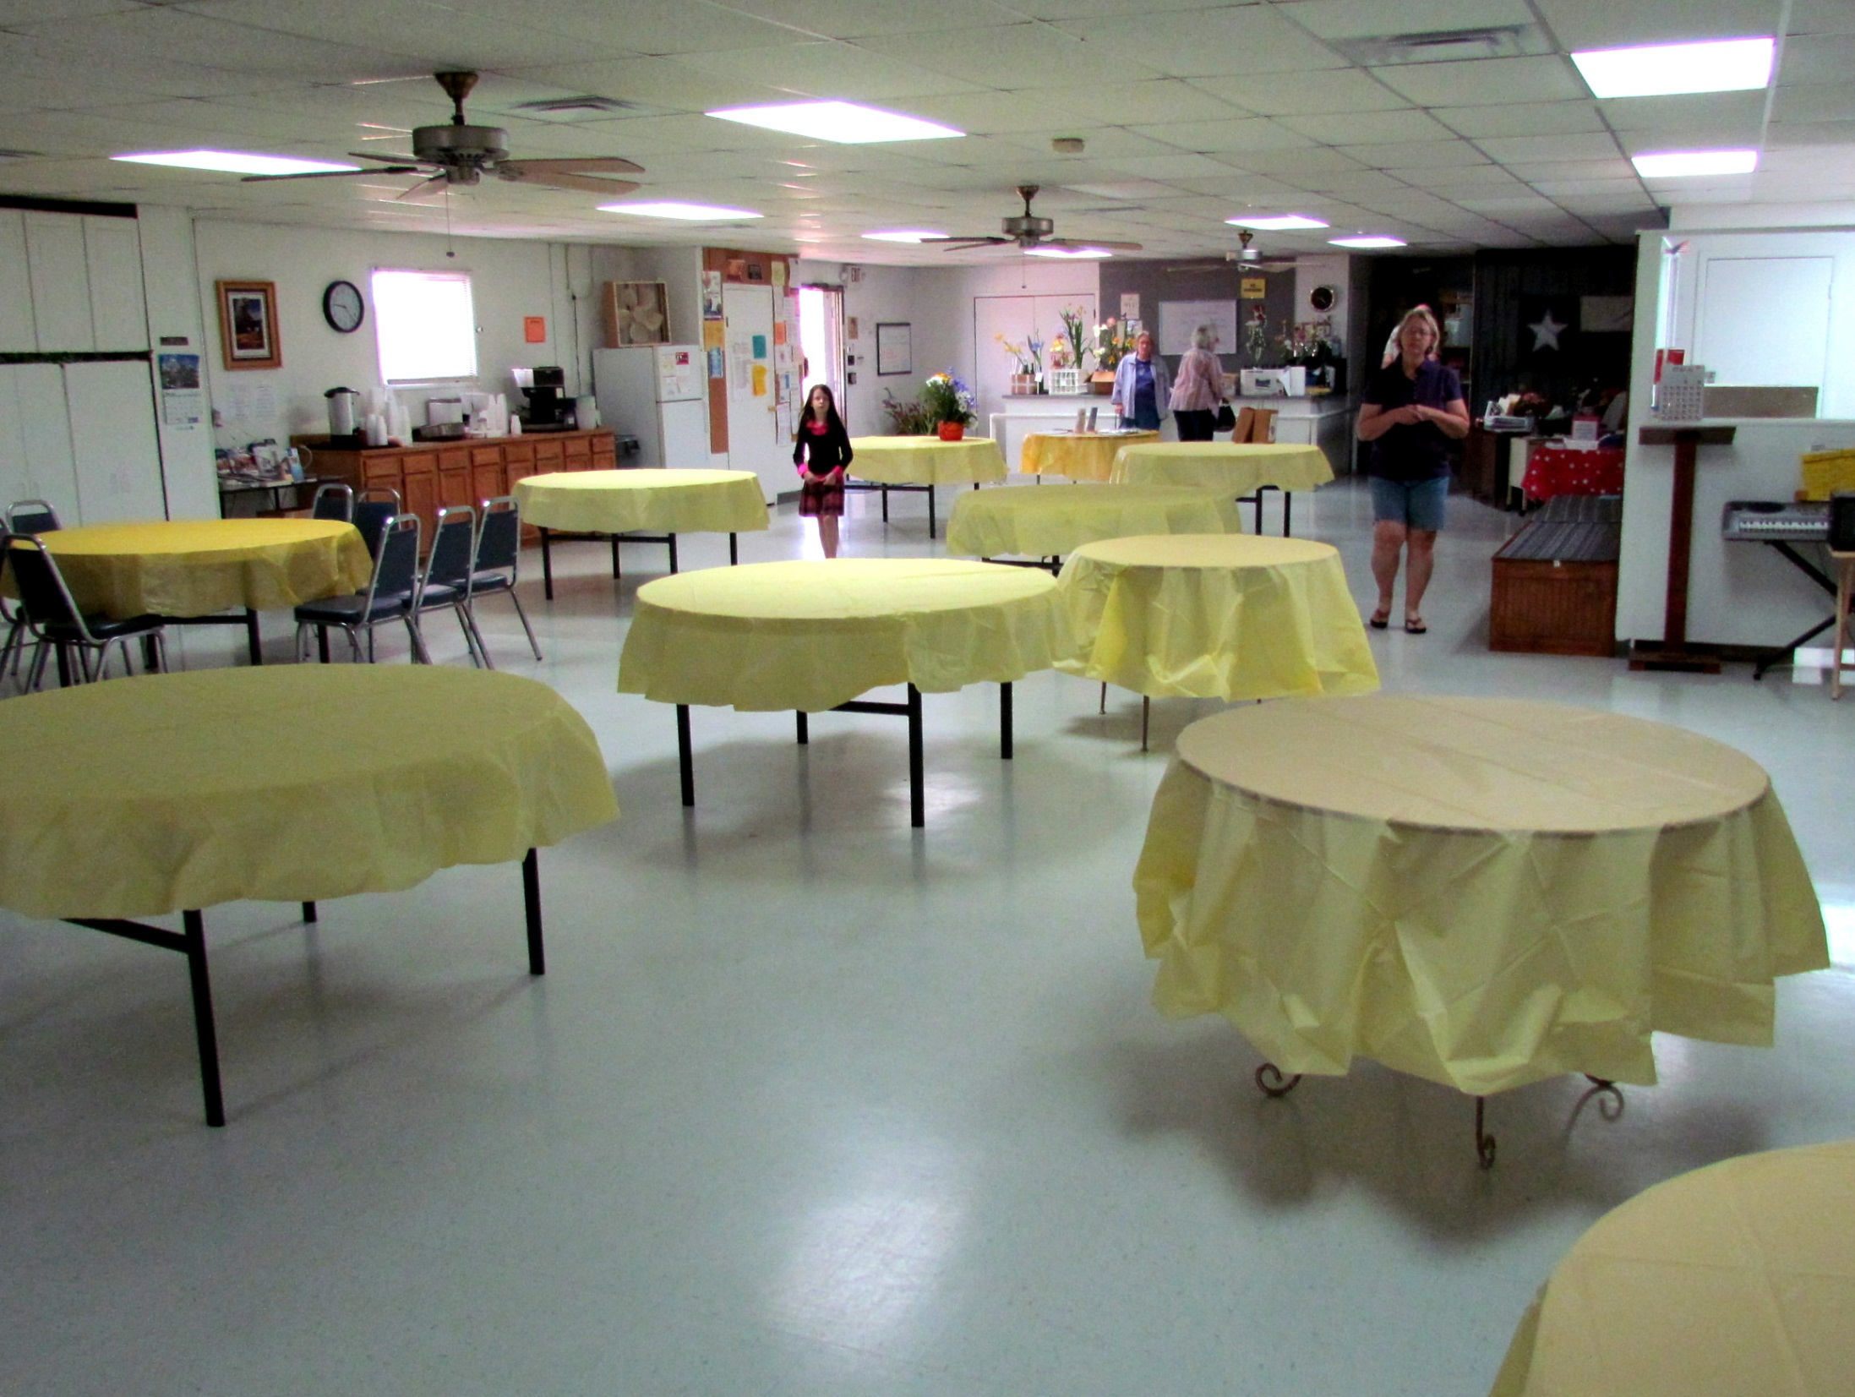
Setting up for the Show at the Belton Senior Center

Slide 4
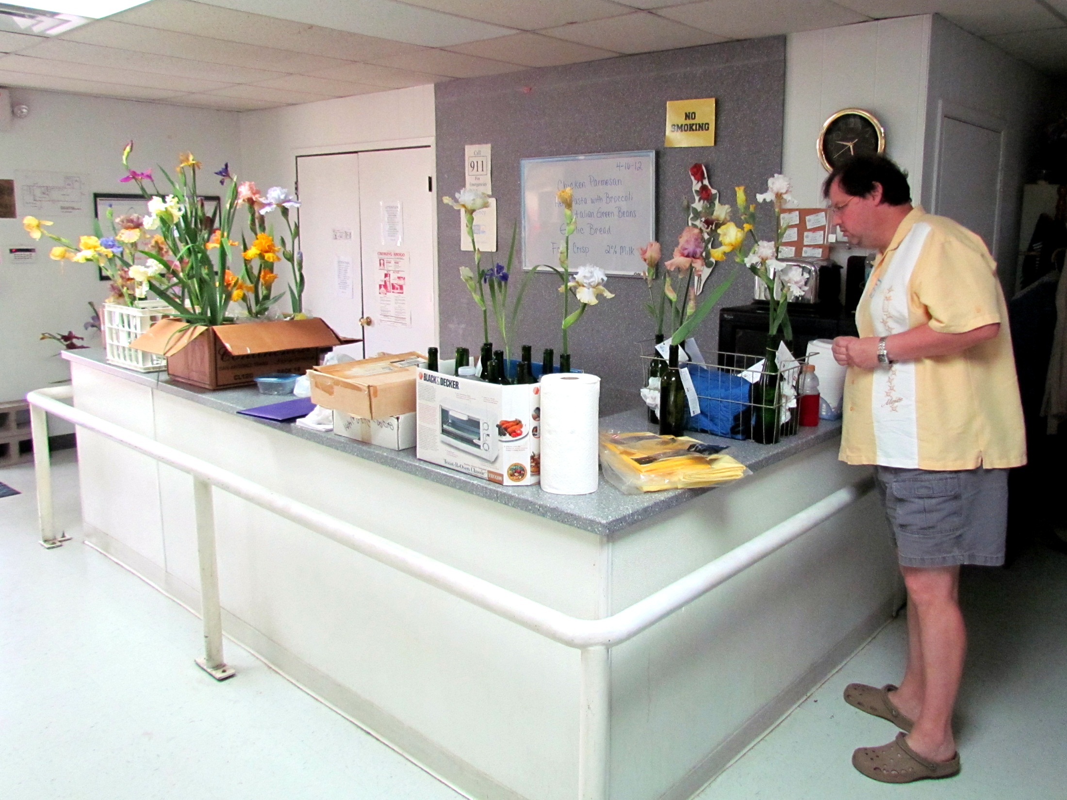
Jaime Hadley from the Iris Society of Austin looks over some of the blooms brought in by local Belton members.

Slide 5
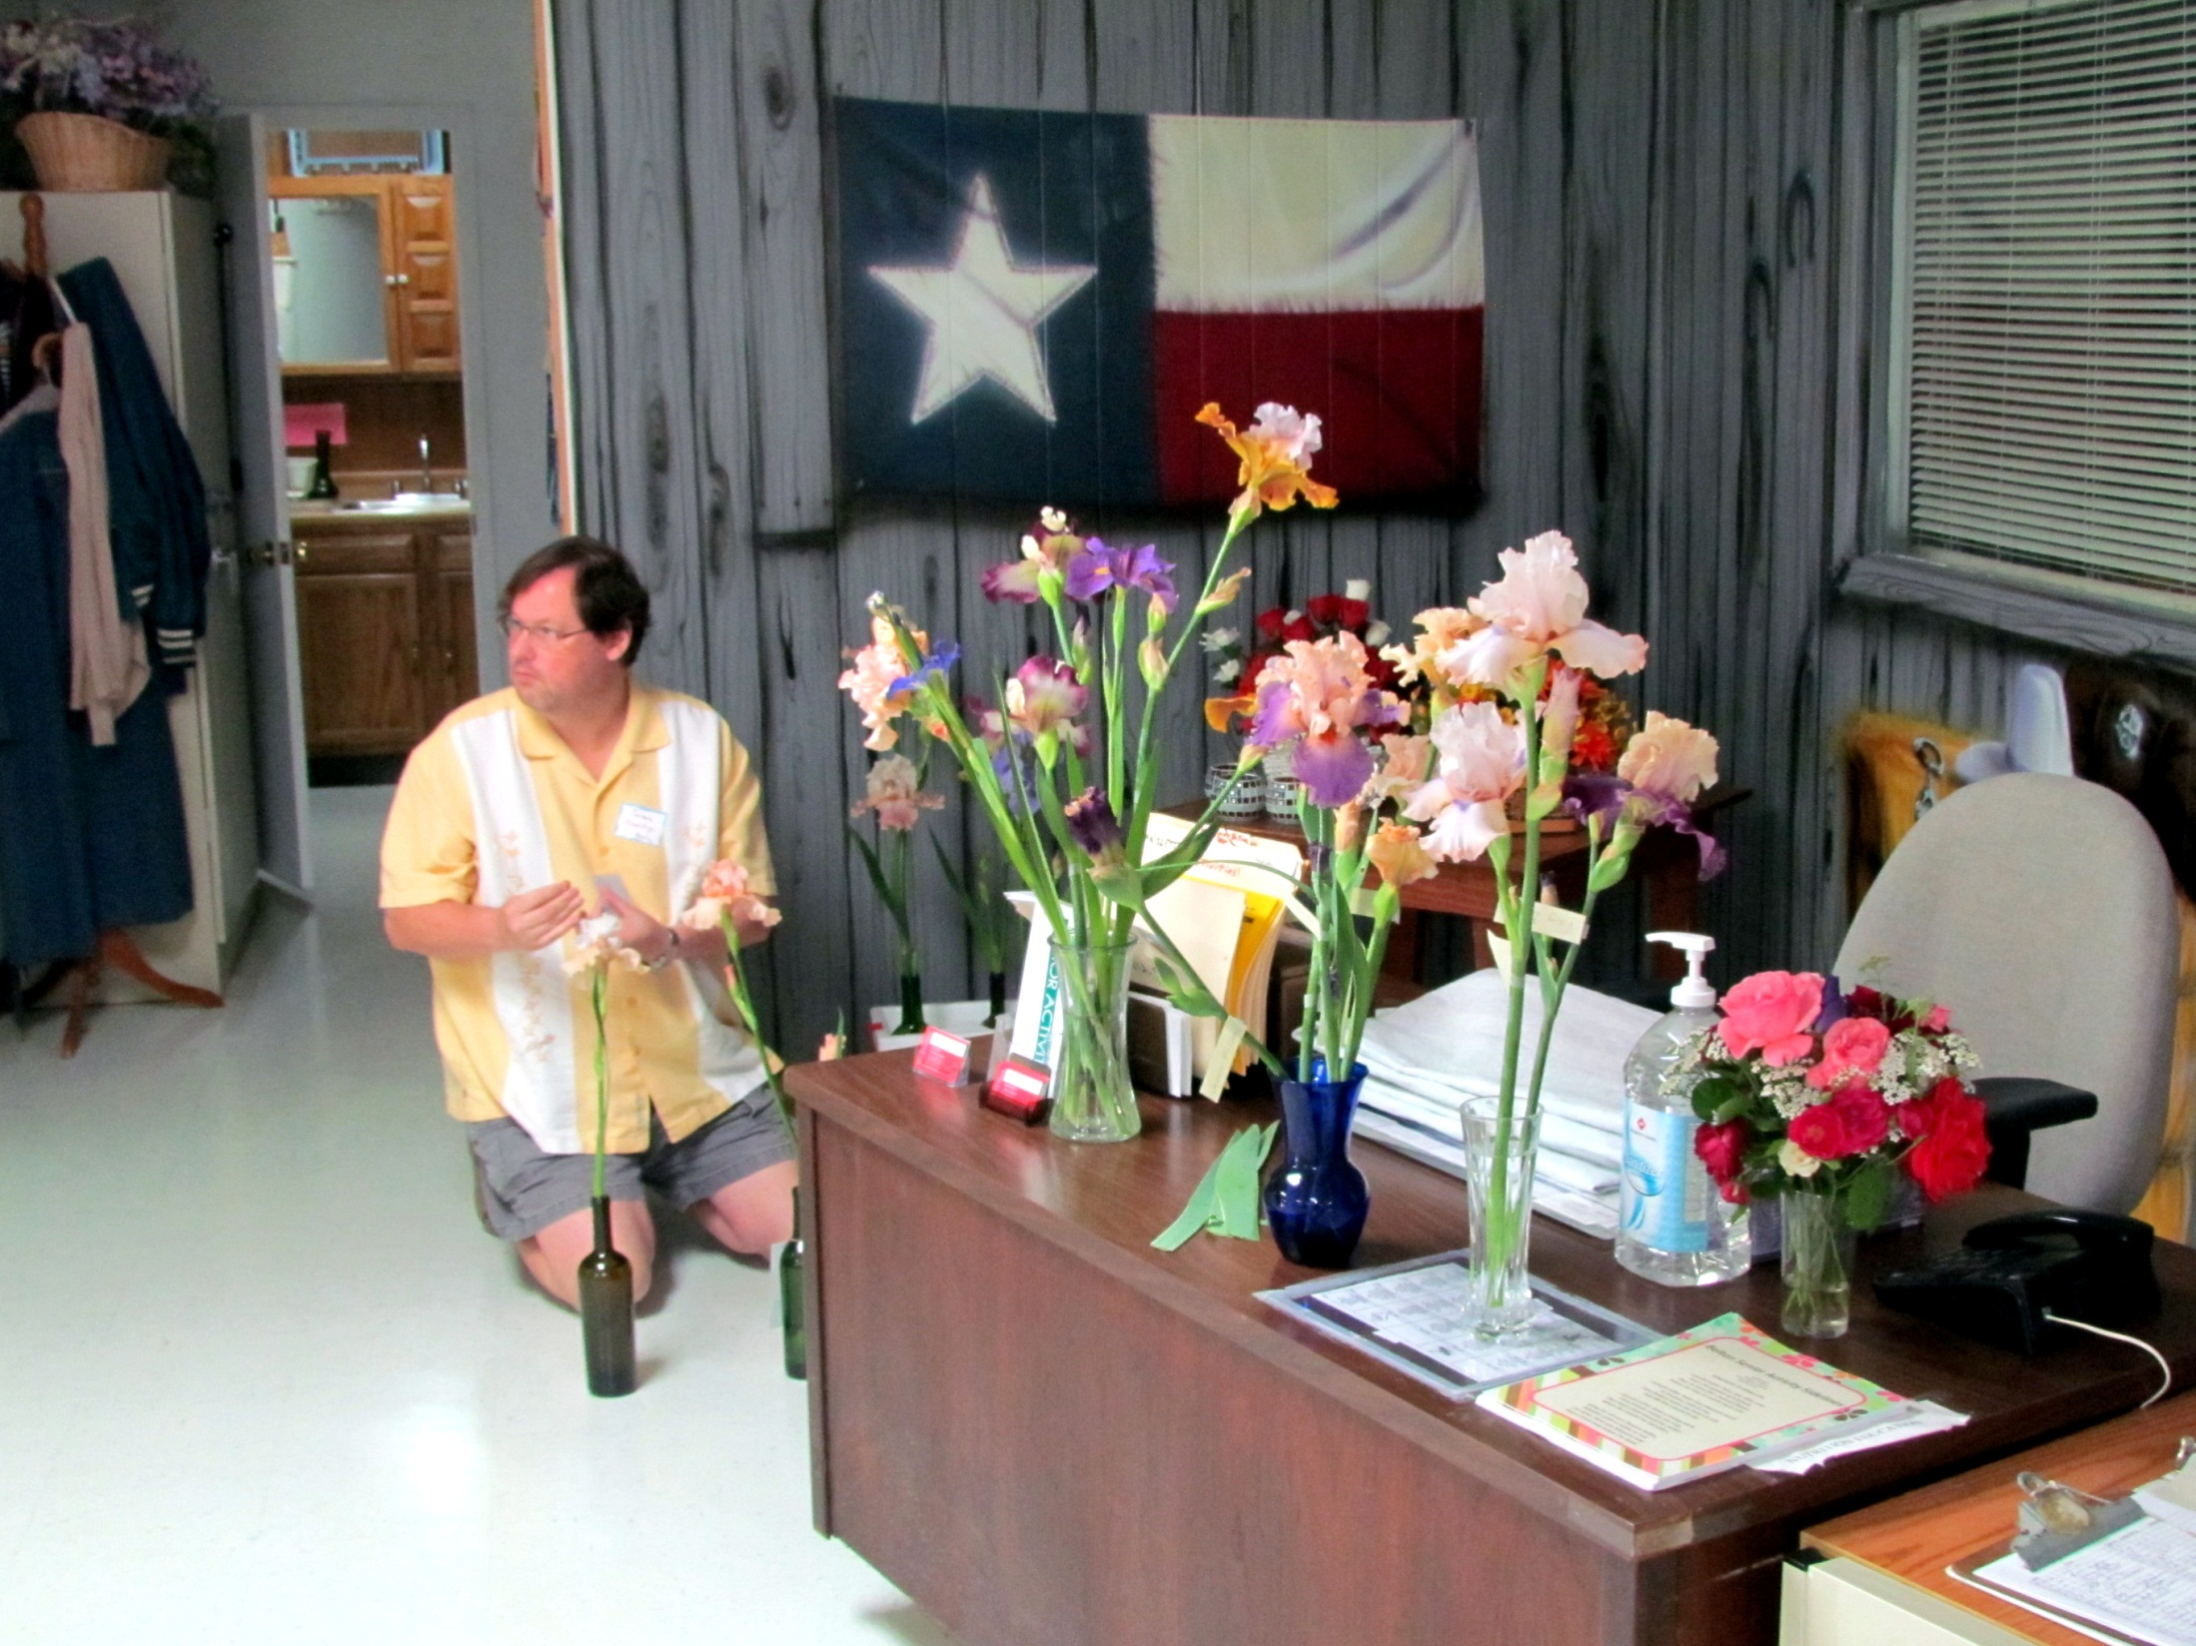

Slide 6
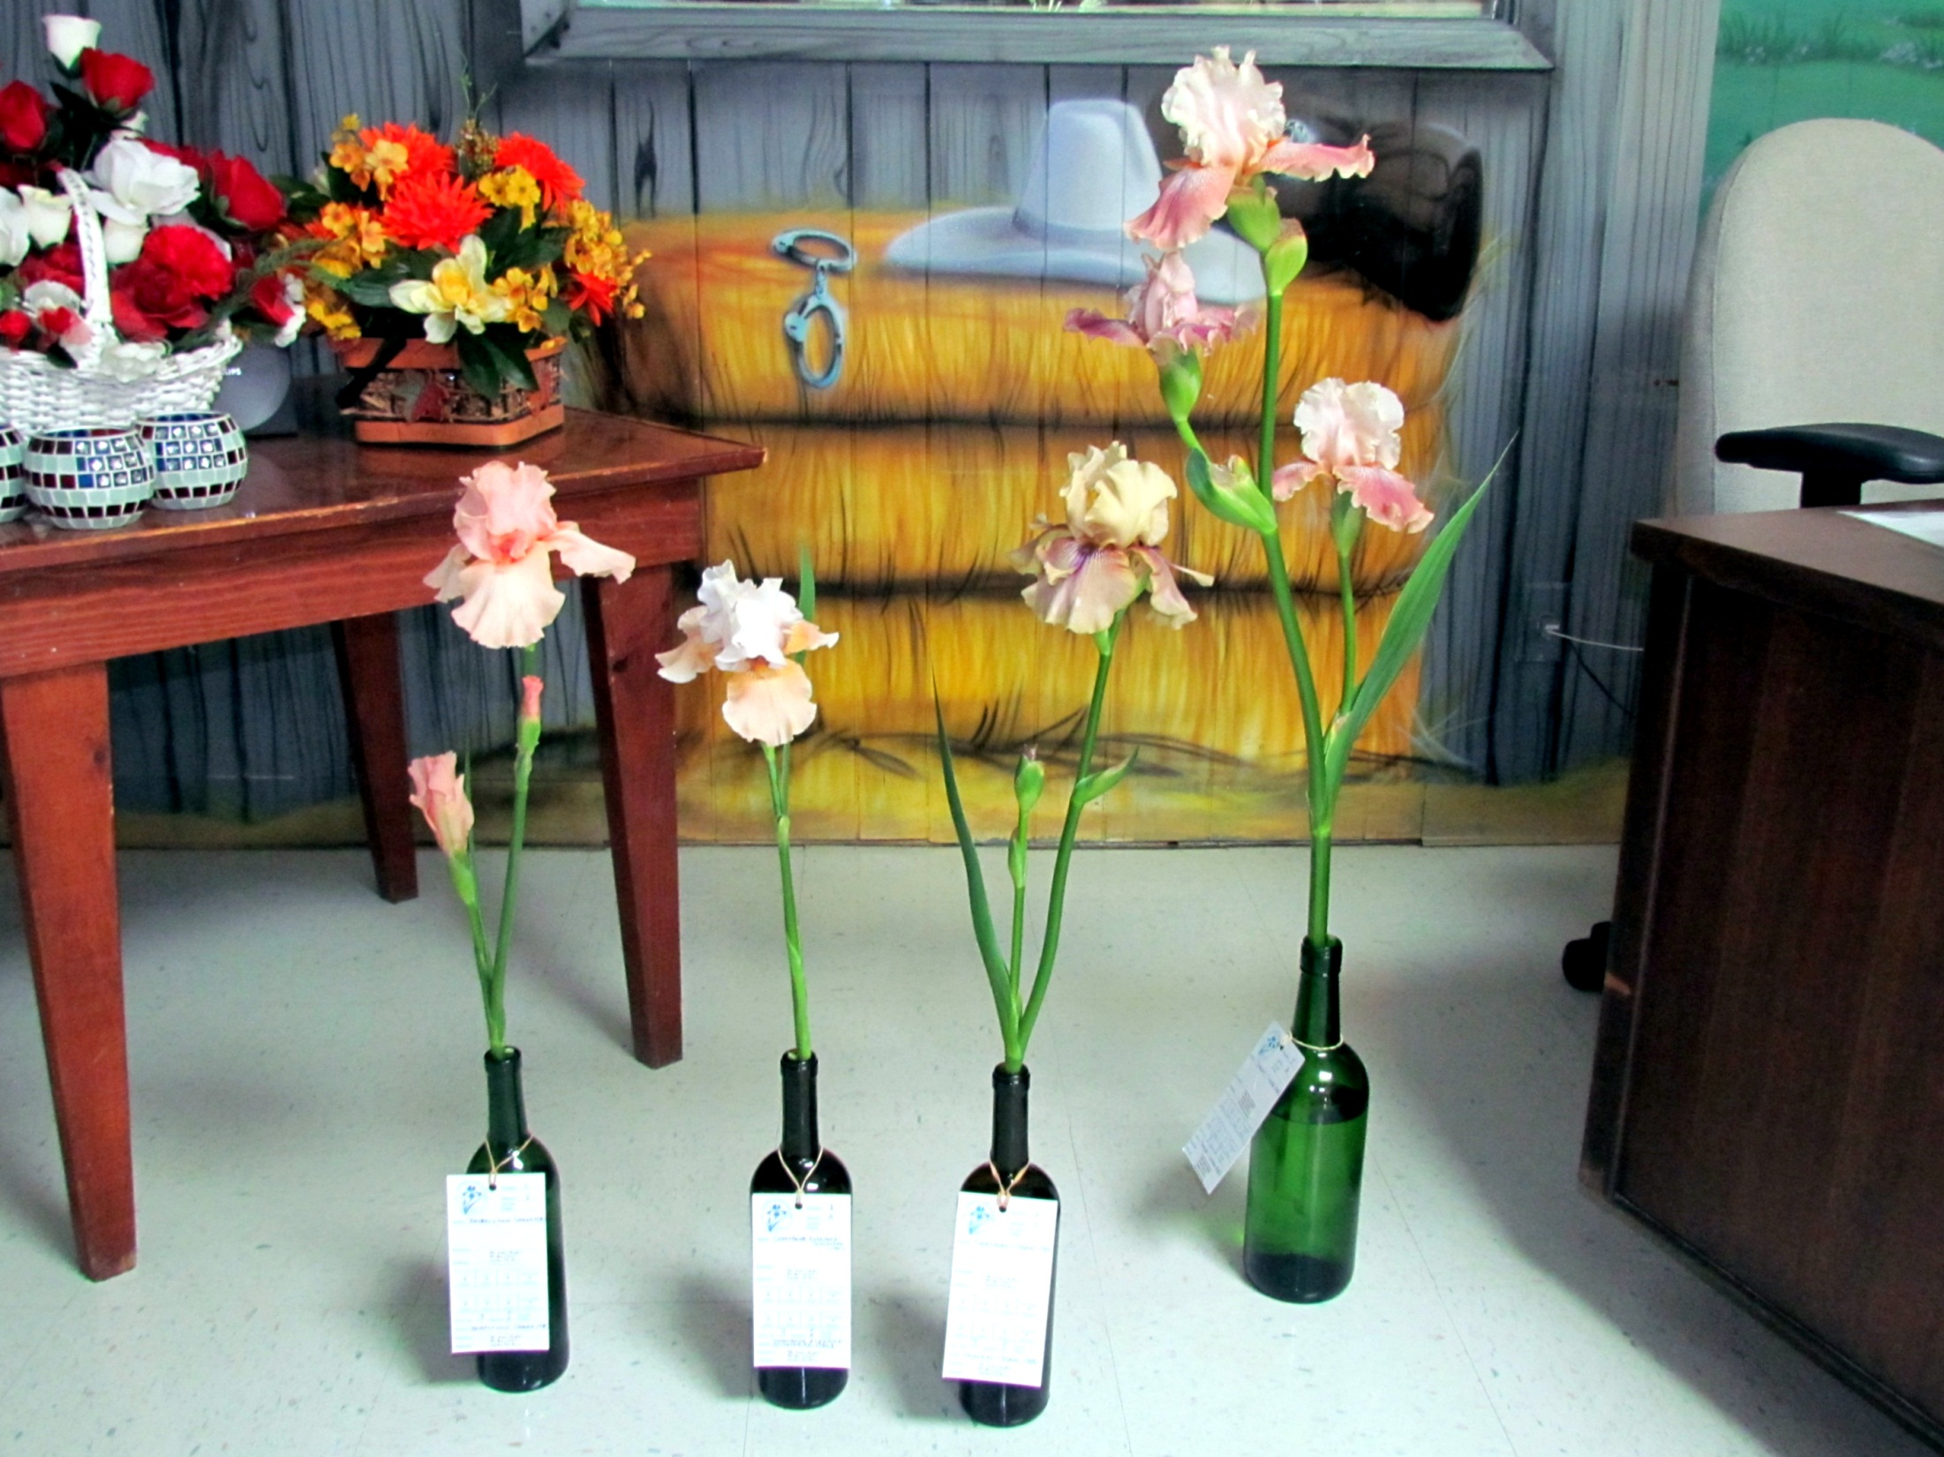
Jaime Hadley's irises

Slide 7
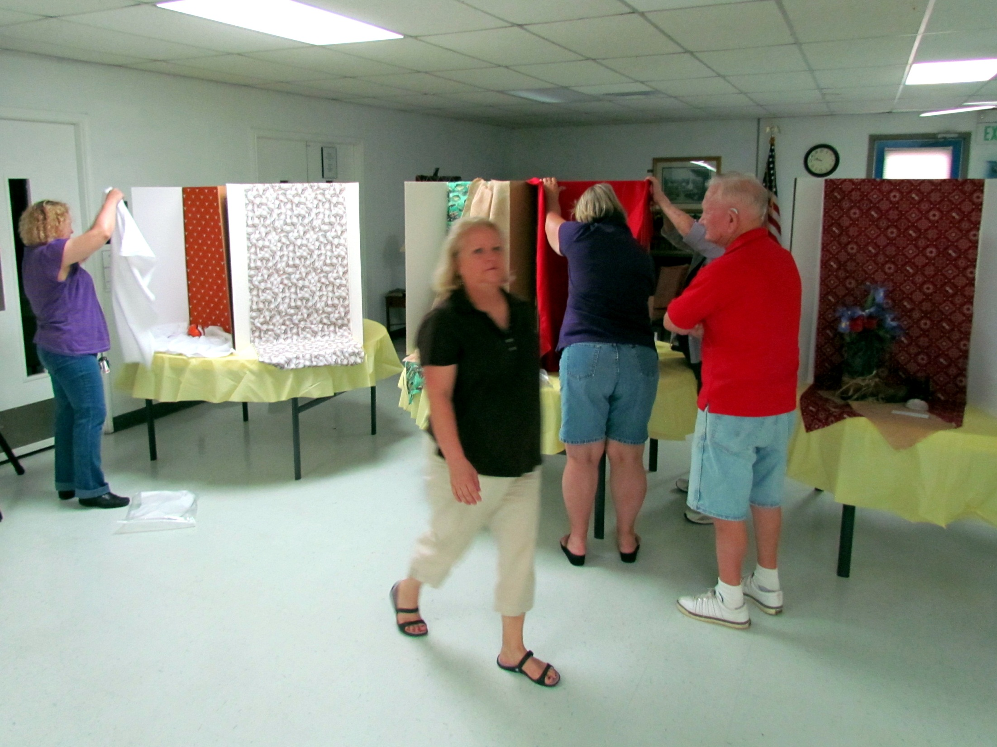
Karen Woods, Susan Krauskopf, and Winnie Culp (behind Mr. Culp) set up their Artistic Designs. Nita Culp (back to camera) gives a helping hand to Winnie.

Slide 8
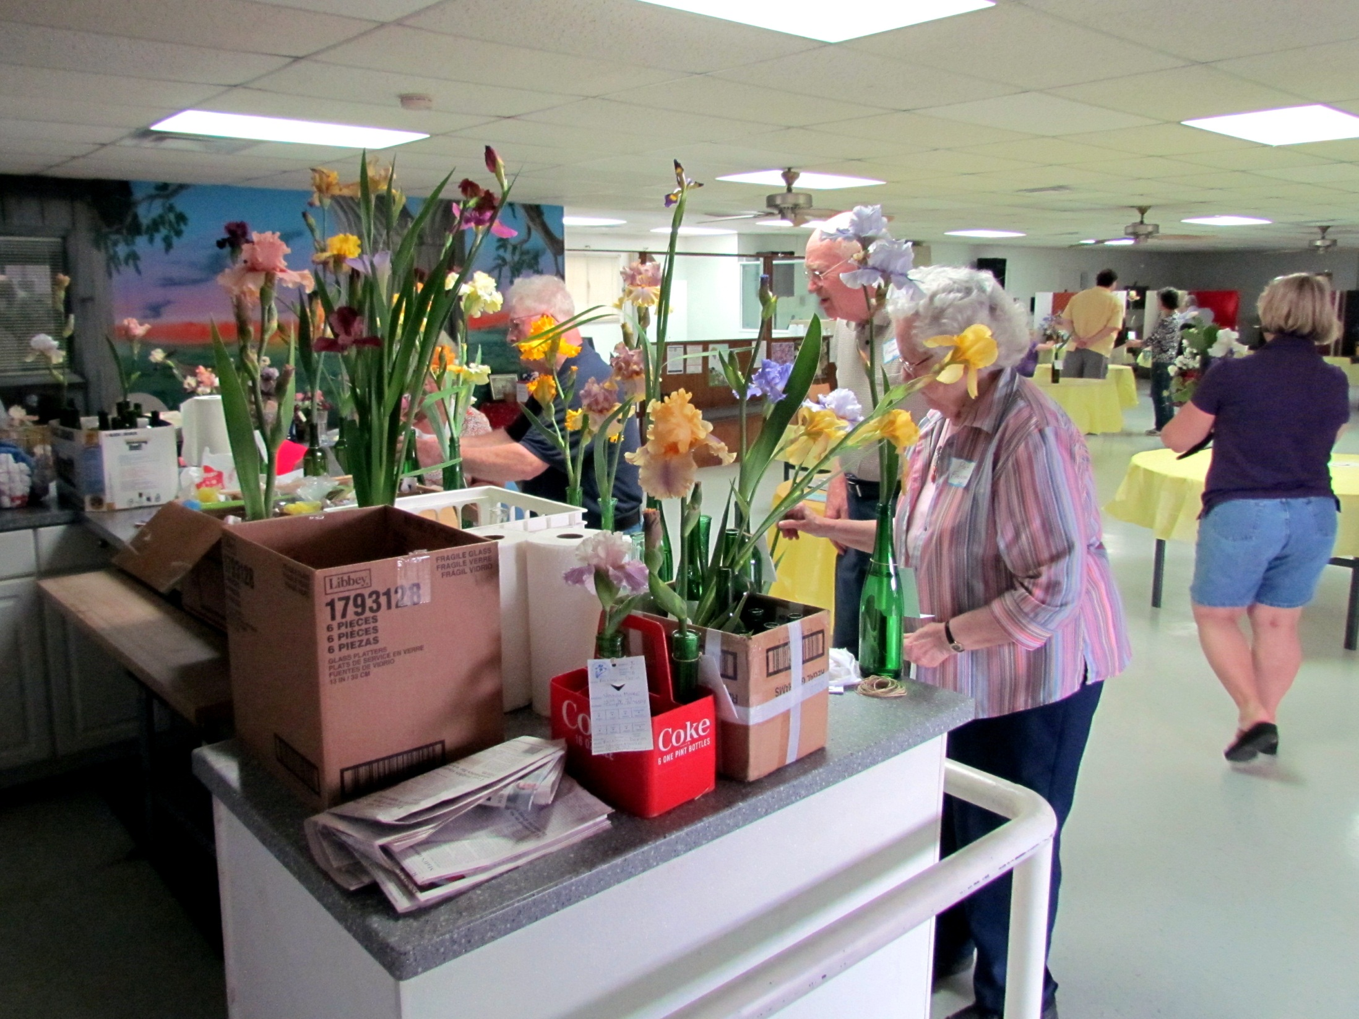
Pat and Don Freeman from the Iris Society of Austin sort out the many irises they have brought to Belton.

Slide 9
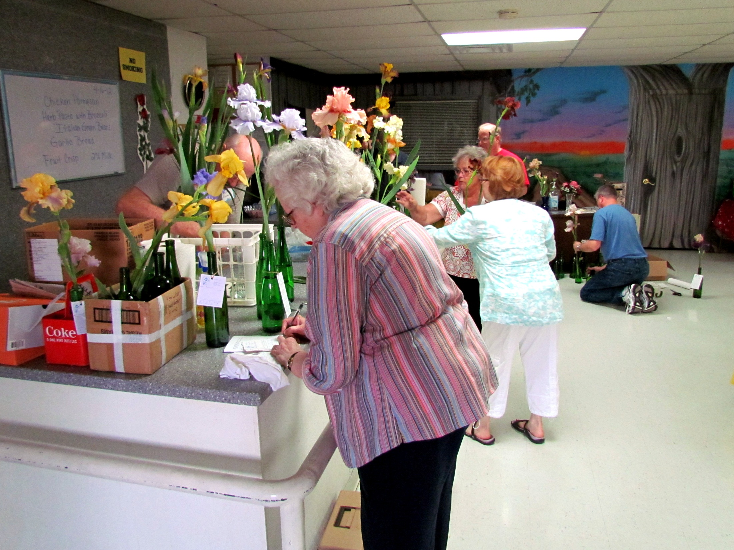

Slide 10
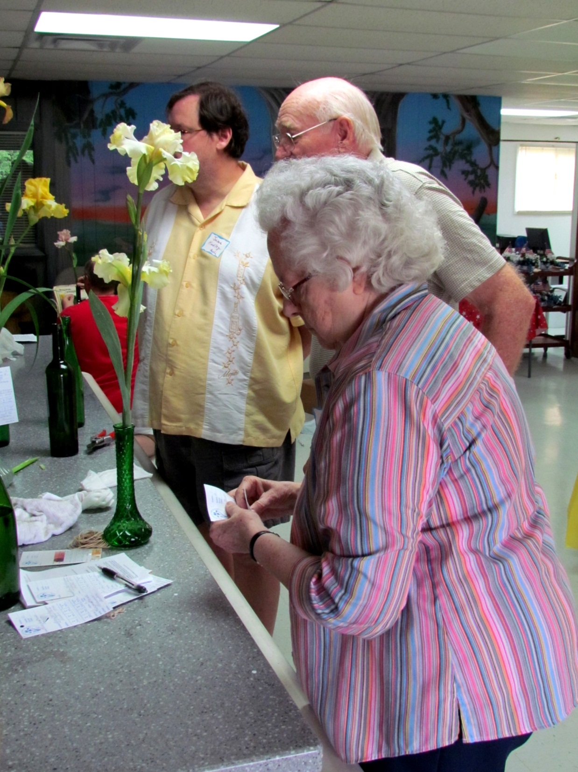

Slide 11
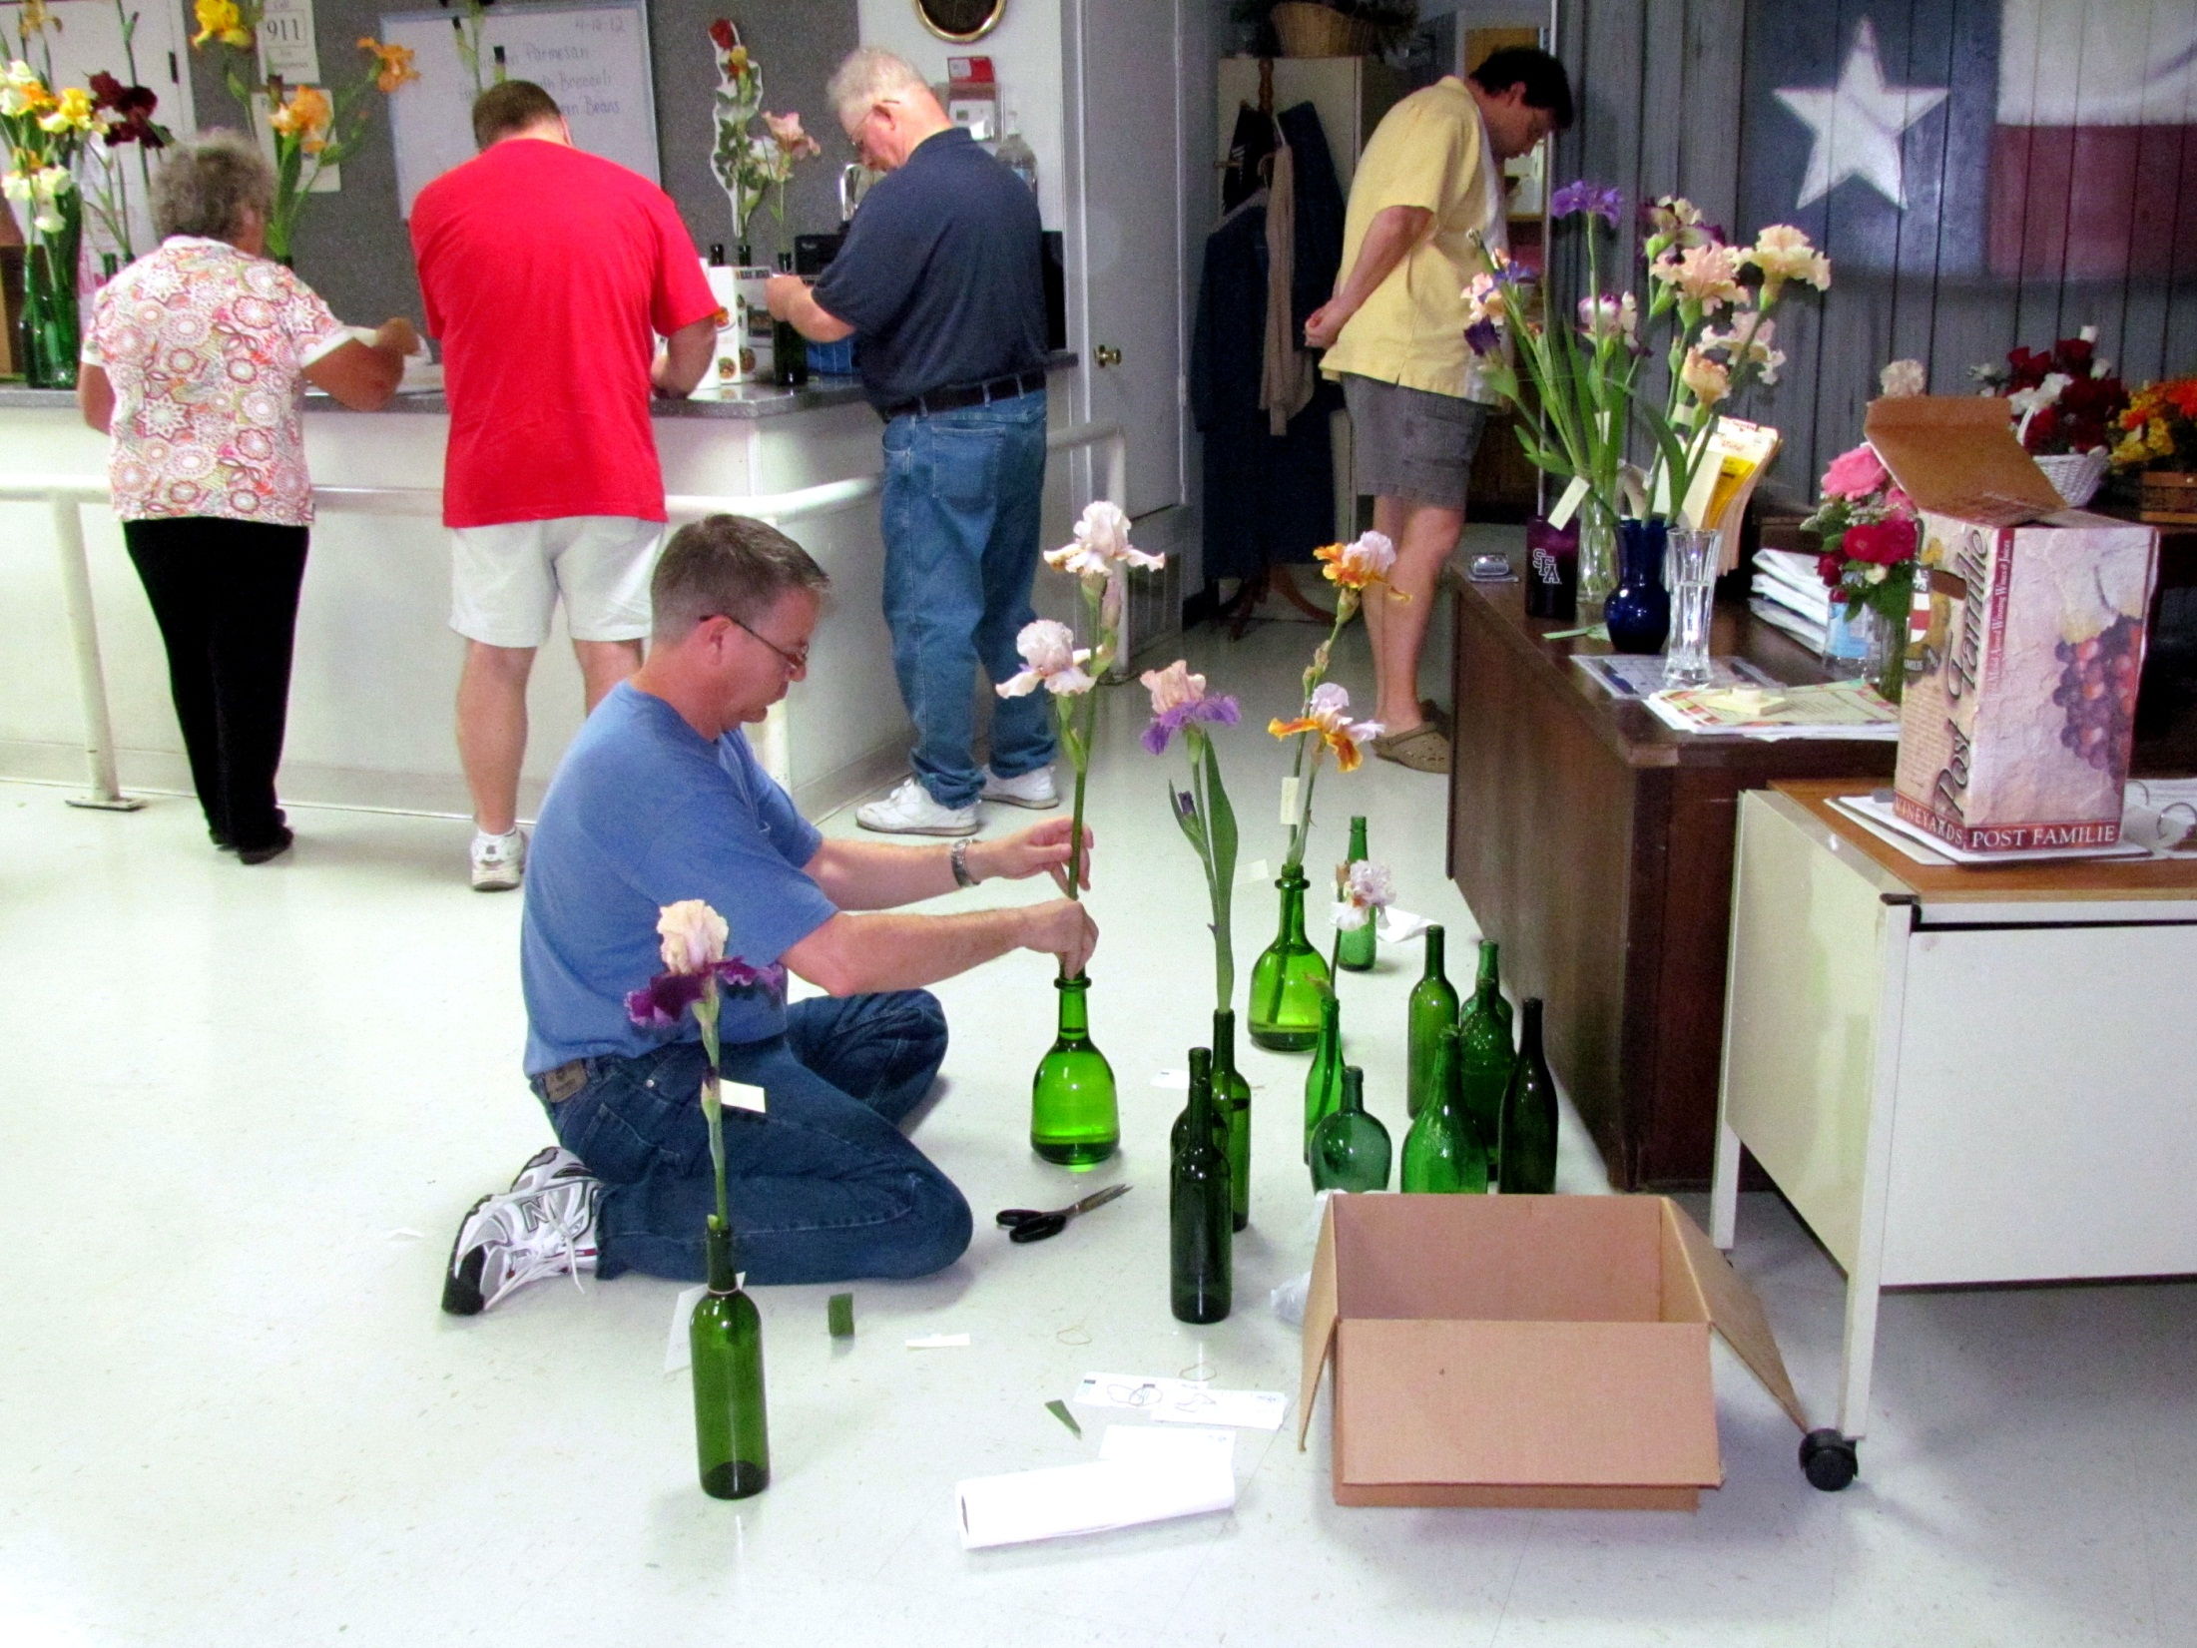
Gary Whitis gets one of his entries ready.

Slide 12
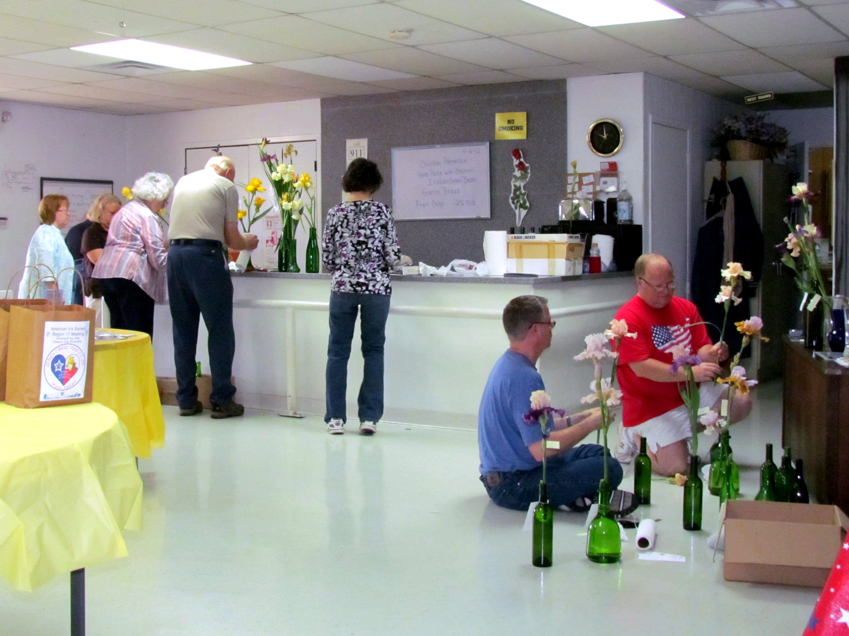
Joan Ervin, Susan Krauskopf, Pat and Don Freeman, Gail Jacobs, Gary Whitis, and Jesse Roberts all work to get entries ready.

Slide 13
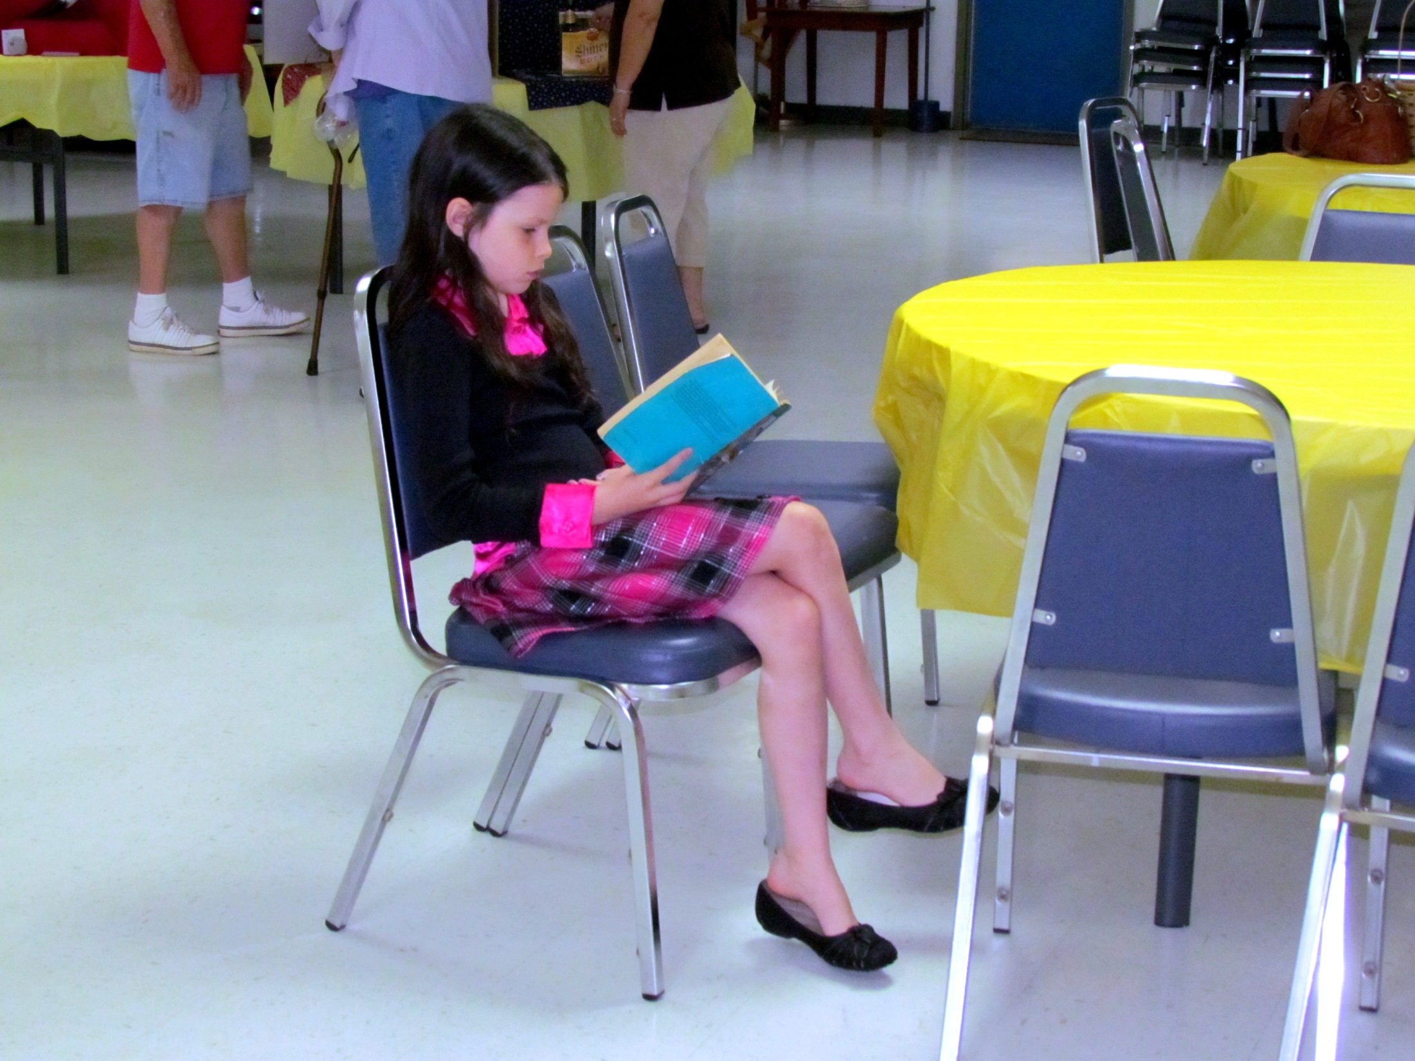
After helping set up the tables, Gail Jacobs’ granddaughter takes a break reading while the adults continue getting ready for the show.

Slide 14
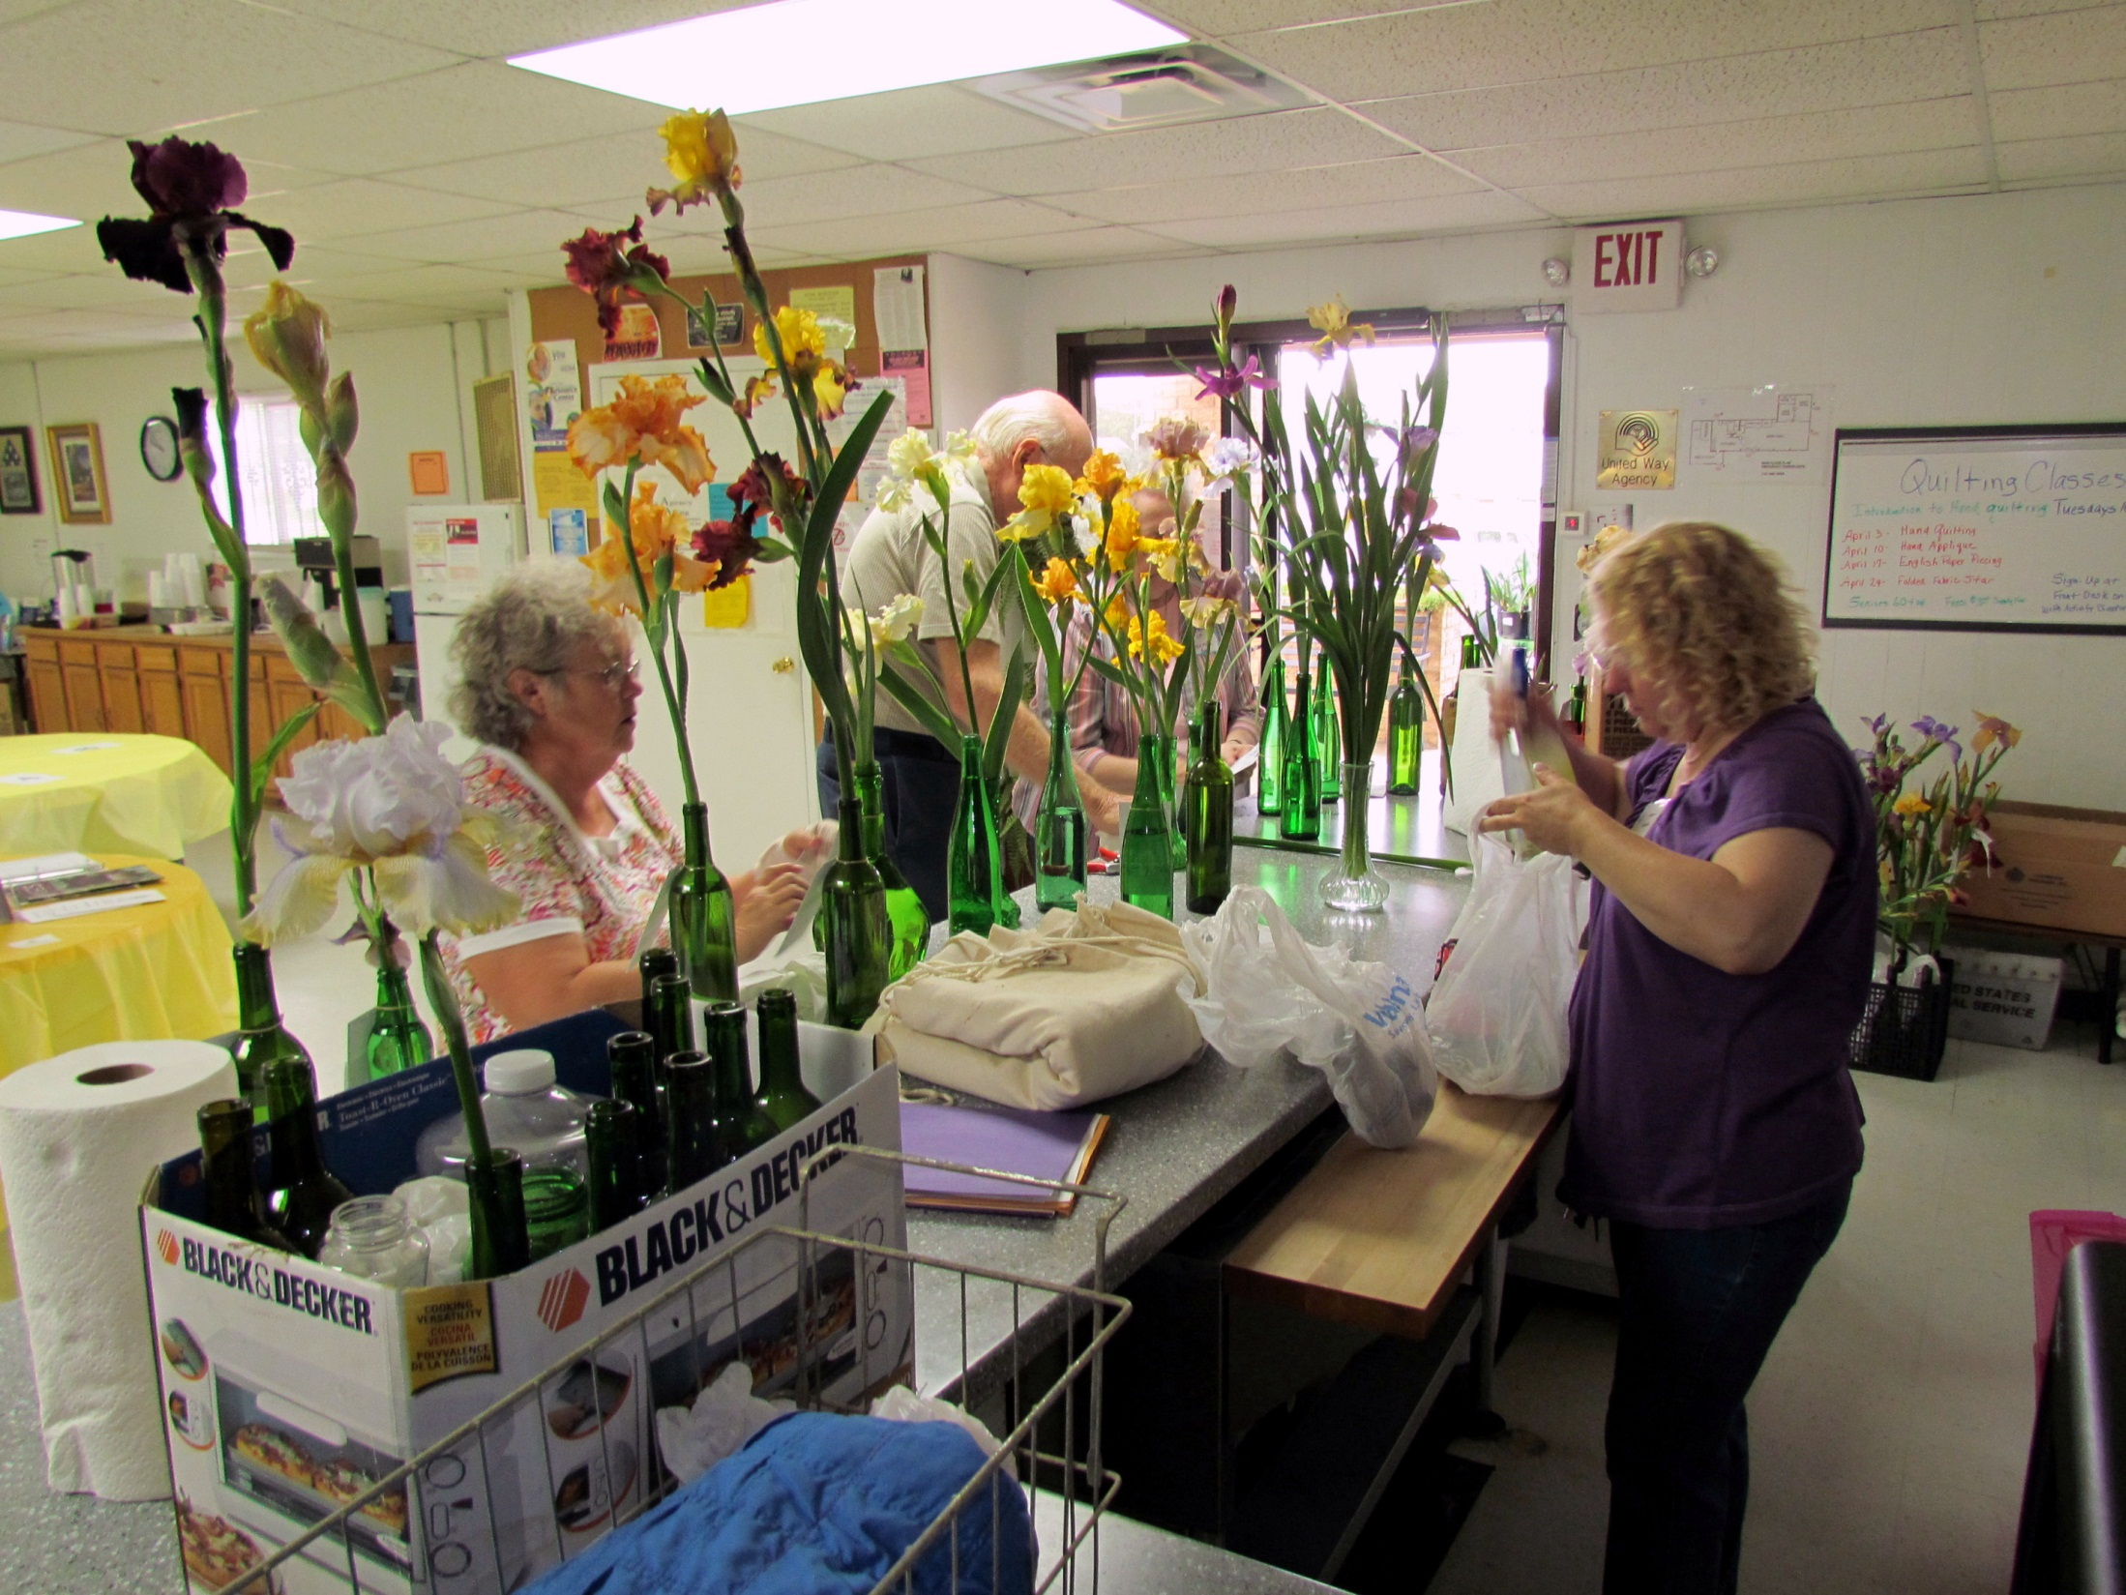
Dolores Avram, Don and Pat Freeman, and Belton IS President Karen Woods

Slide 15
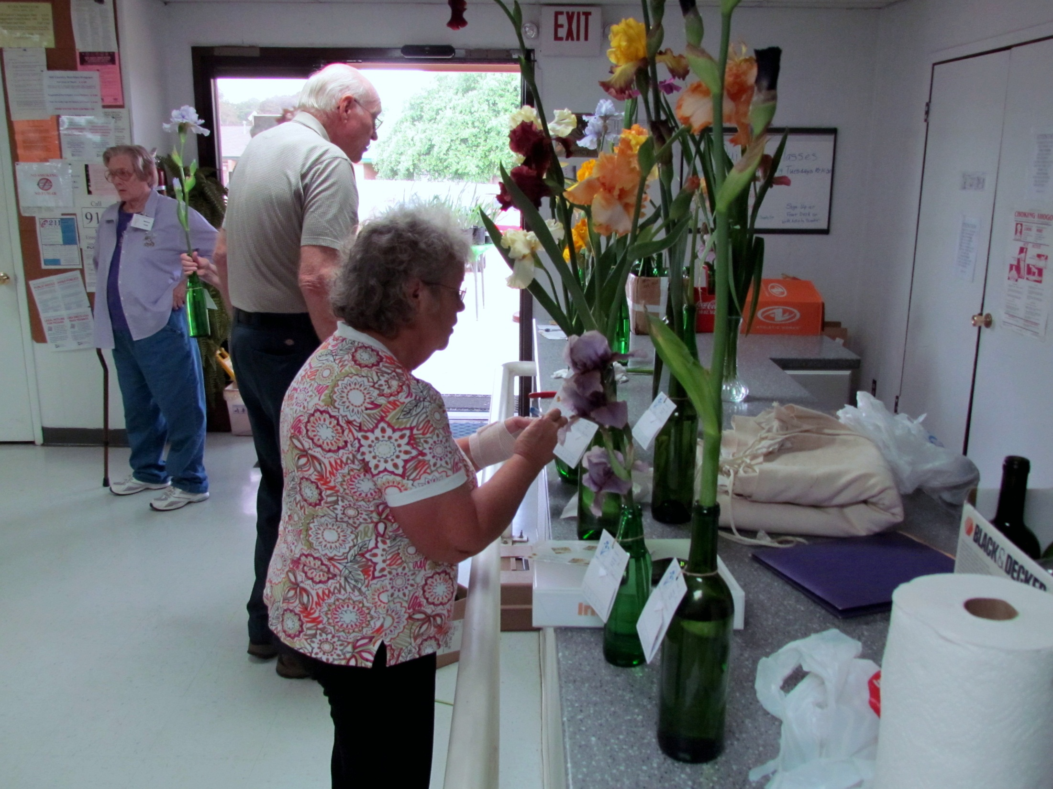
Dolores Avram fills out an entry tag as Winnie Culp (left) looks over the show room.

Slide 16
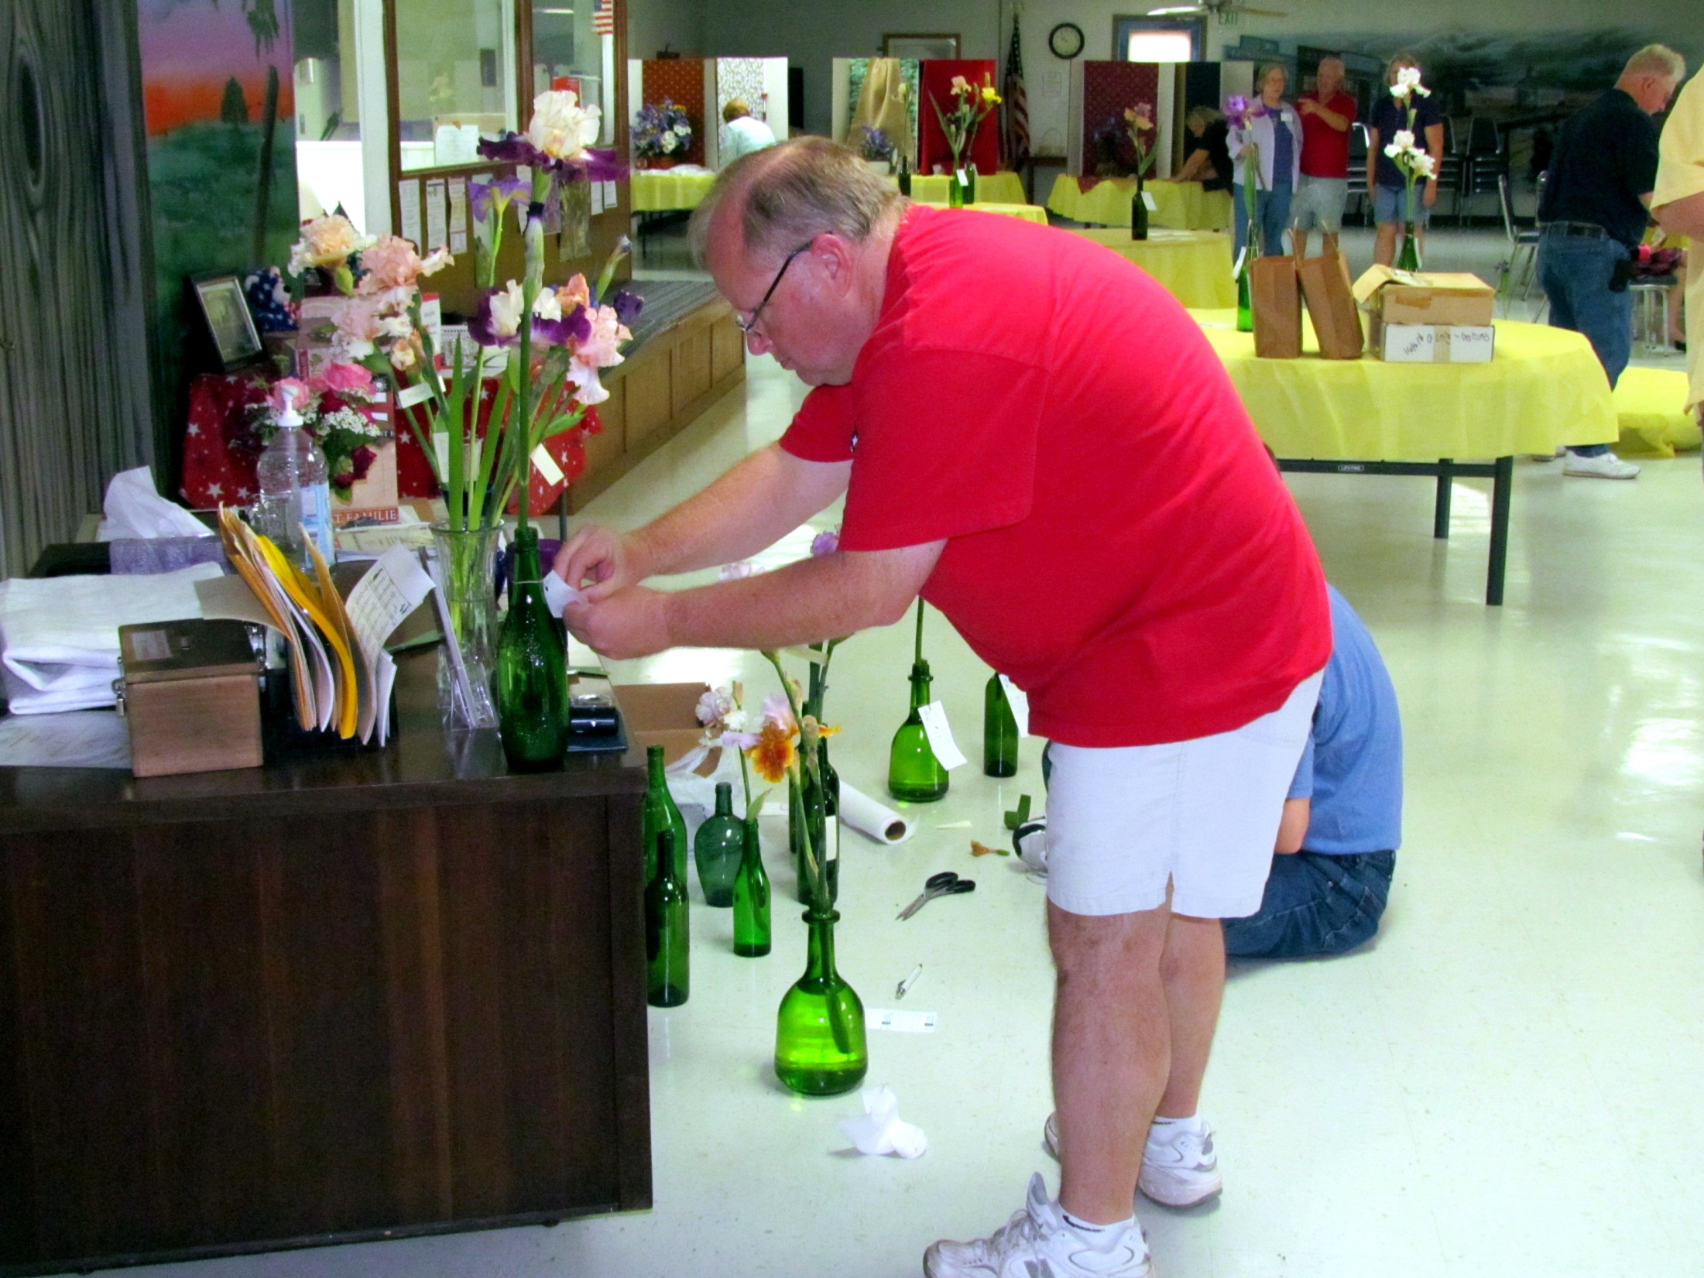
Jesse Roberts adjusts an entry tag.

Slide 17
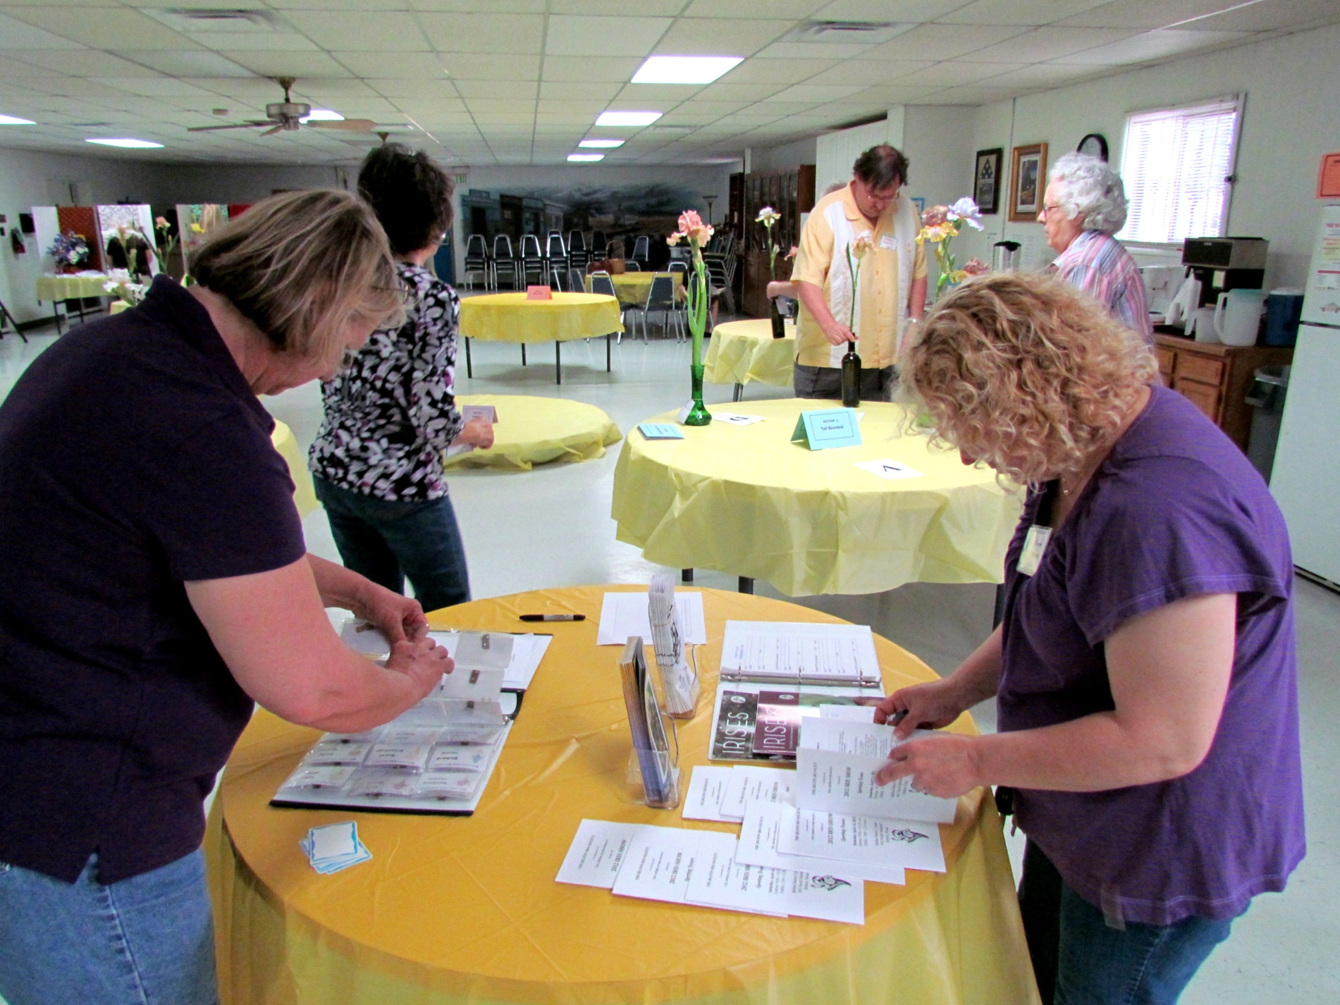
Nita Culp sorts out the new name tags as Karen Woods checks the show schedule.

Slide 18
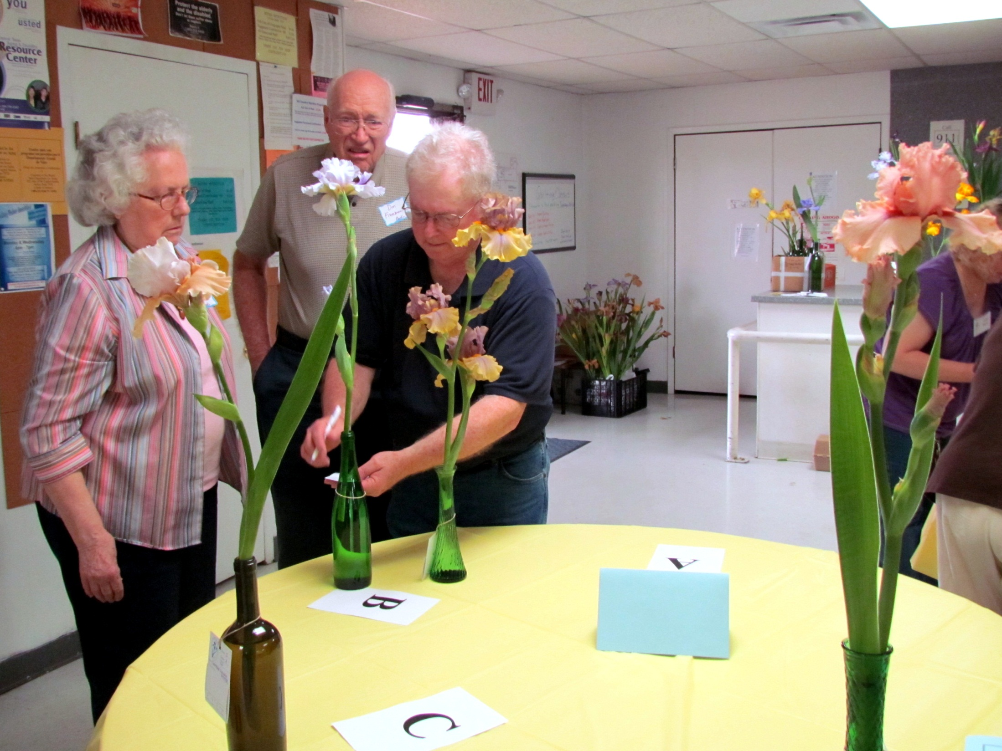
Jim Landers changes an entry category on Pat and Don Freeman's entry tag.

Slide 19
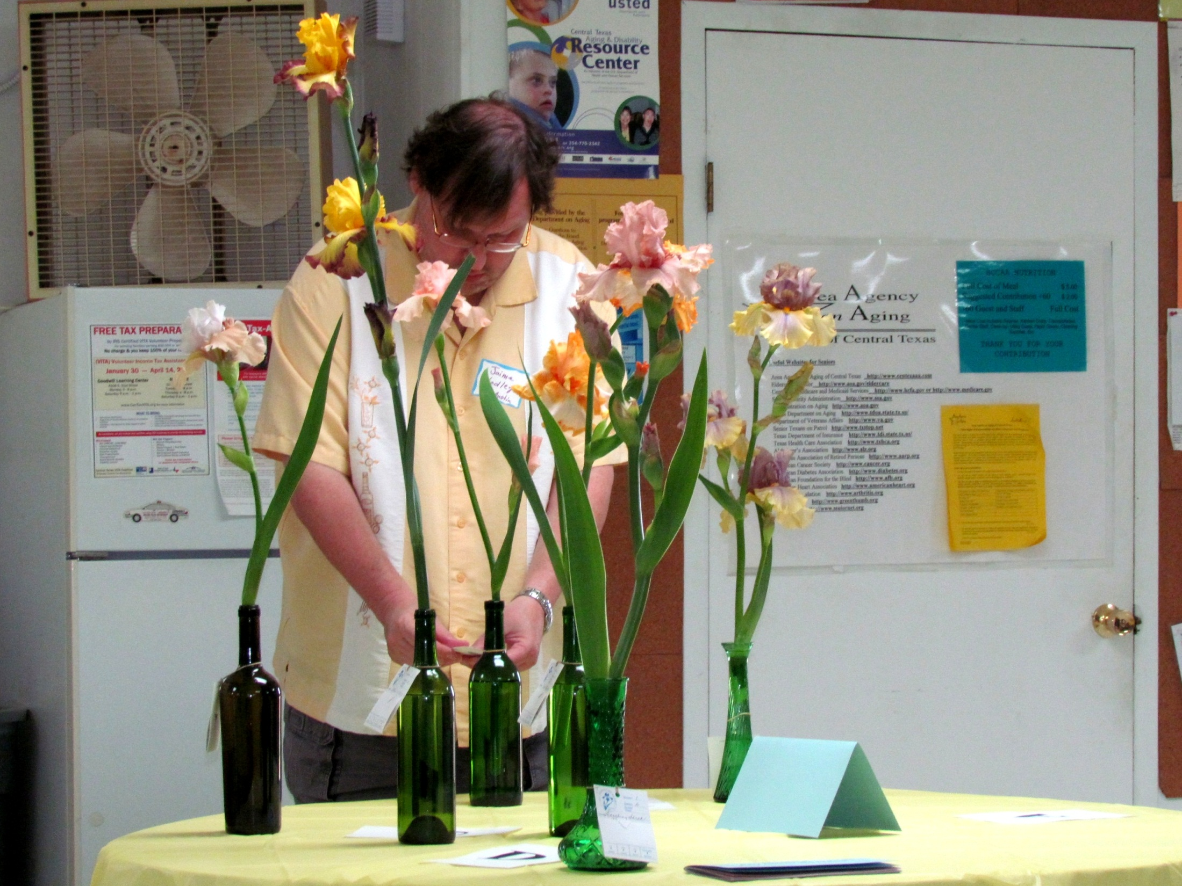

Slide 20
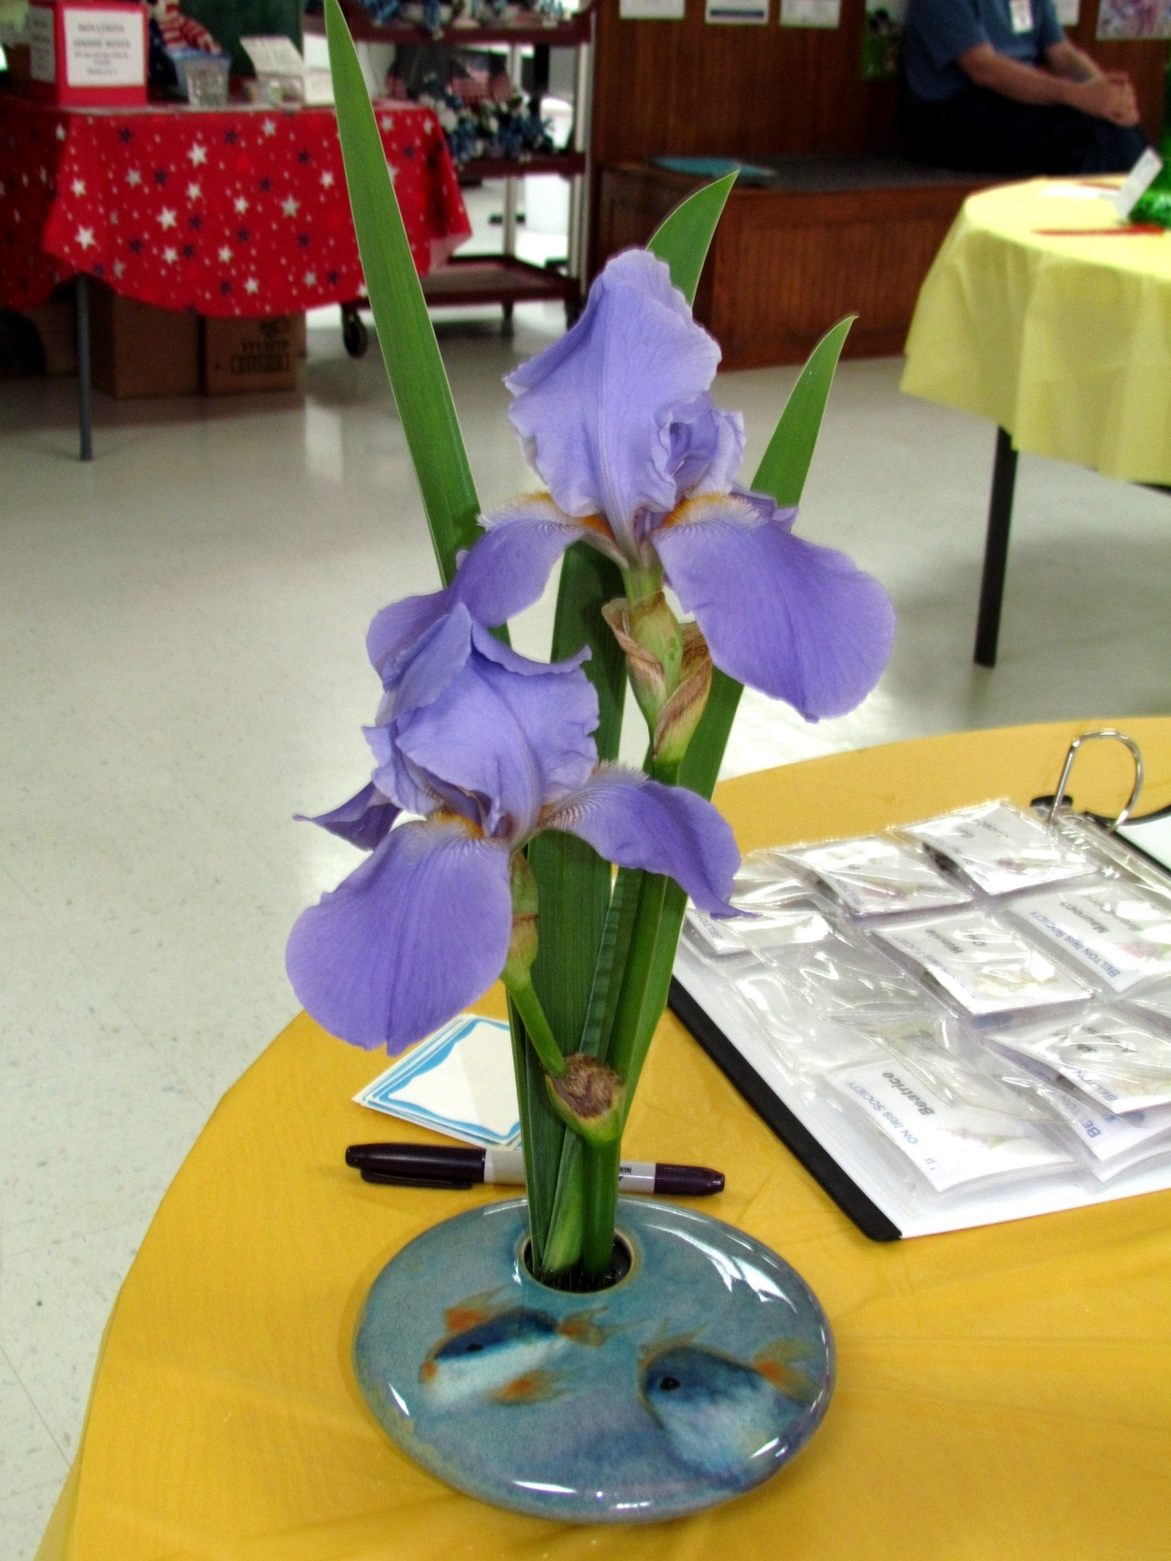
Jaime Hadley's historic iris 'Missouri' decorates the welcome table.

Slide 21
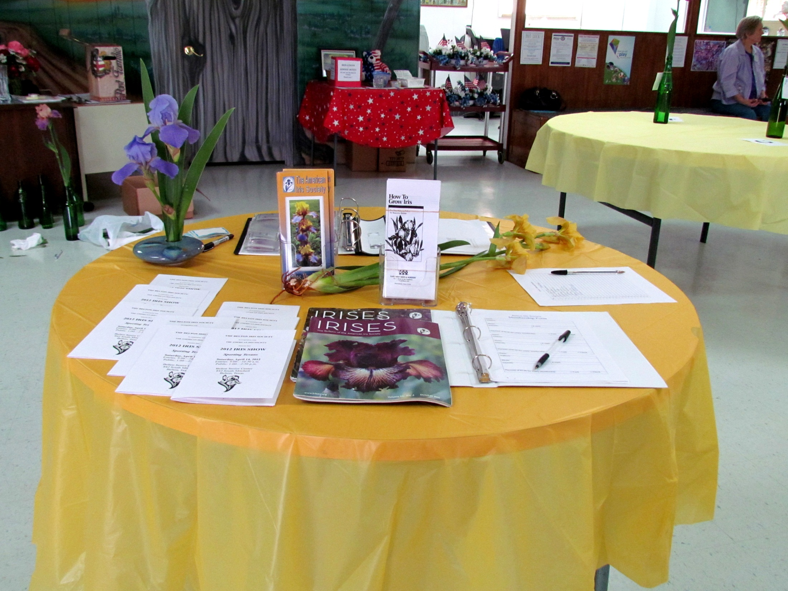

Slide 22
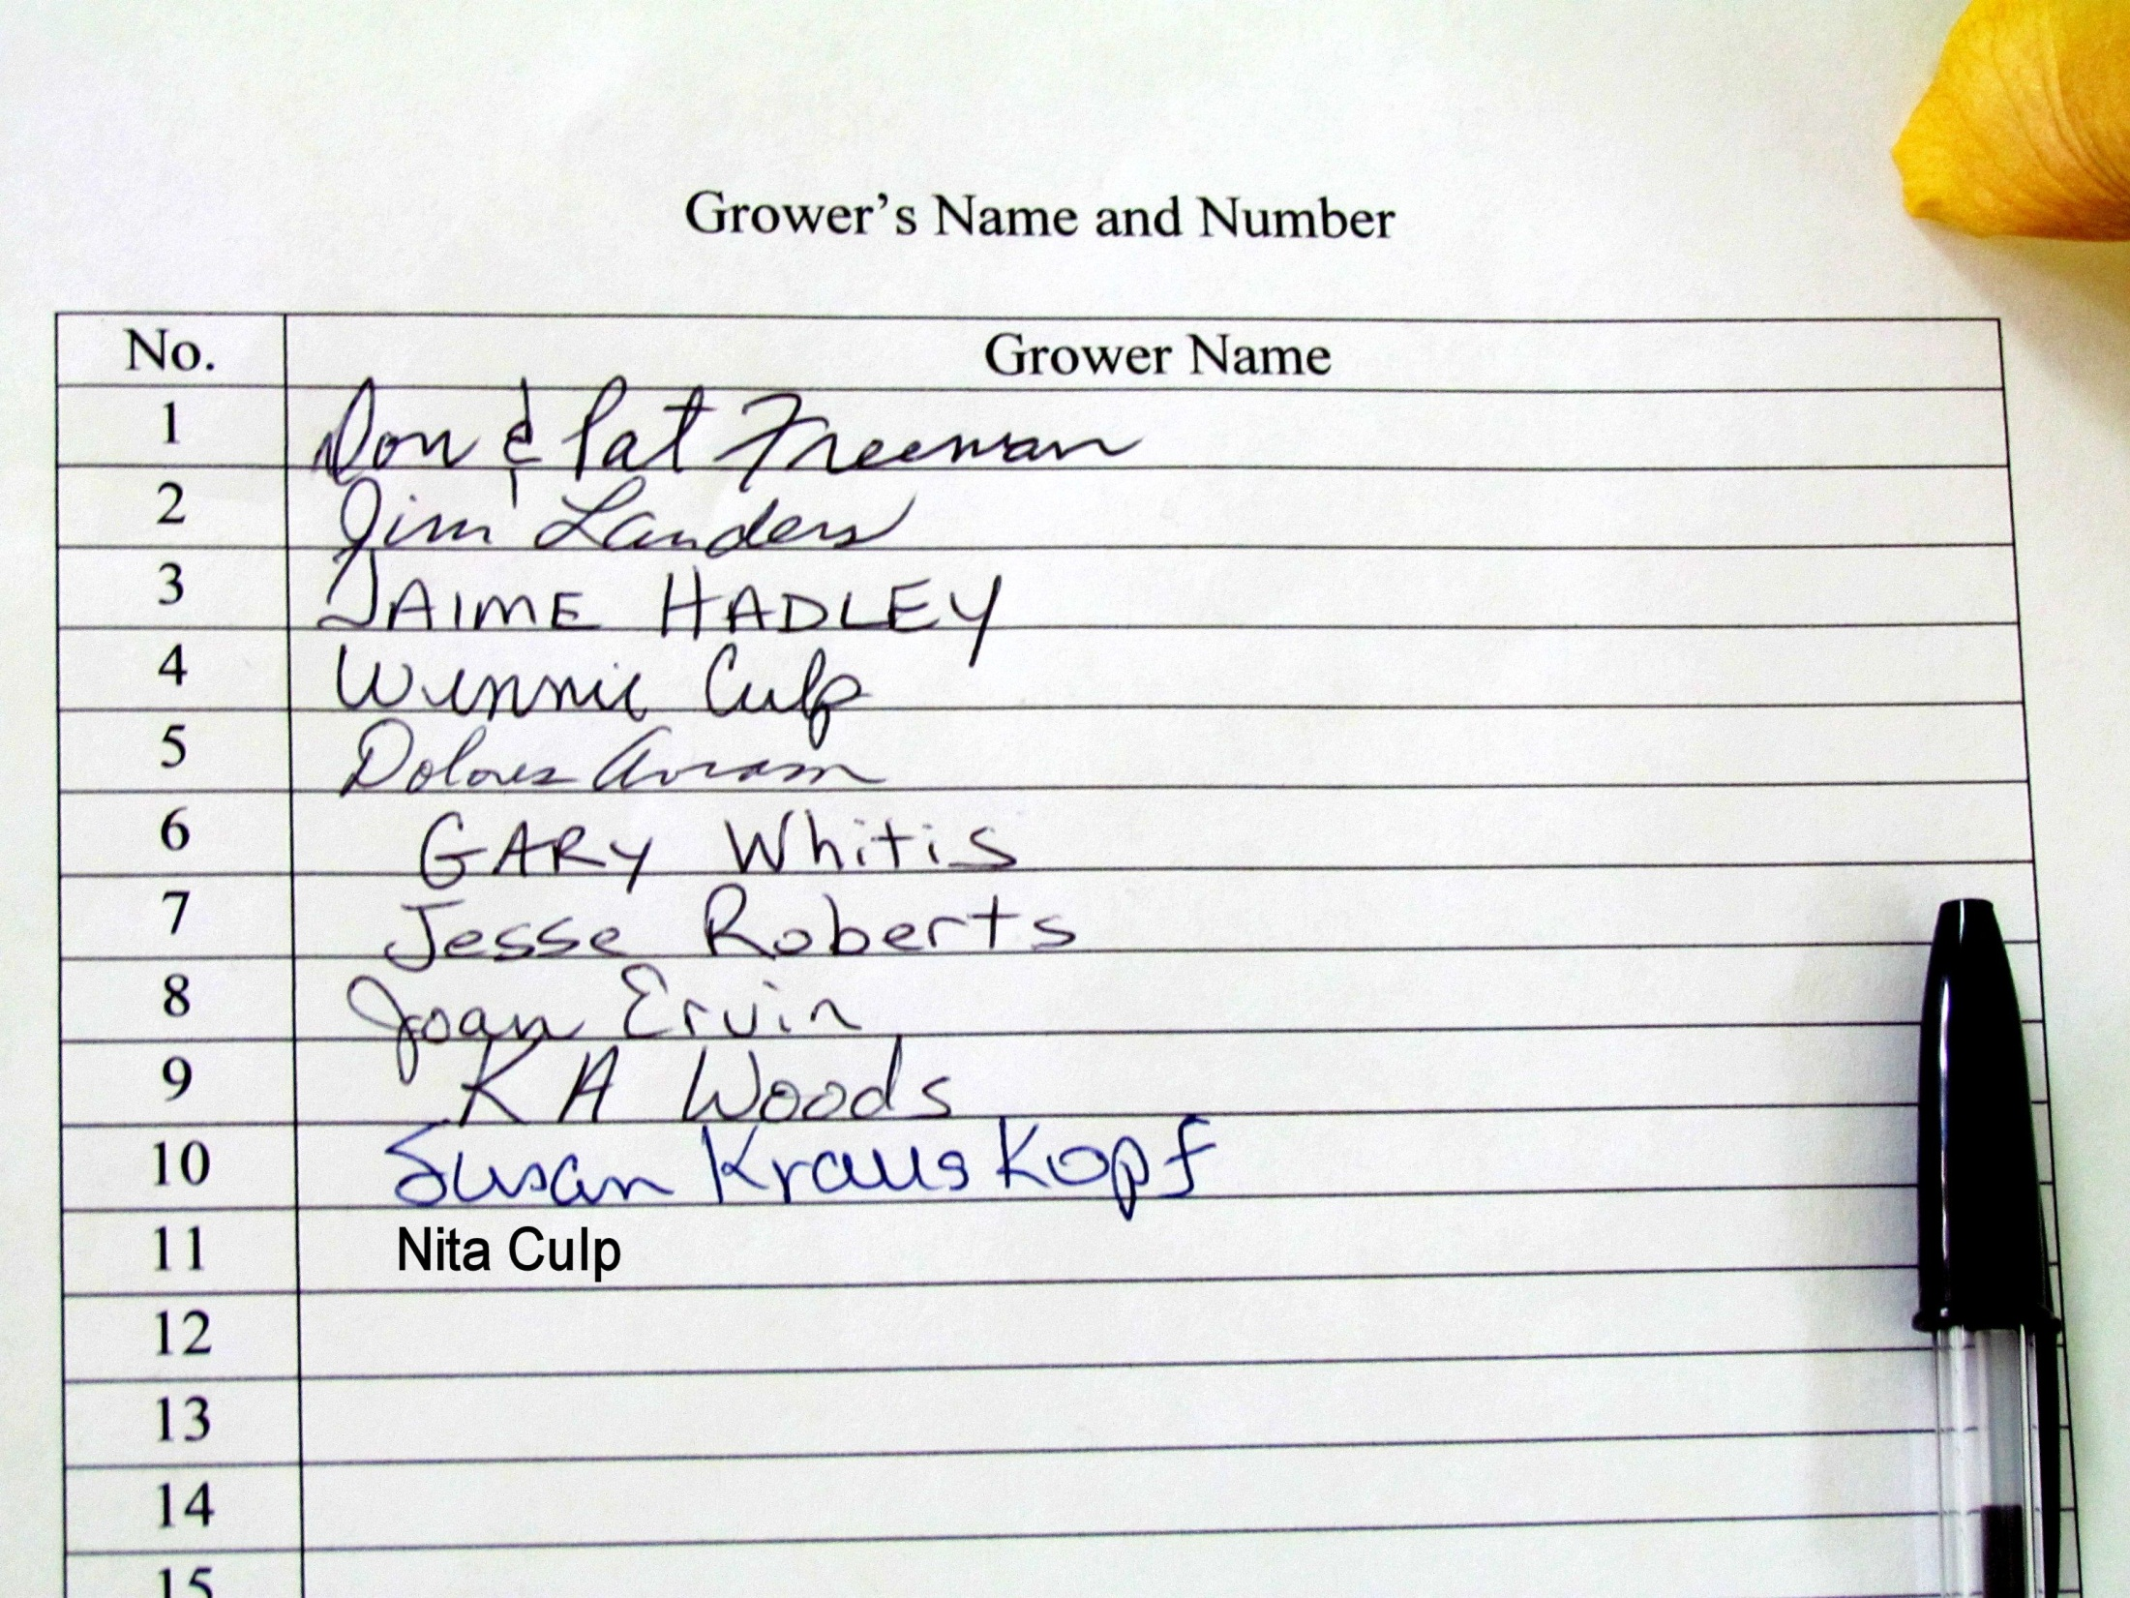

Slide 23
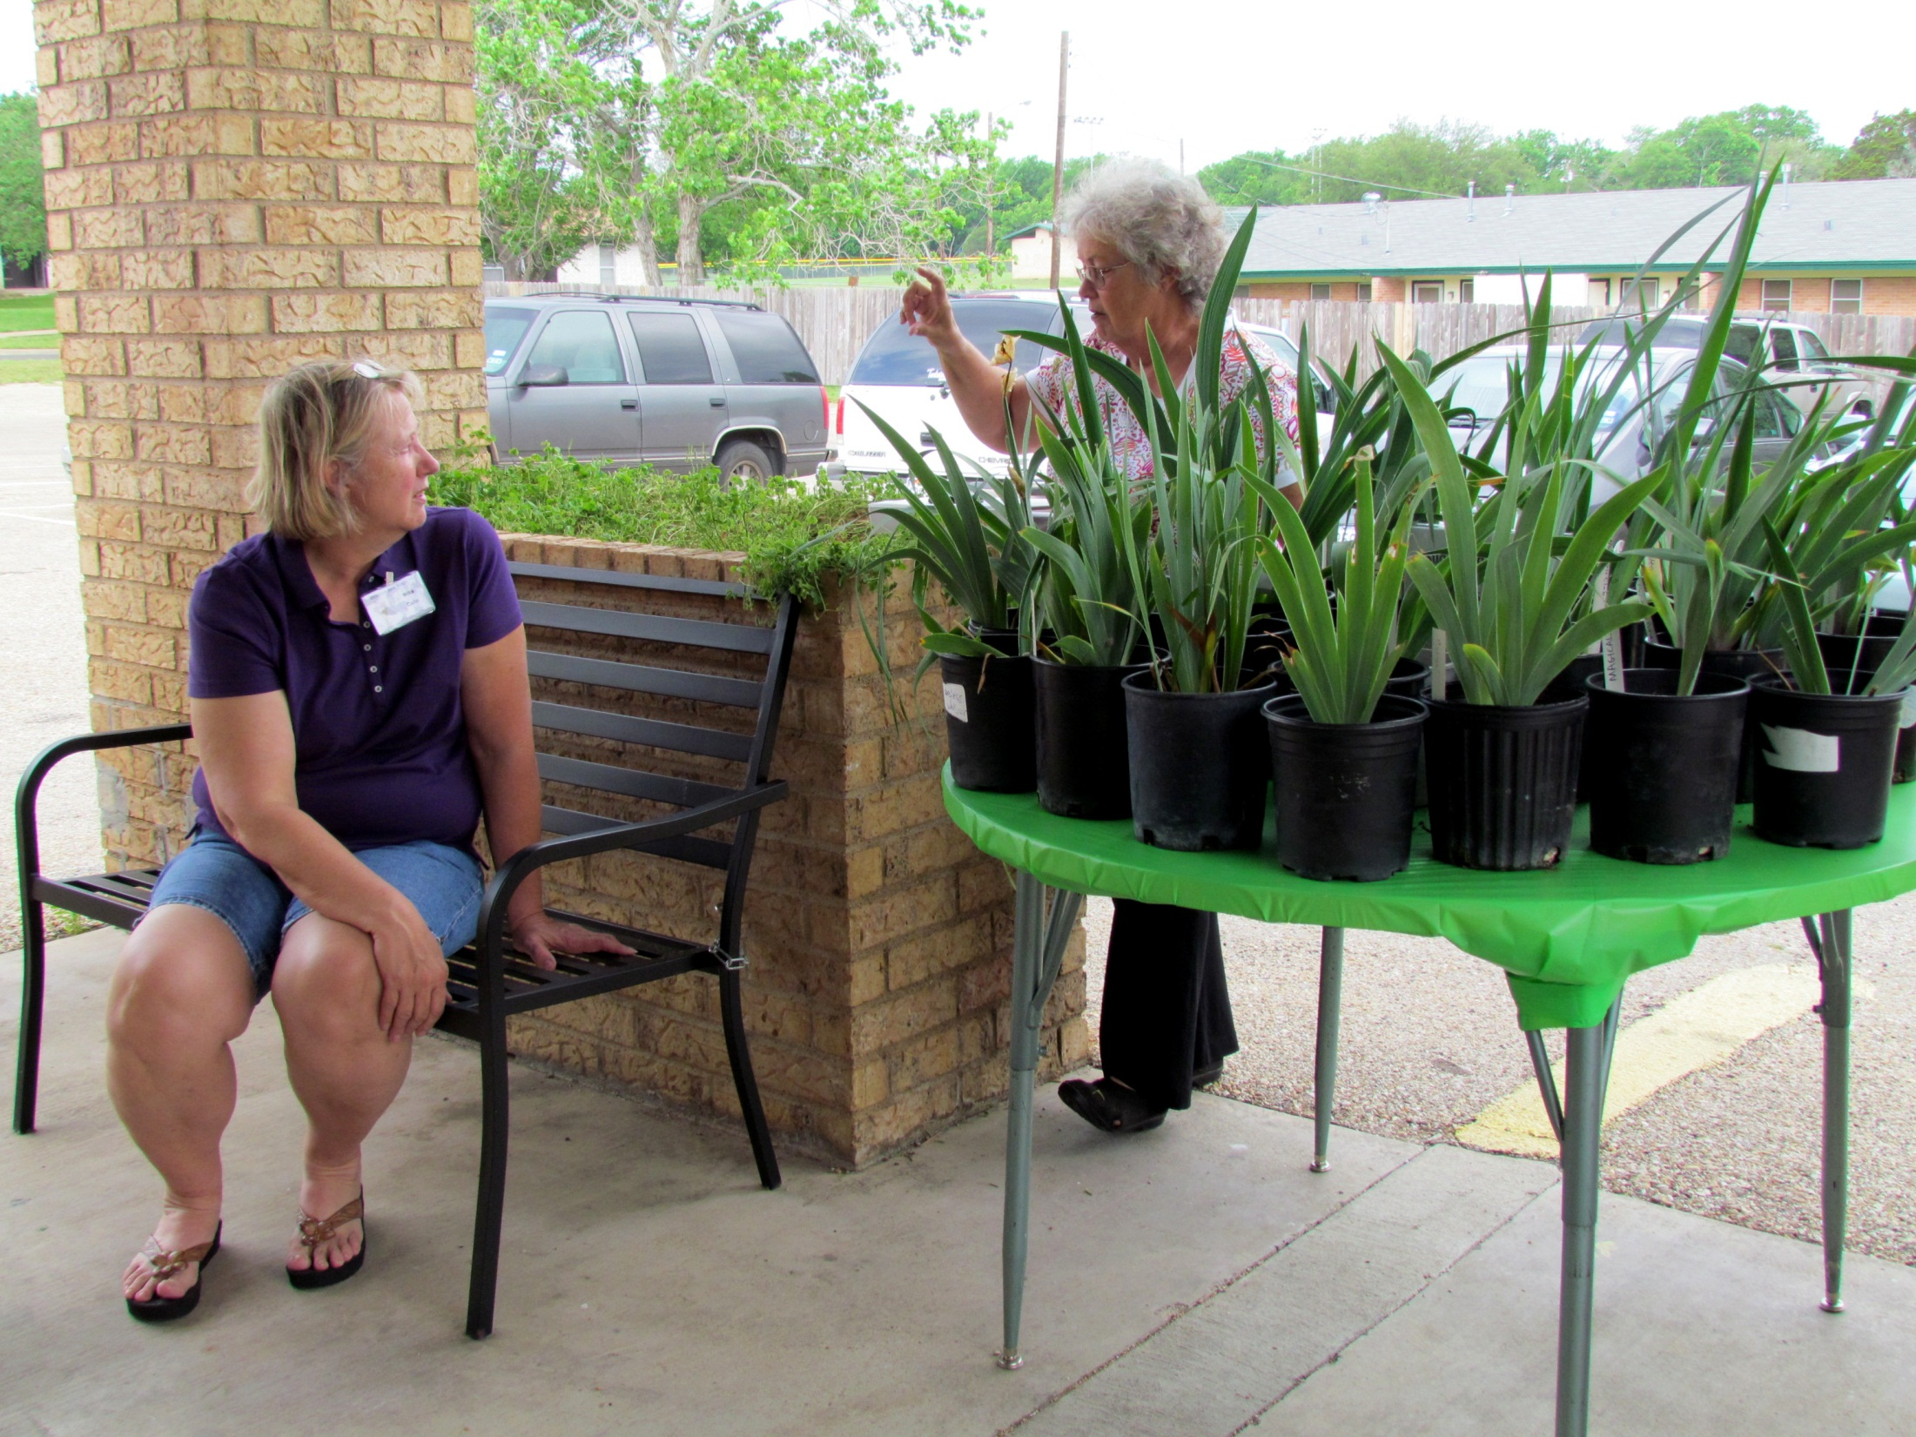
Potted irises are available for a modest donation.

Slide 24
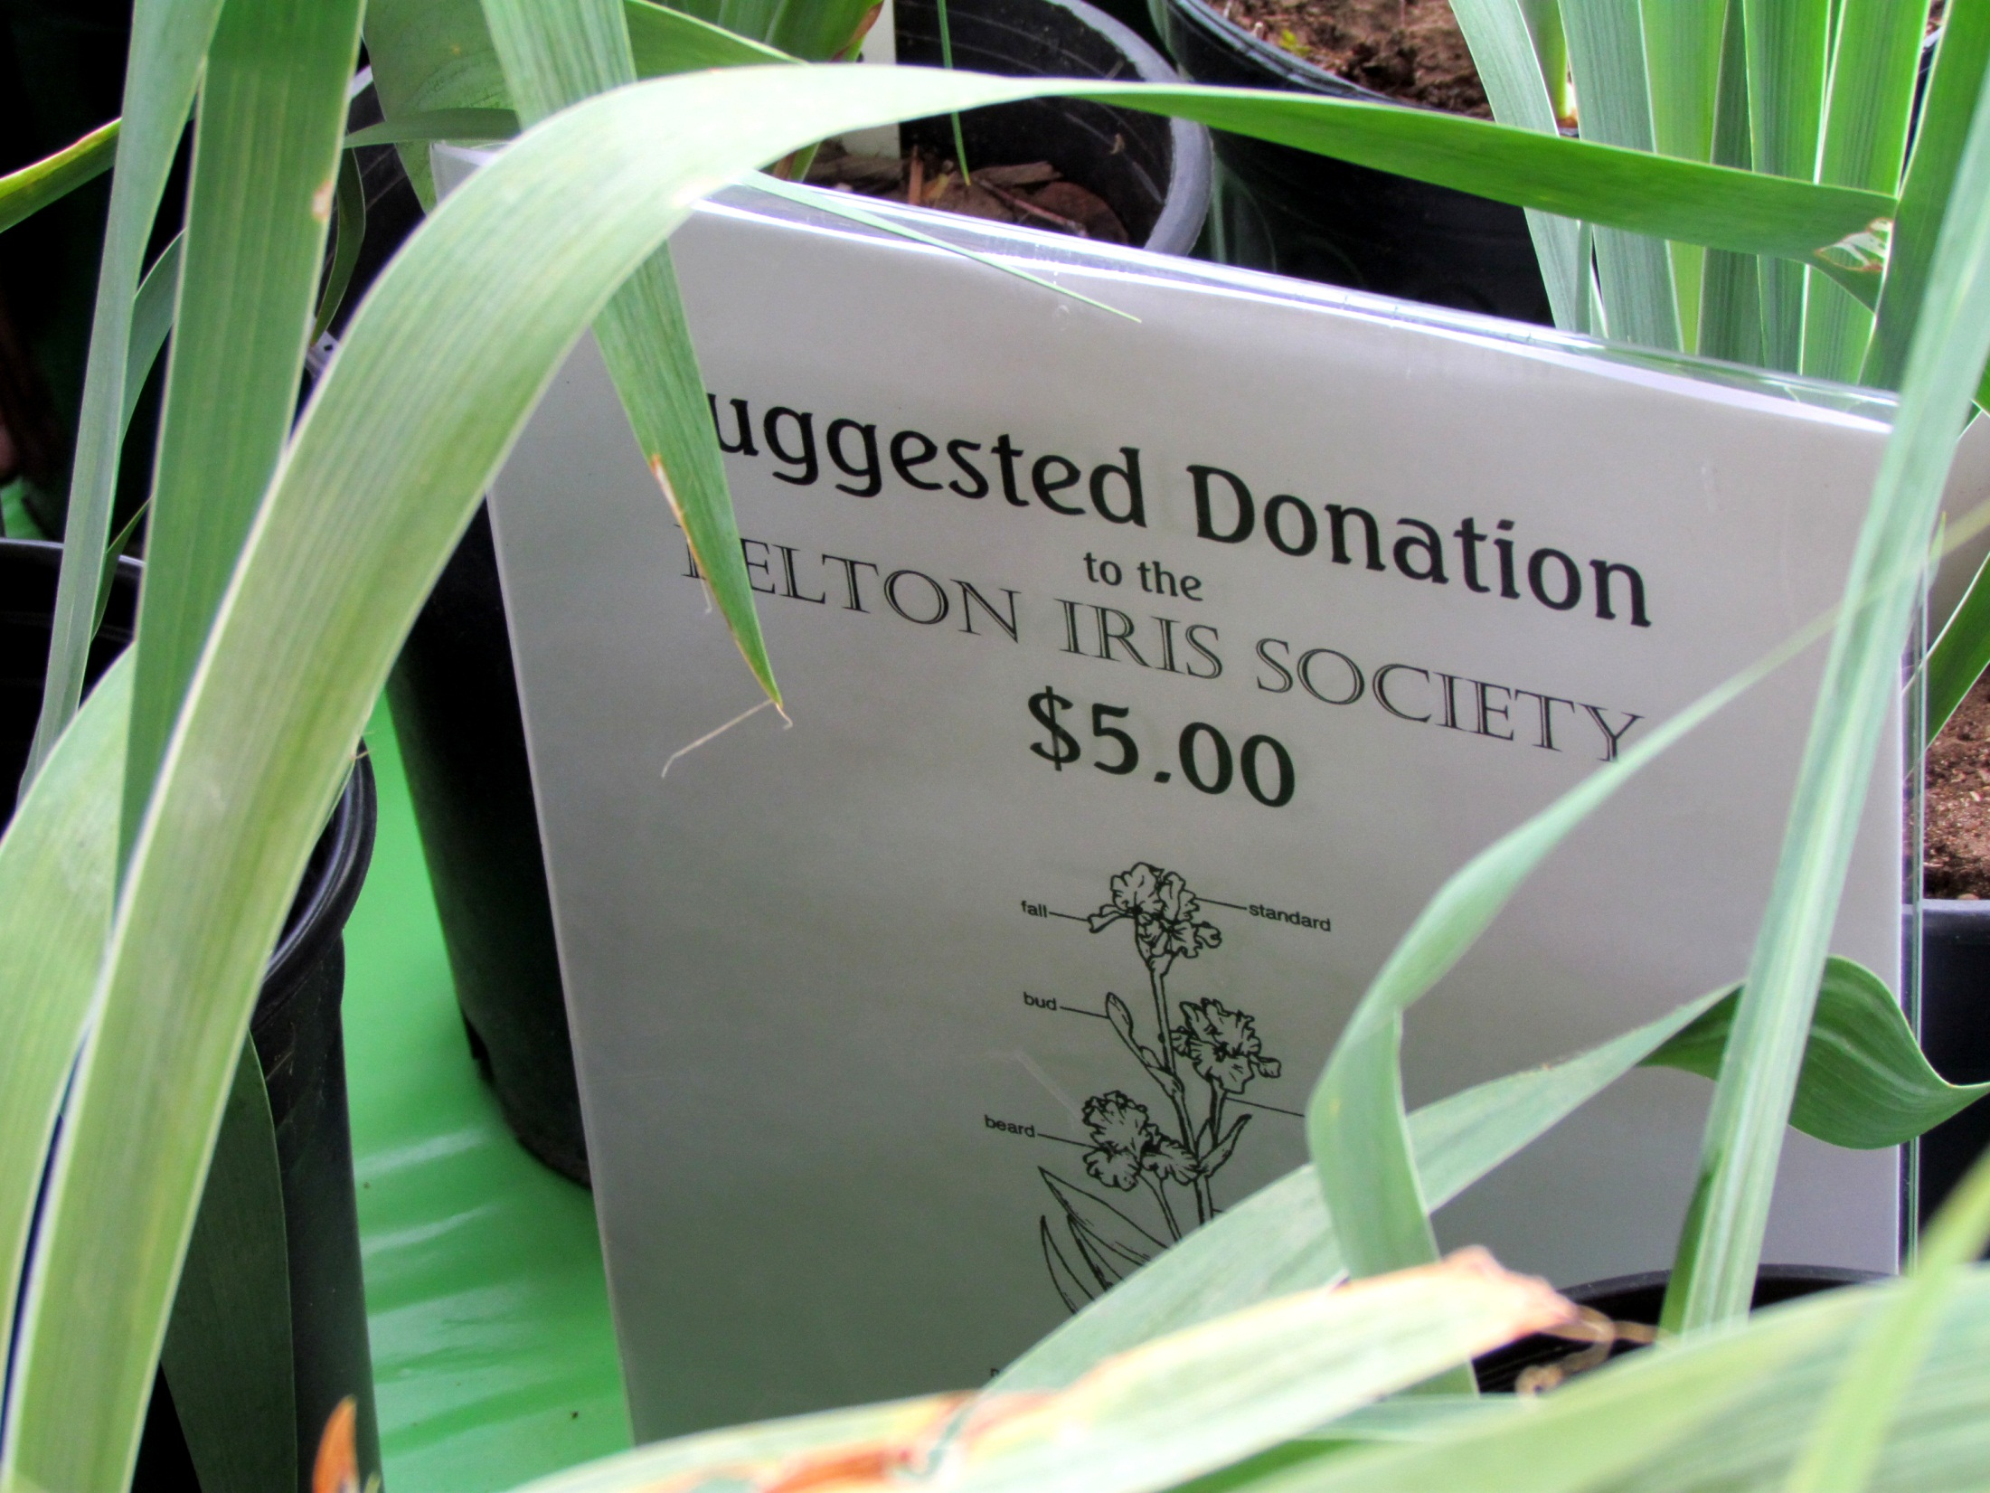

Slide 25
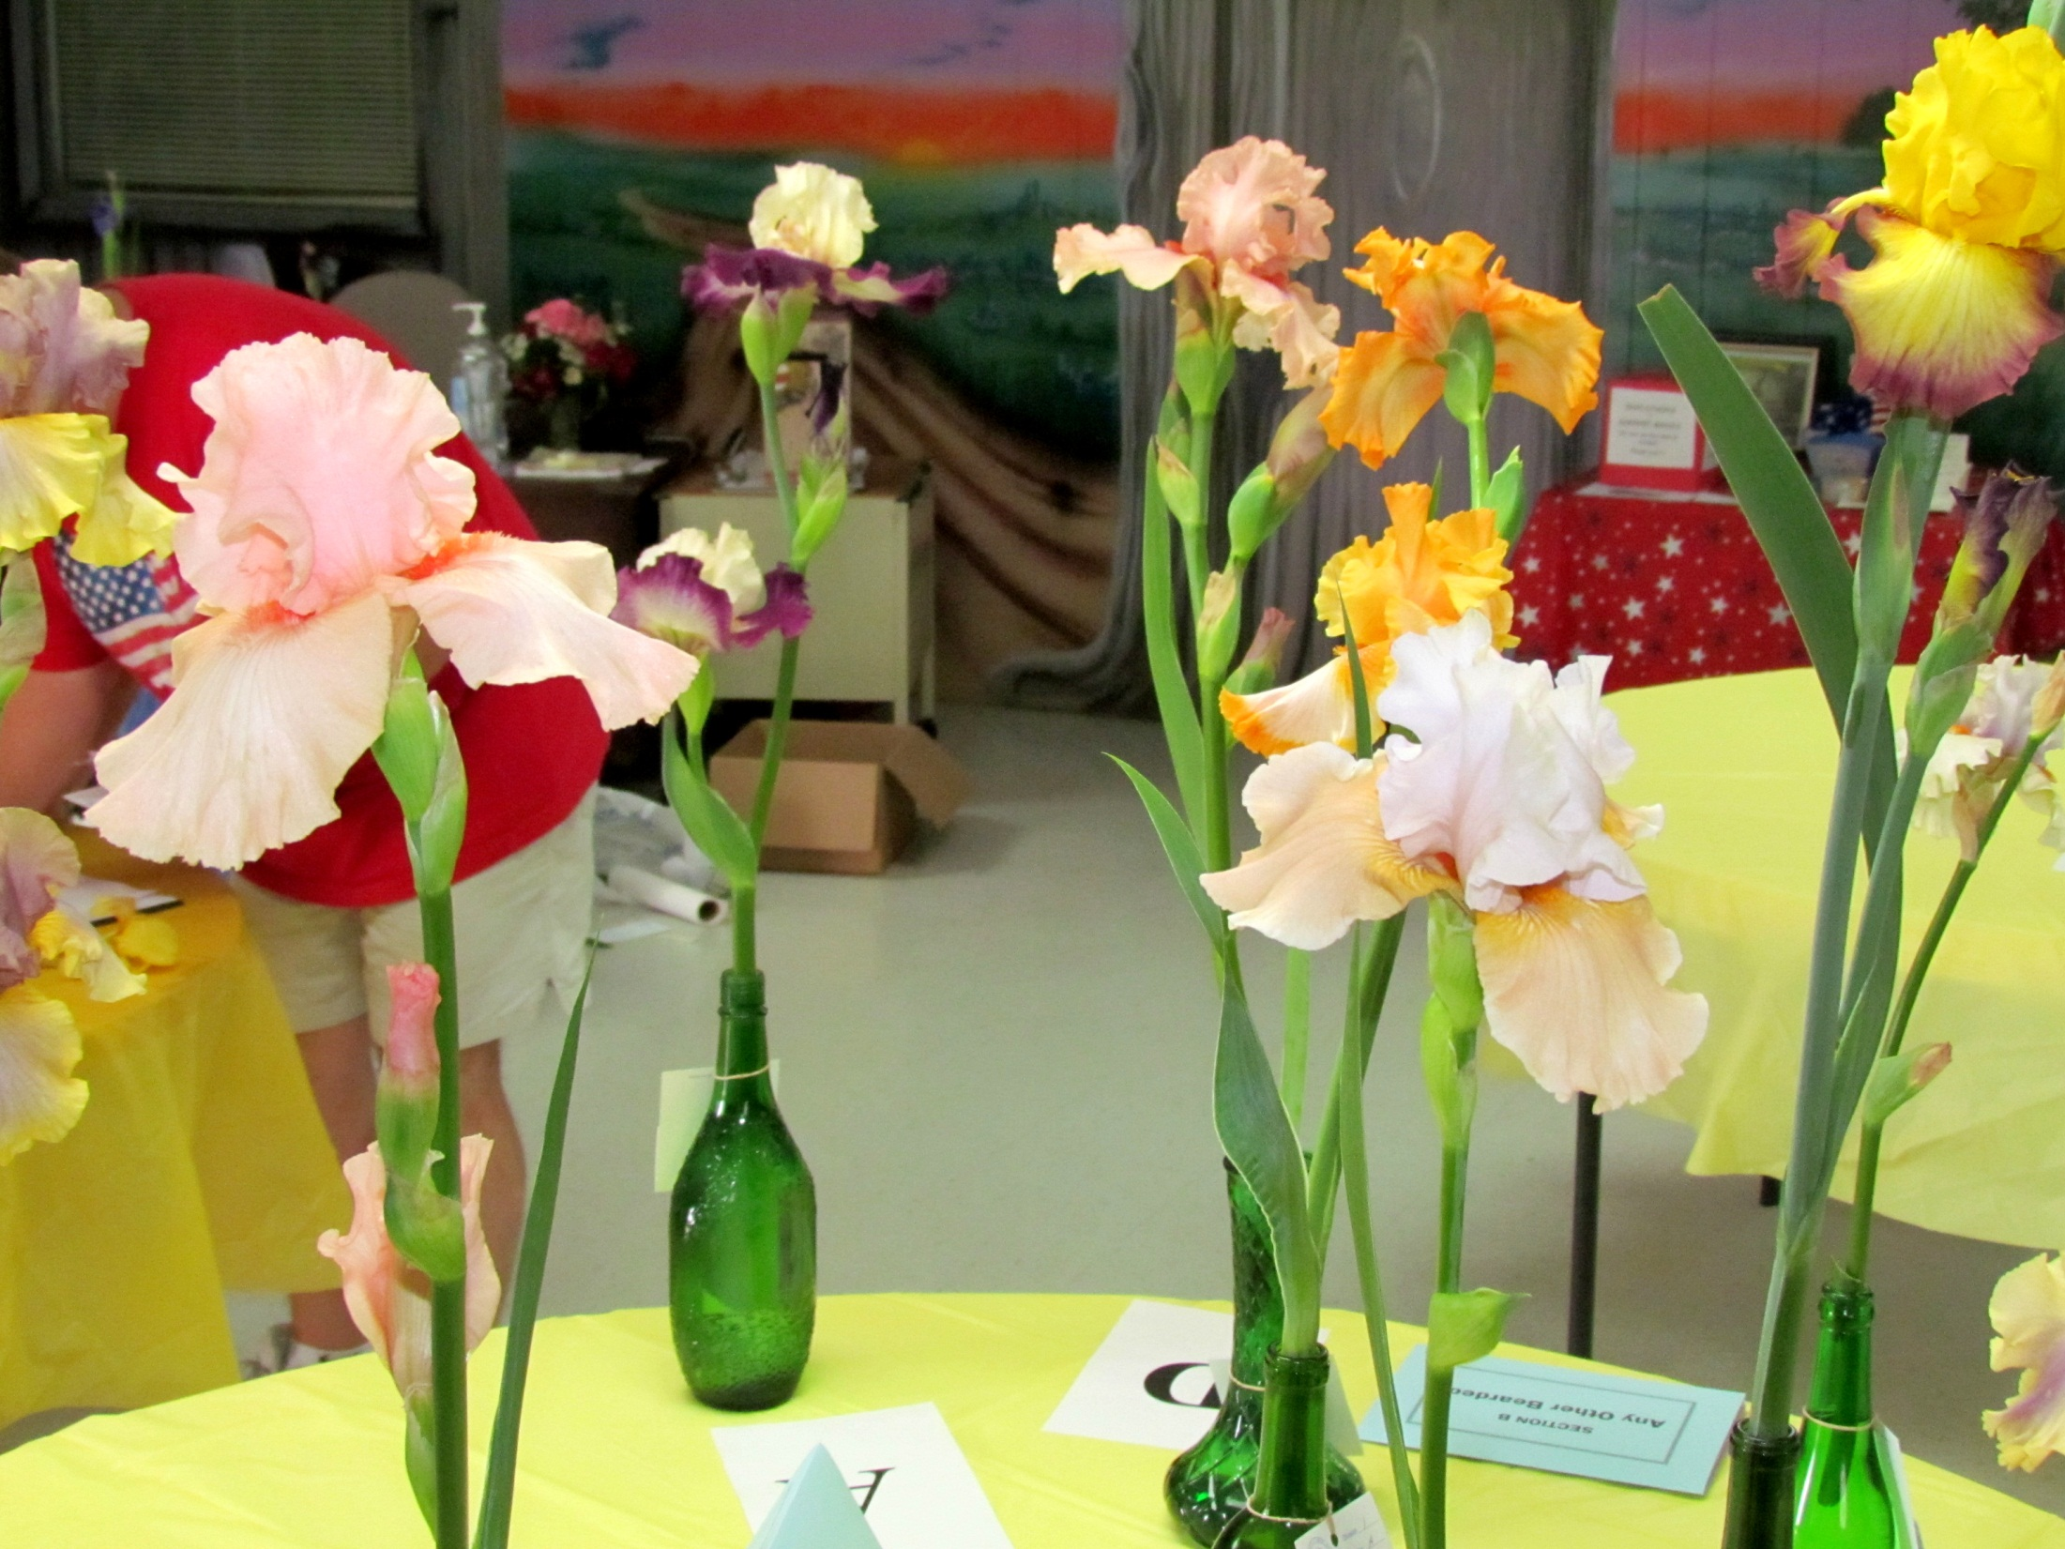
Tall Bearded irises ready for judging

Slide 26
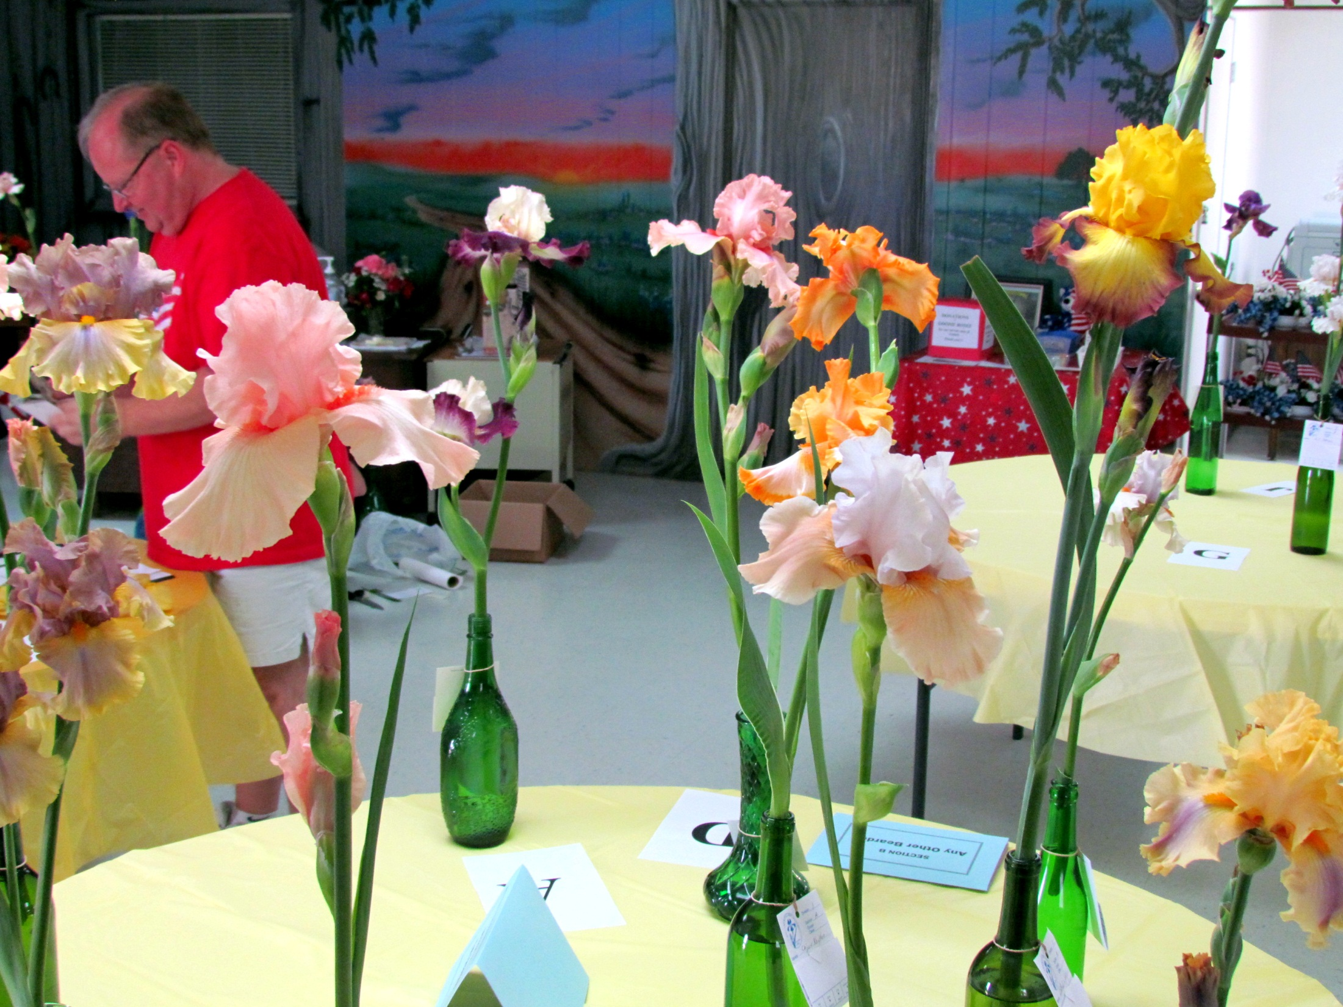

Slide 27
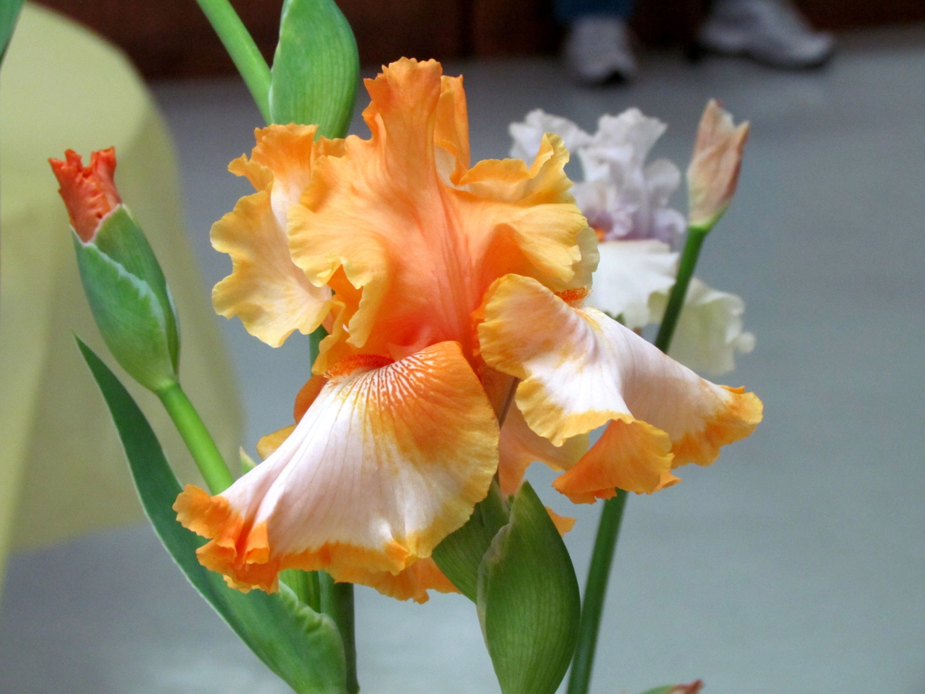
'Cajun Rhythm'

Slide 28
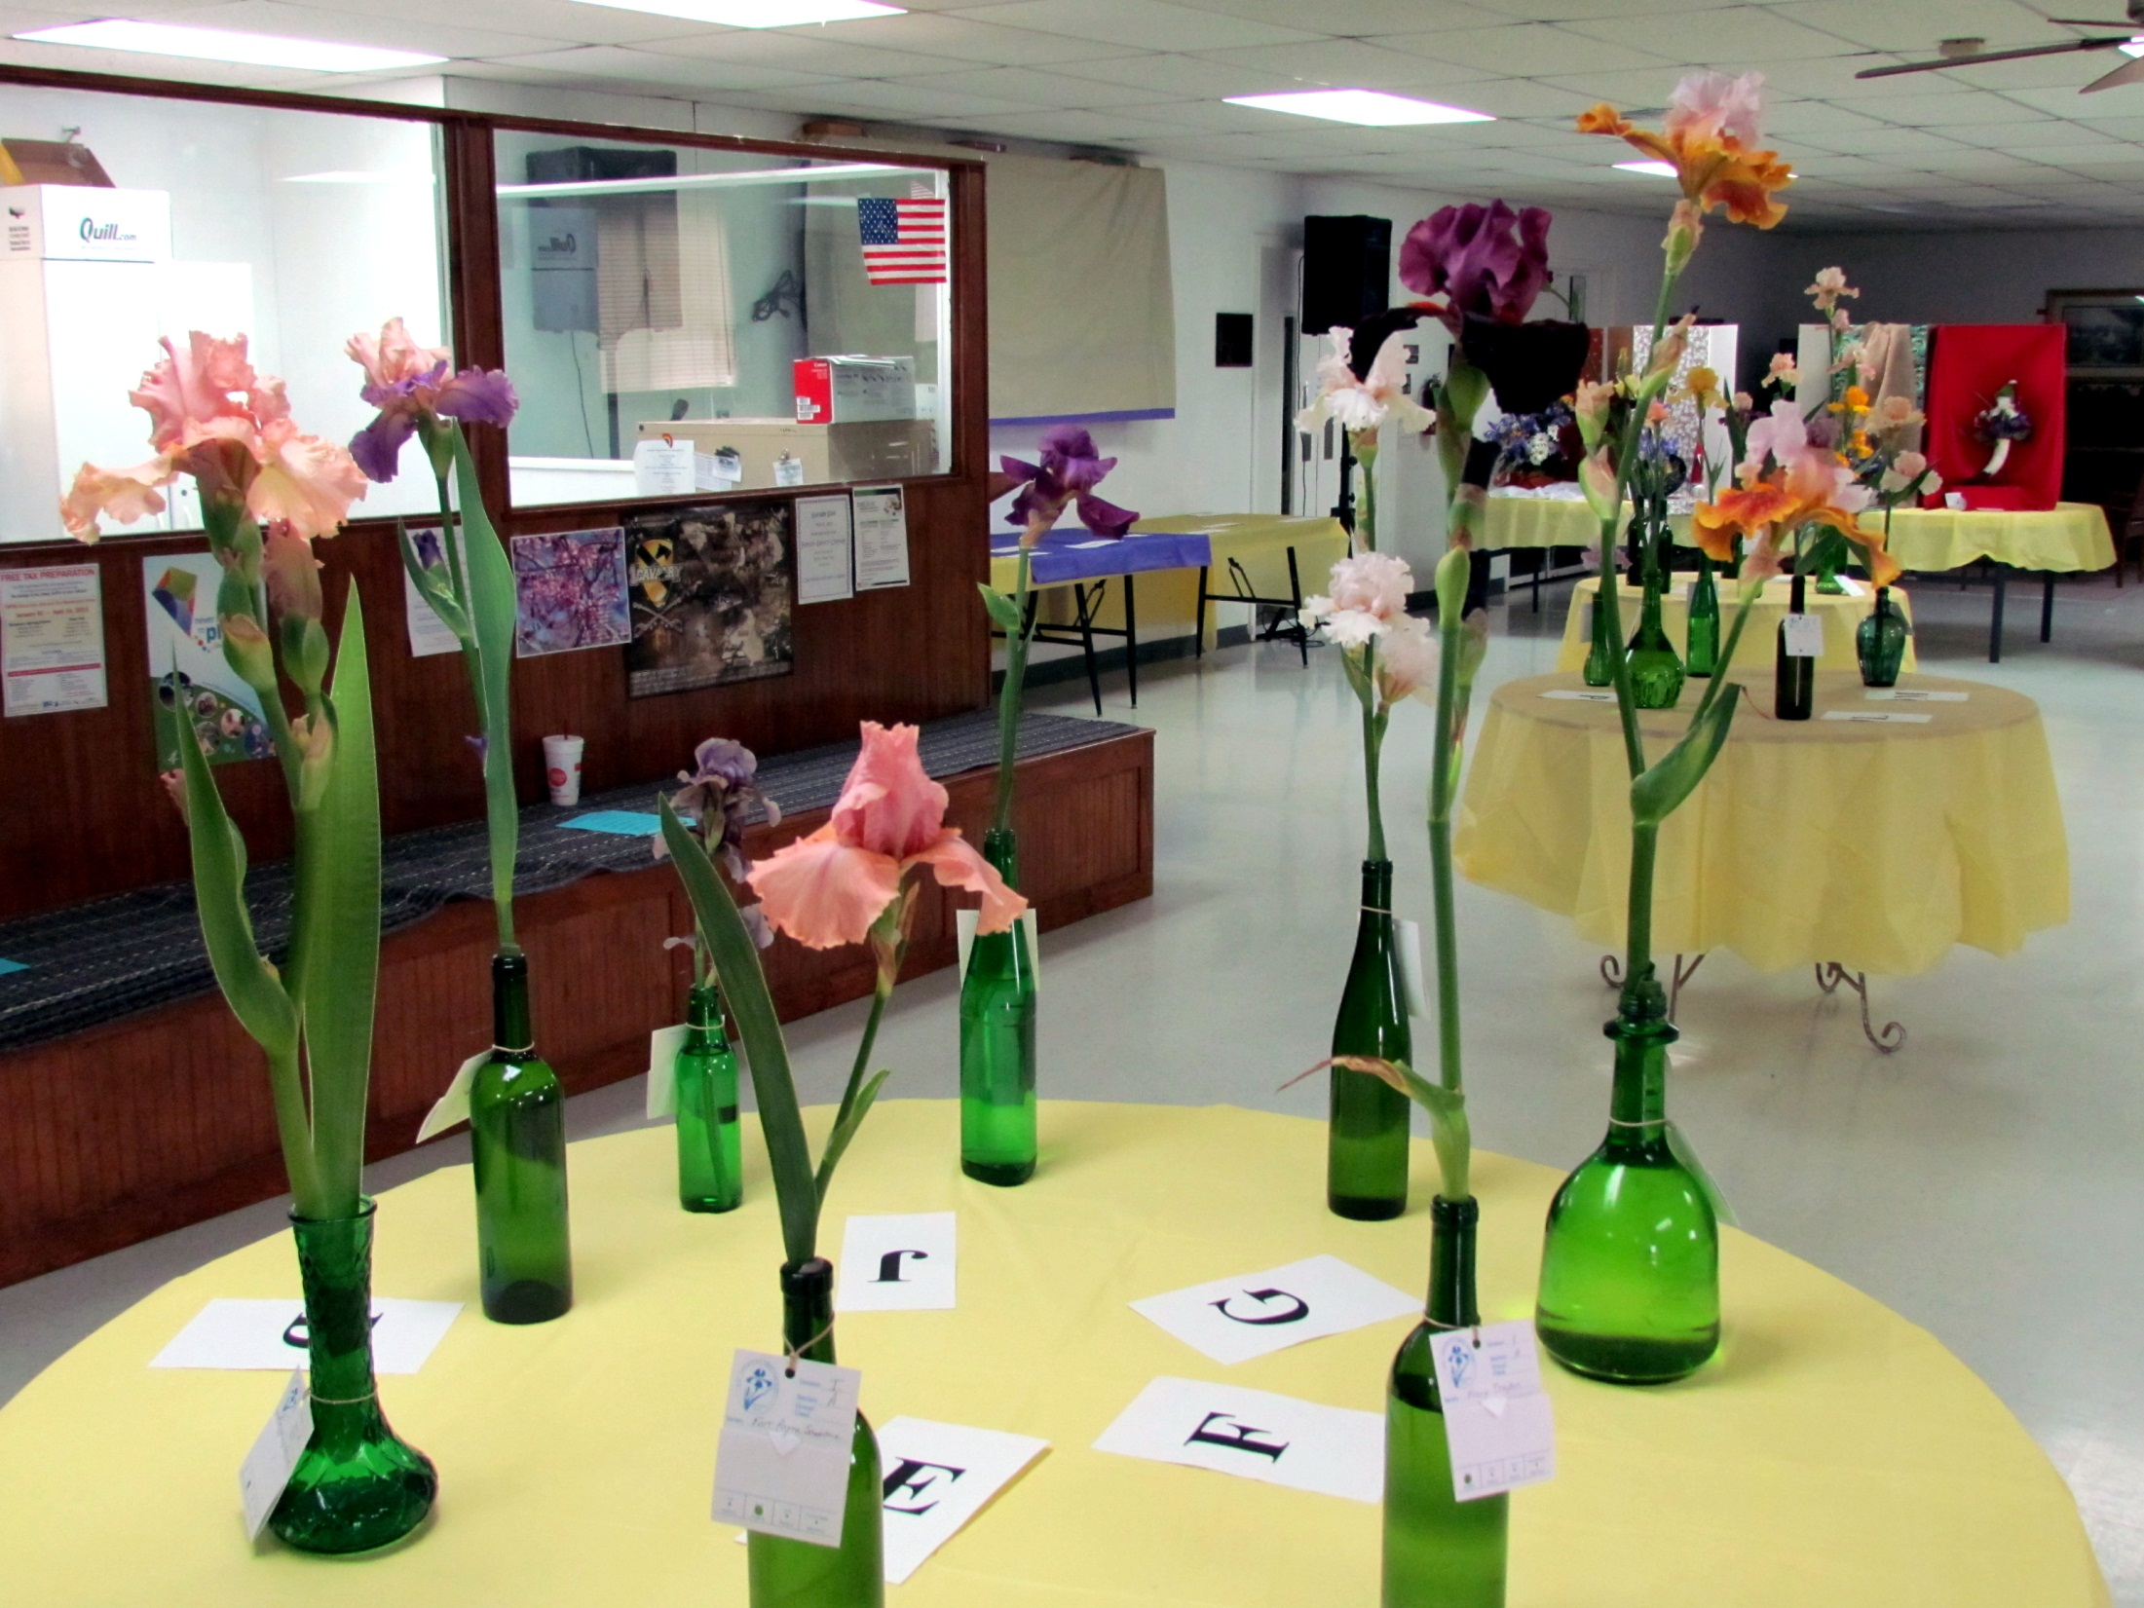

Slide 29
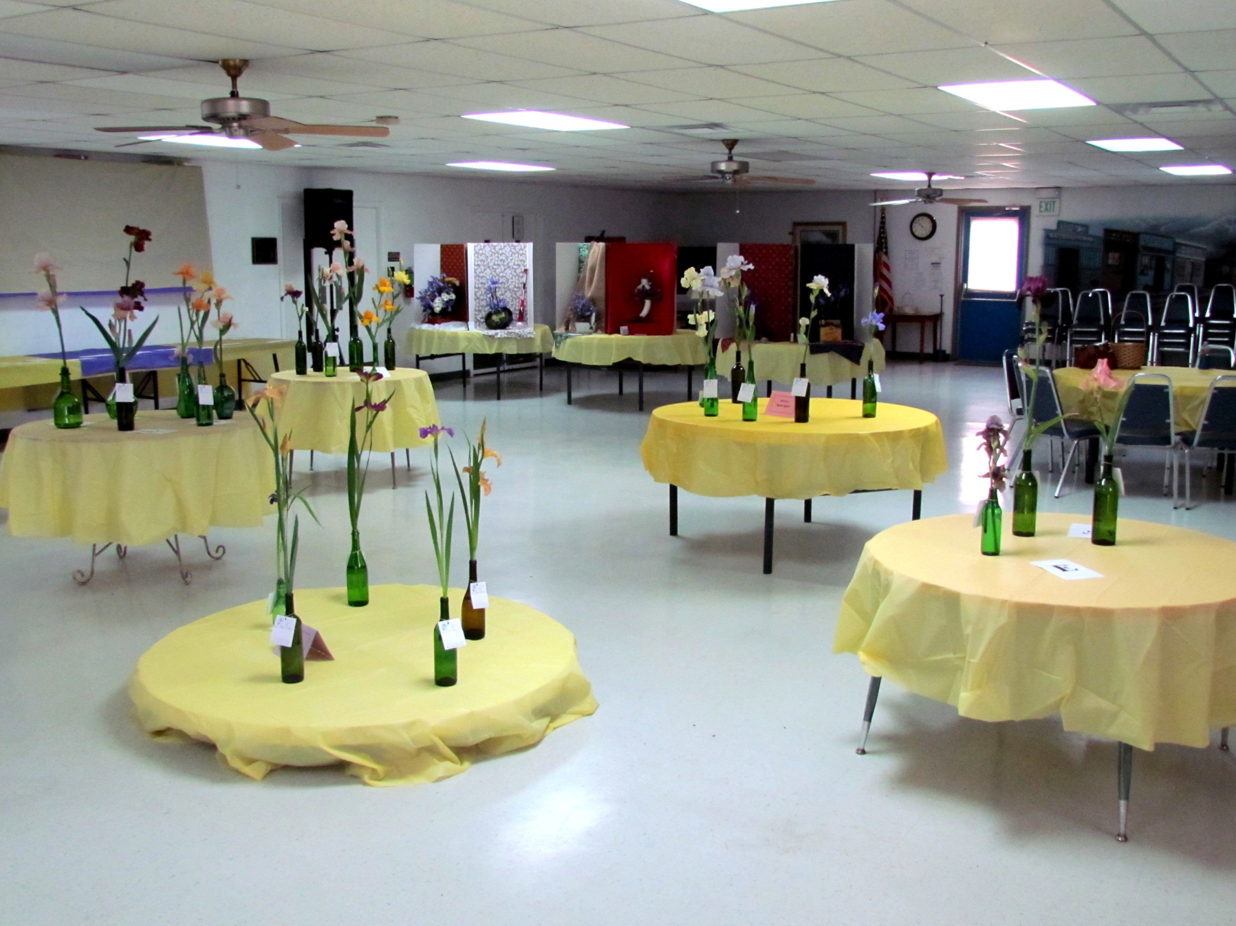

Slide 30
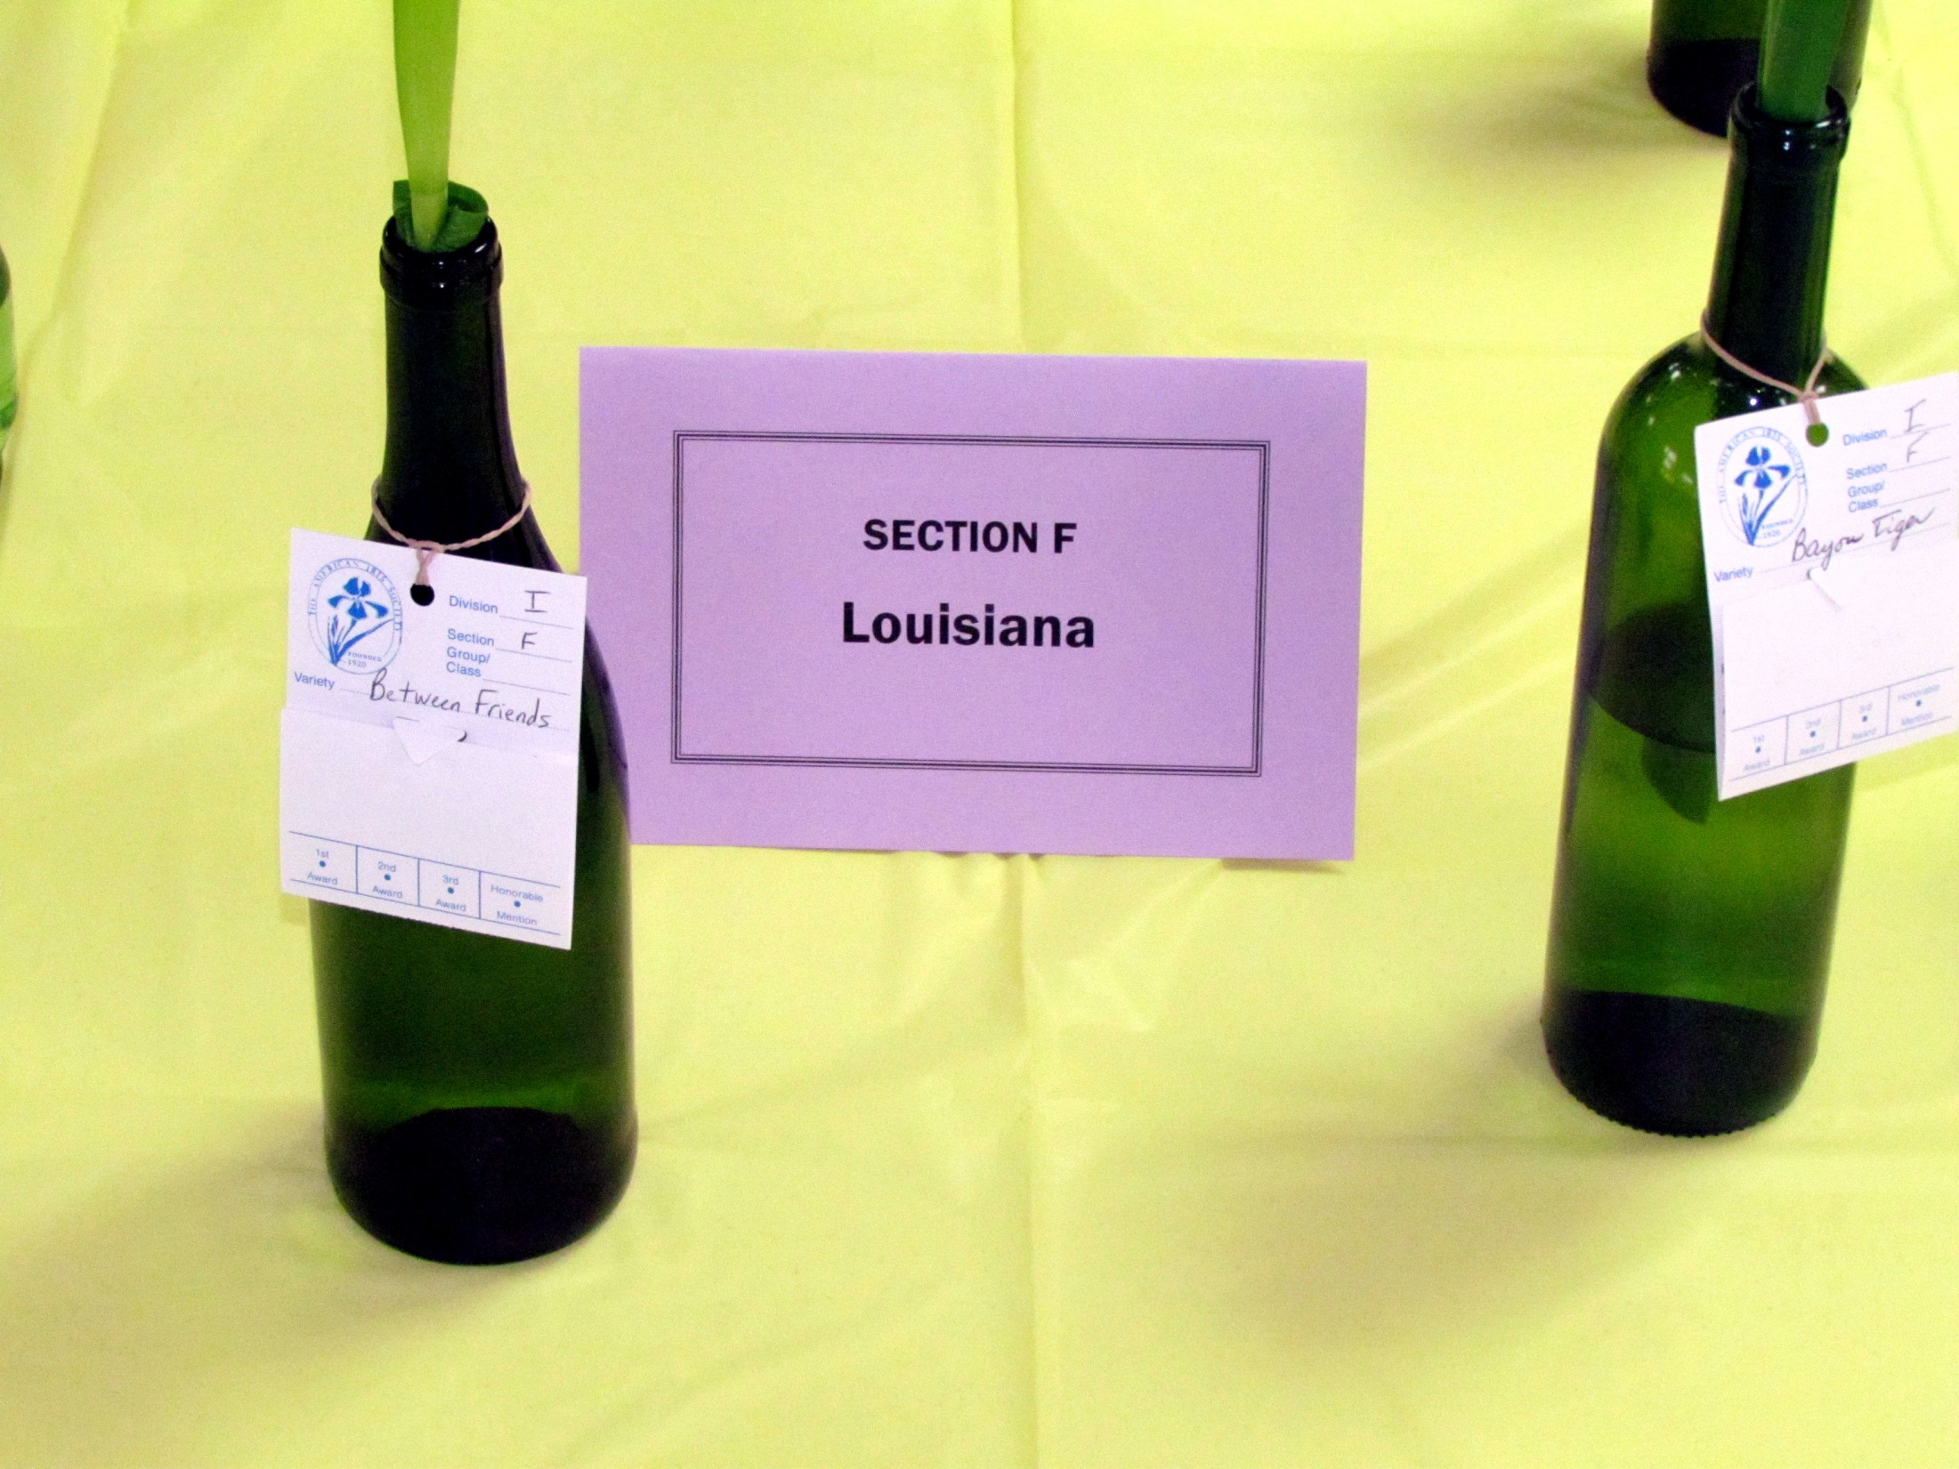

Slide 31
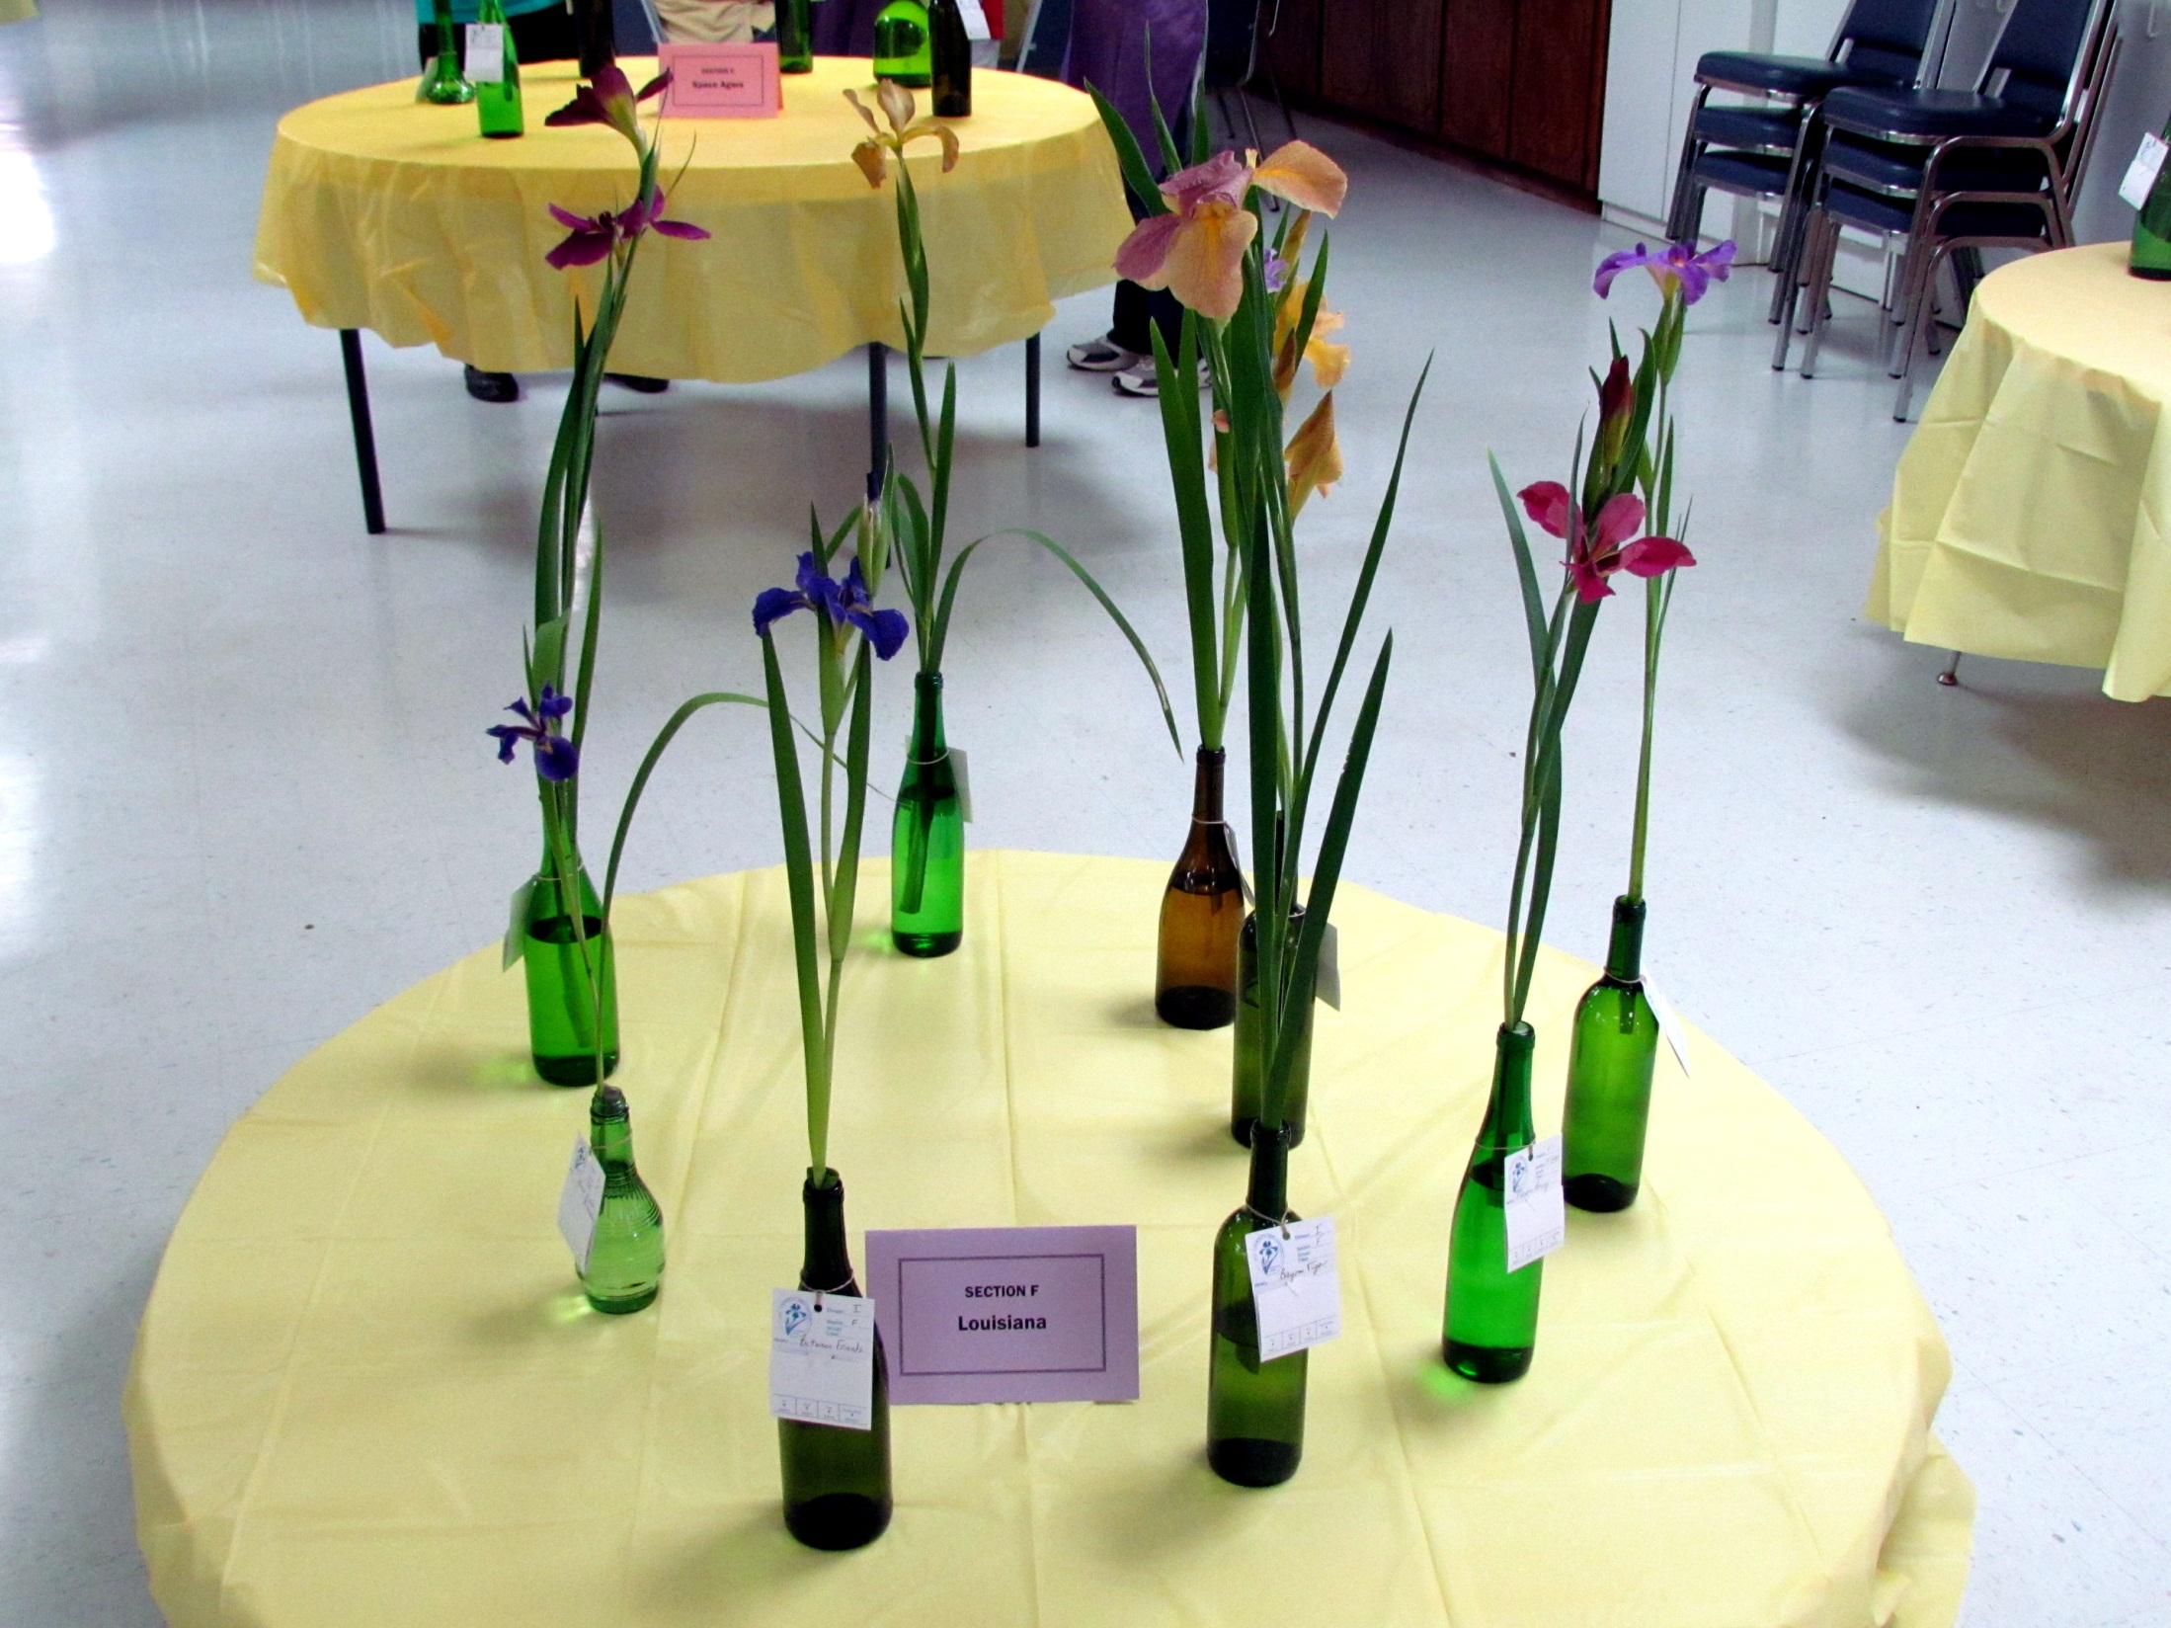

Slide 32
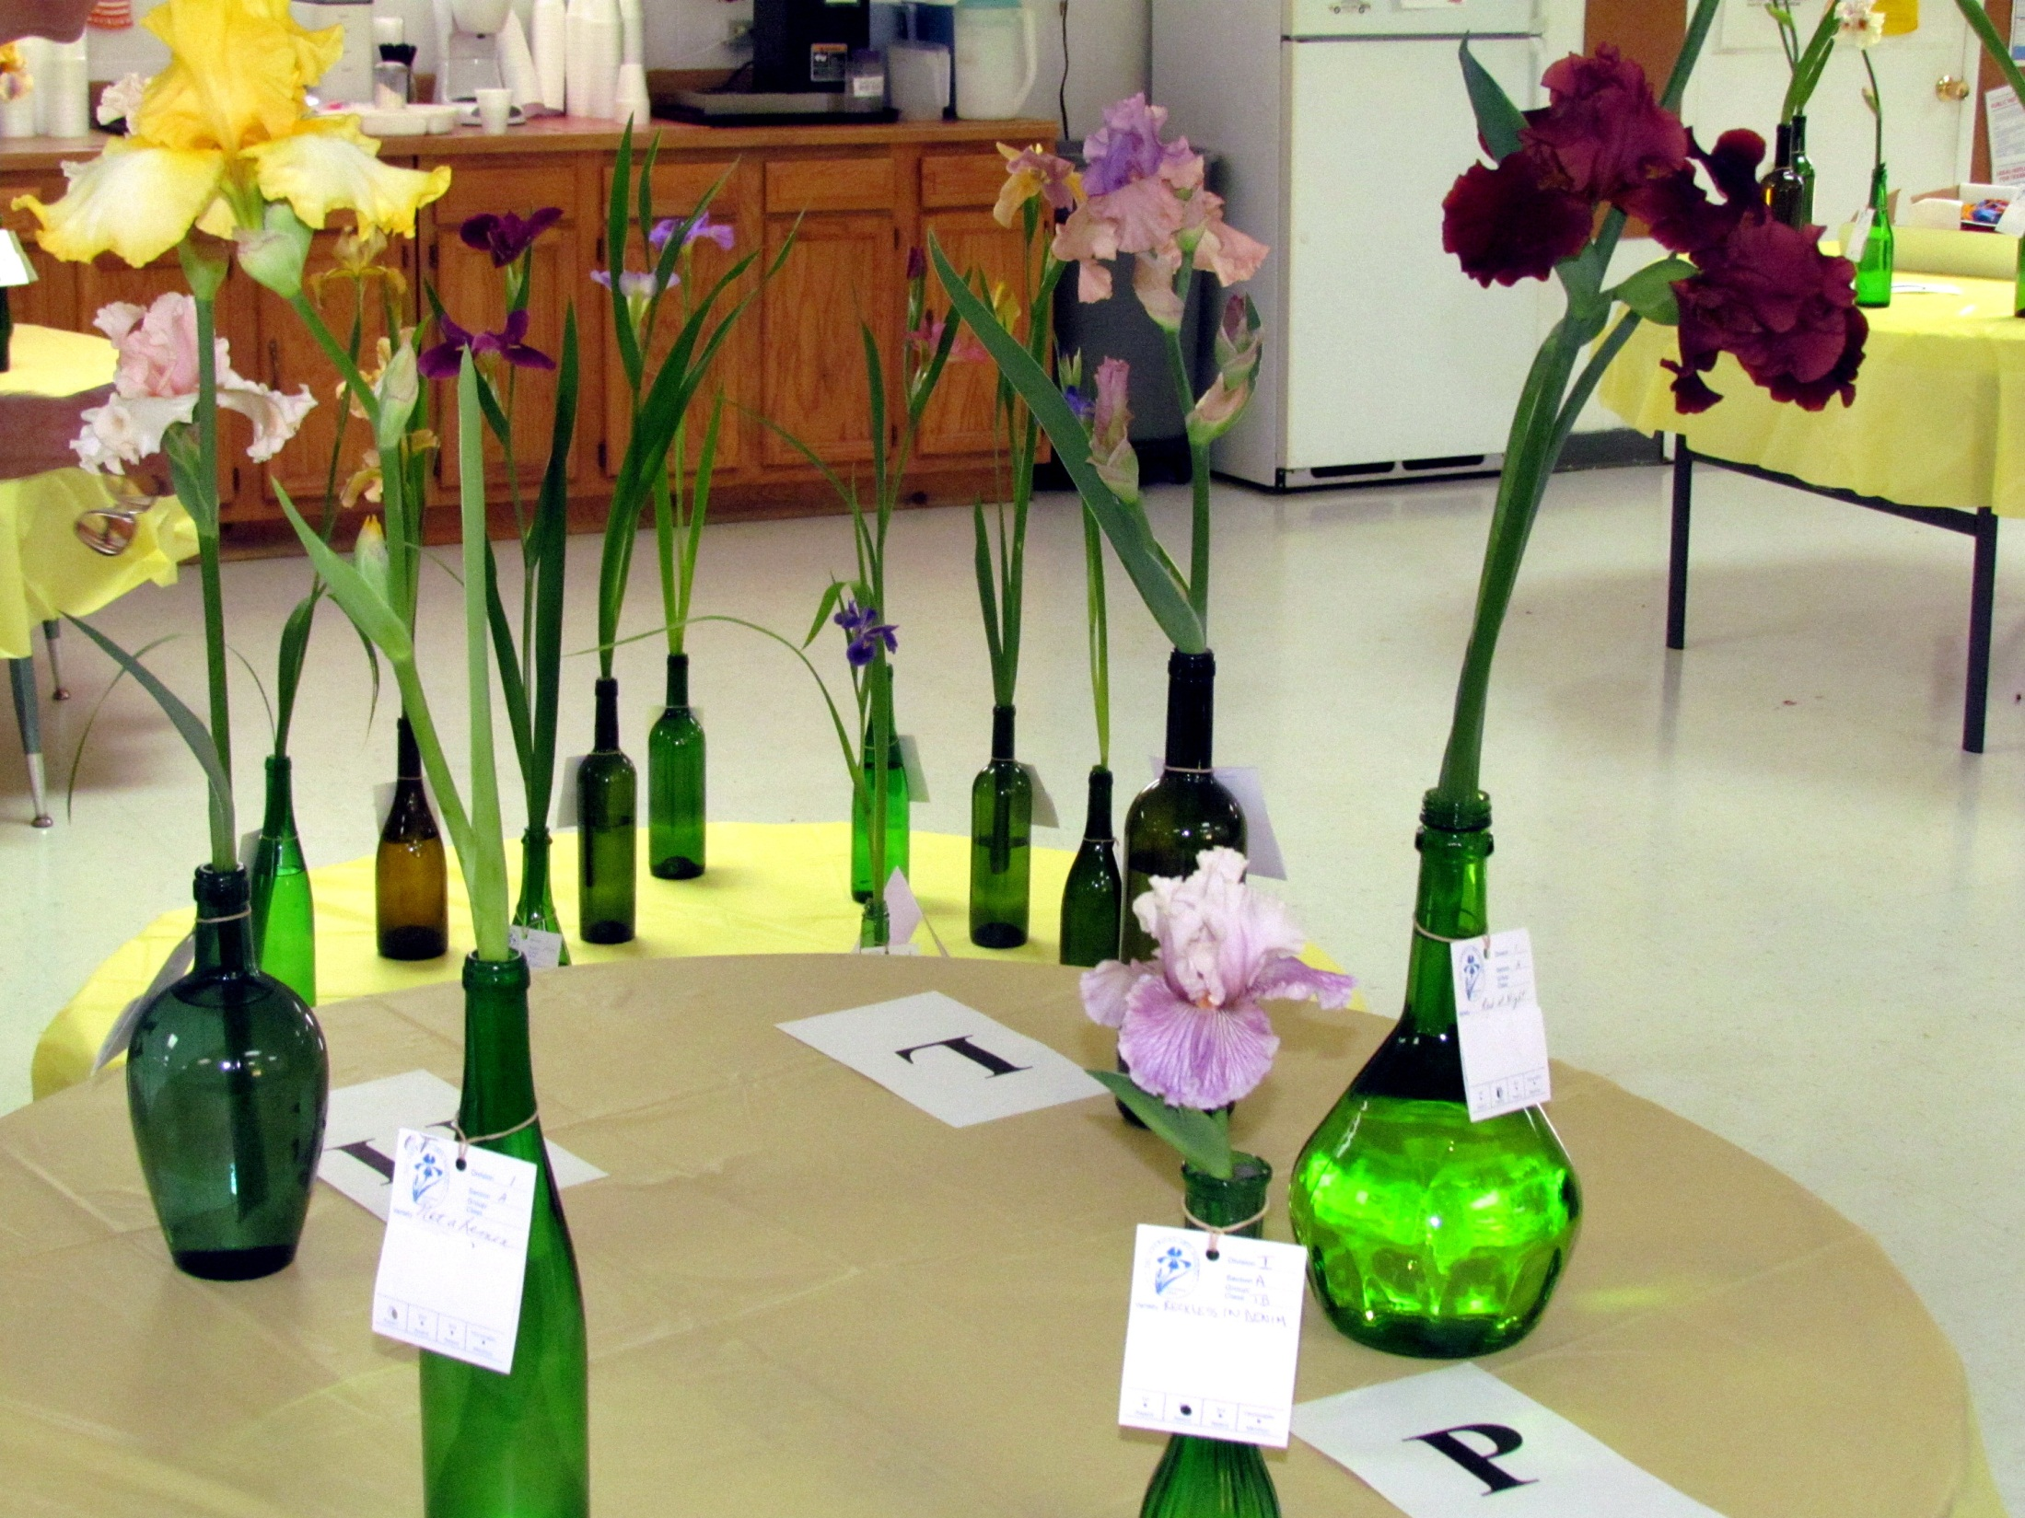

Slide 33
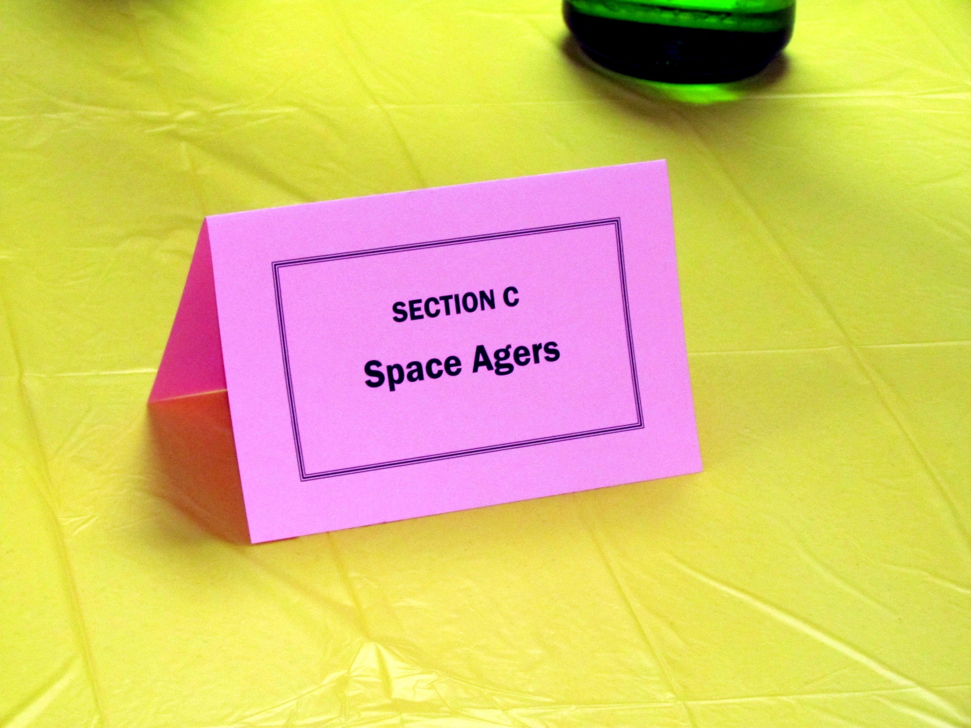

Slide 34
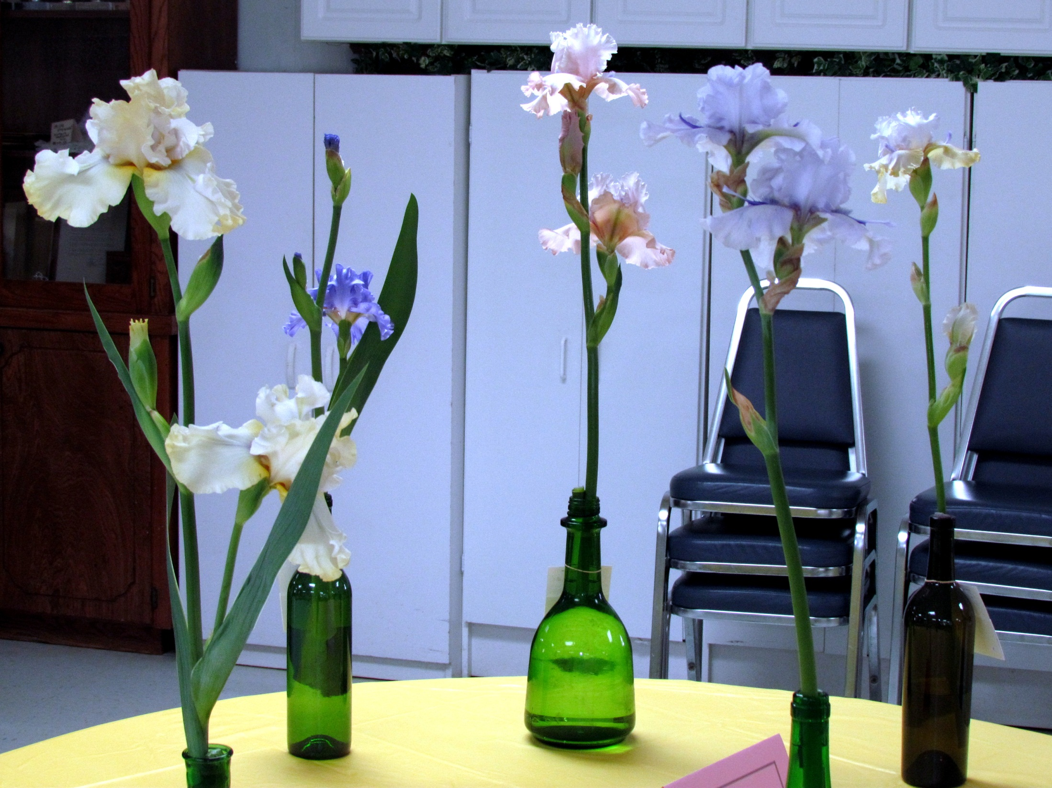

Slide 35
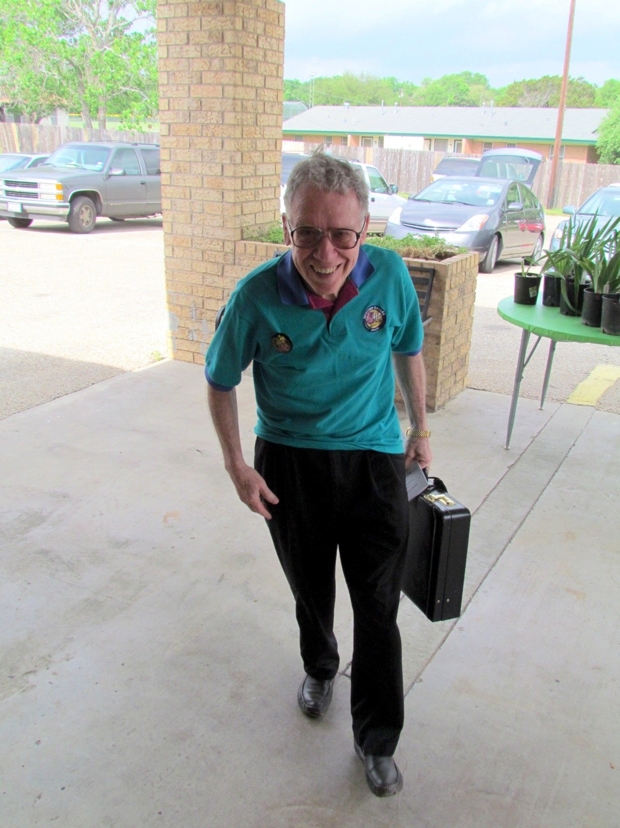
Show Judge Dr. Lew Begley from Mesquite arrives for the Show.

Slide 36
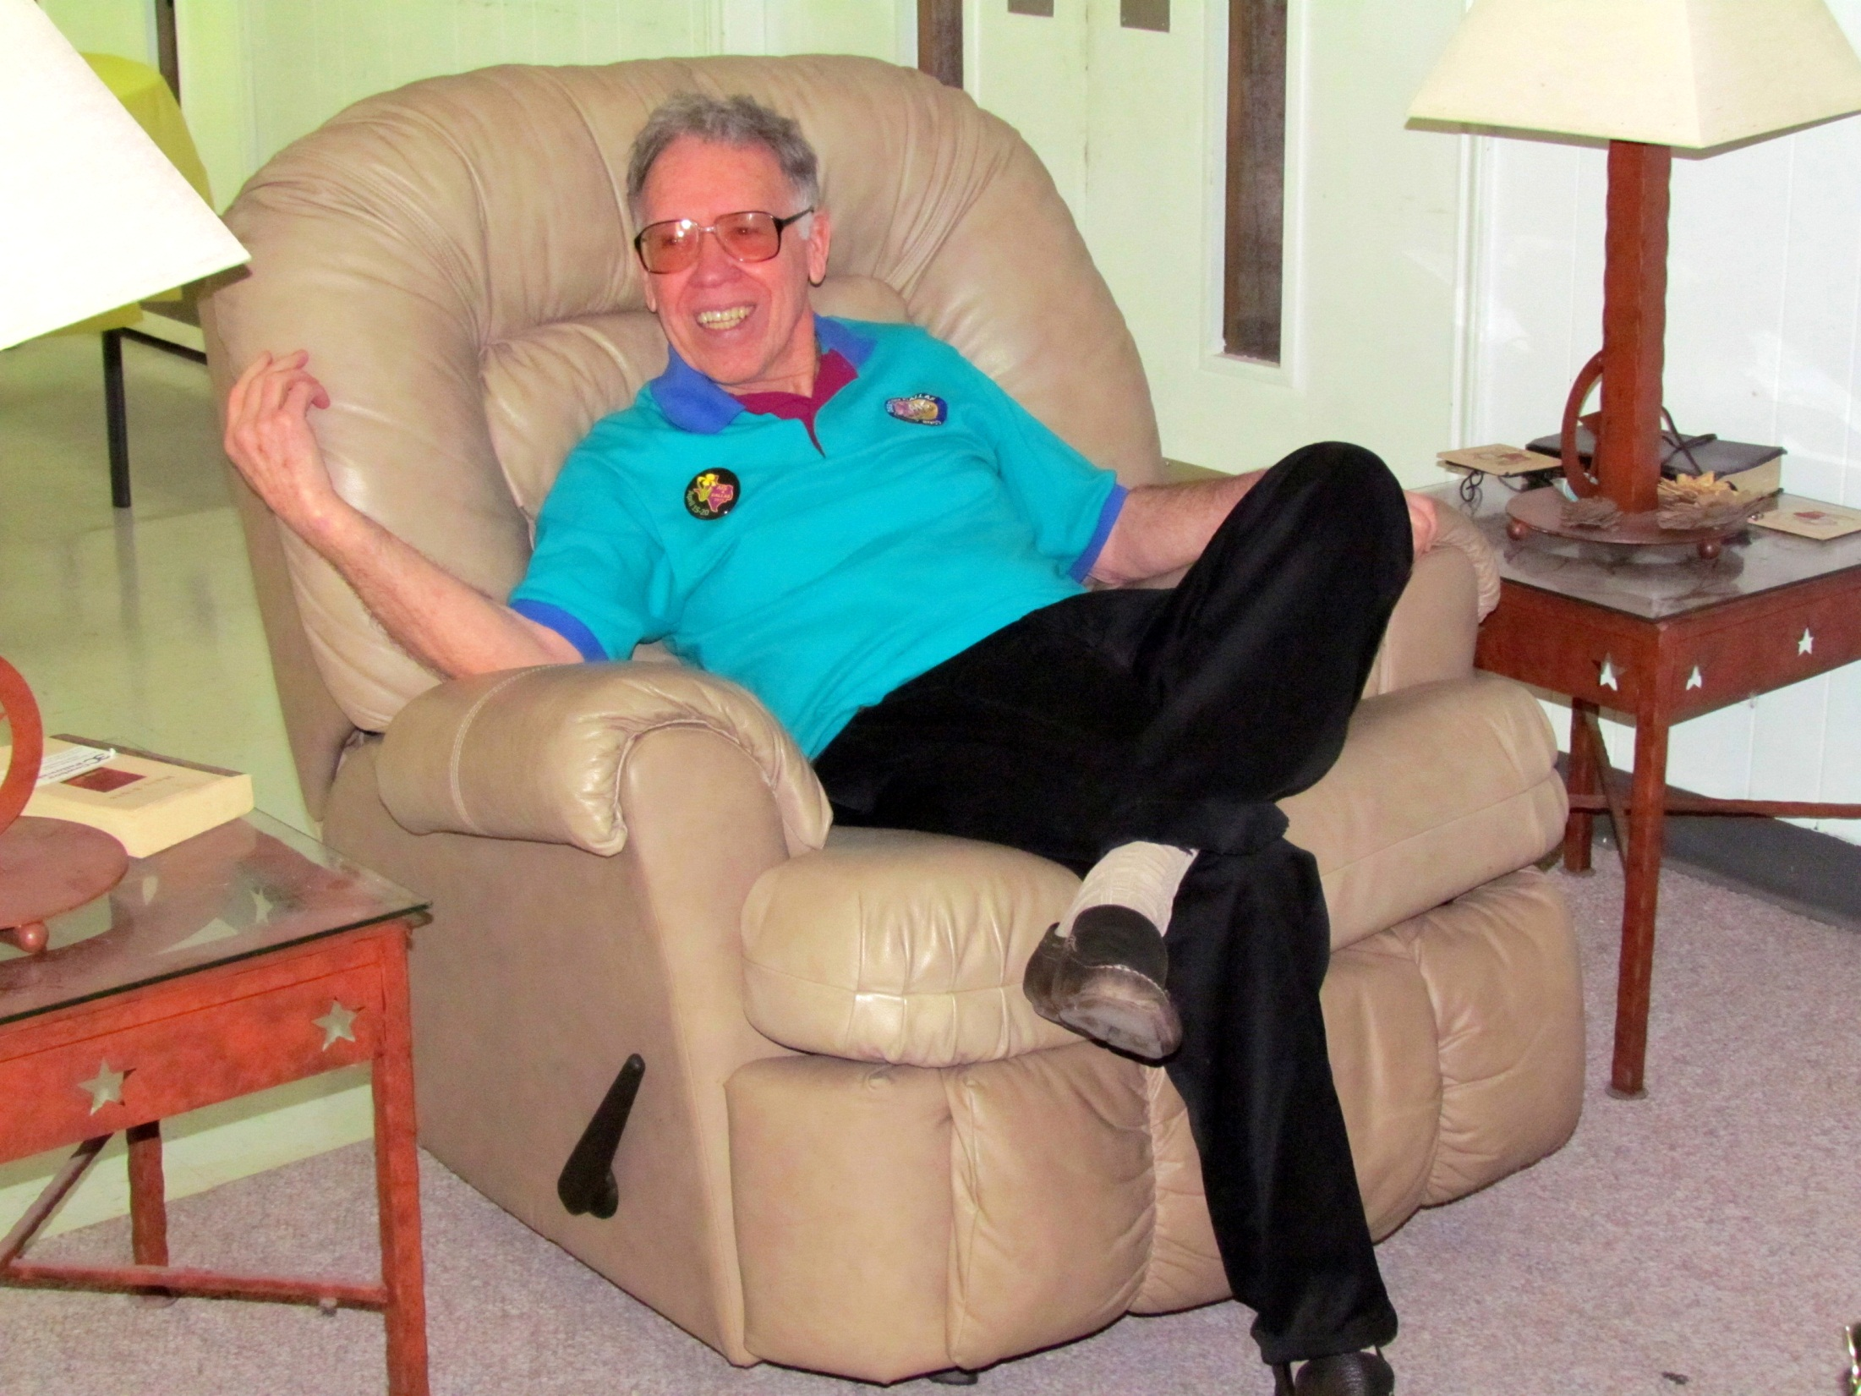
Dr. Lew Begley

Slide 37
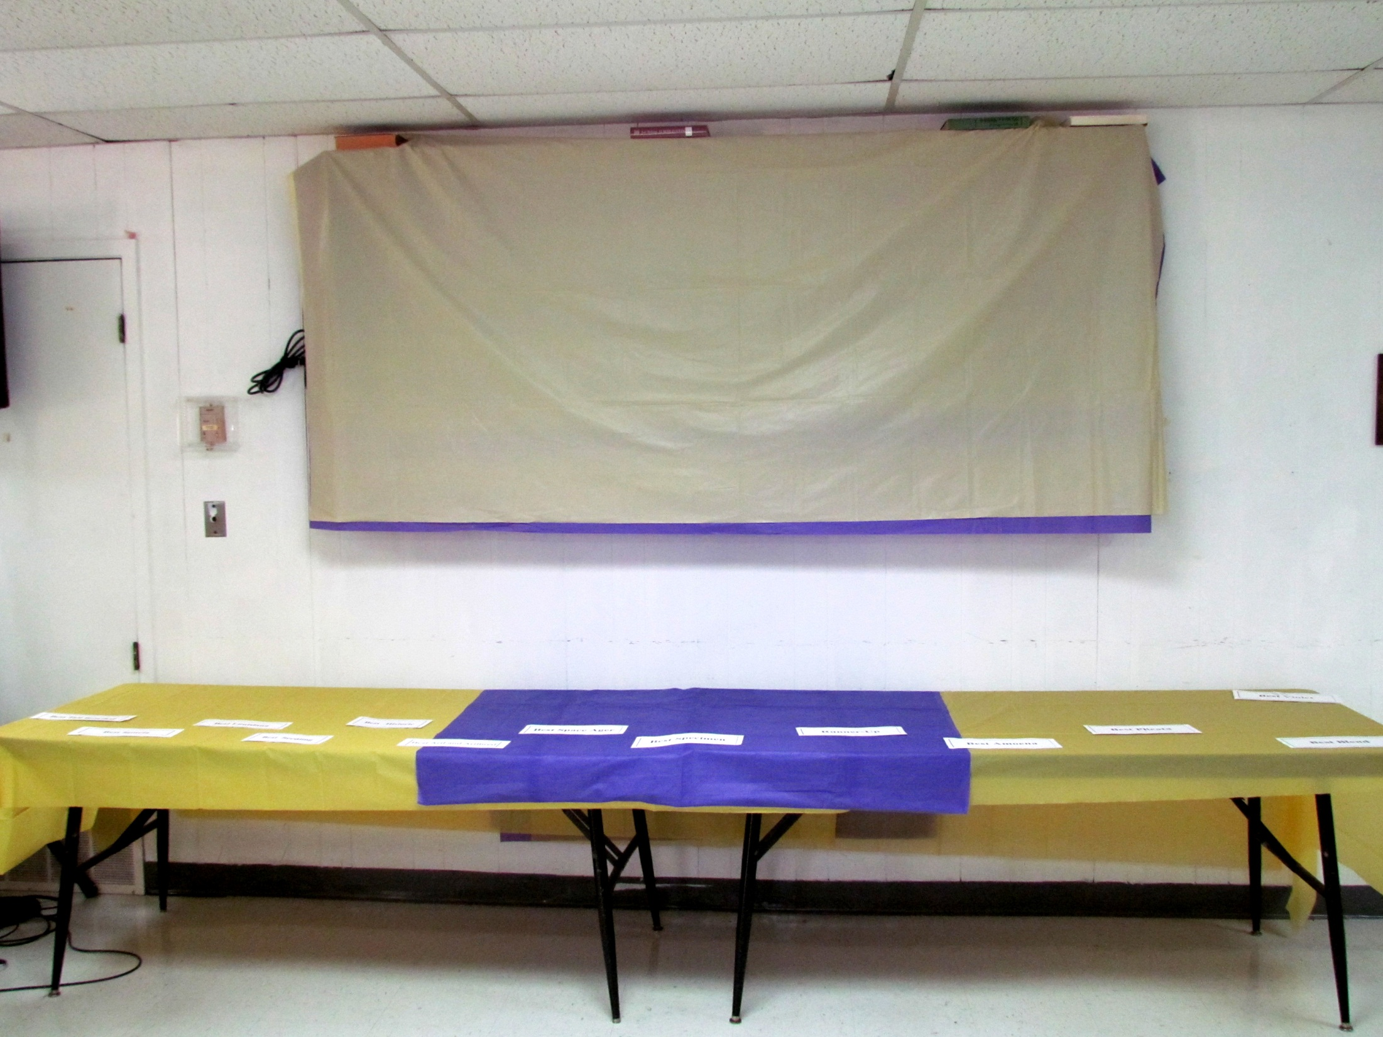
The head table is almost ready. Colored table cloths obscure the huge electronic Bingo board over the table.

Slide 38
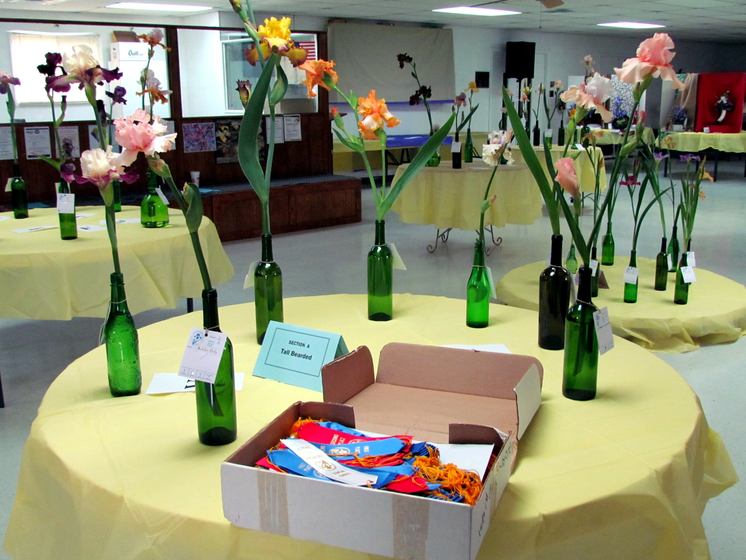
The ribbons await the Judge's decisions.

Slide 39
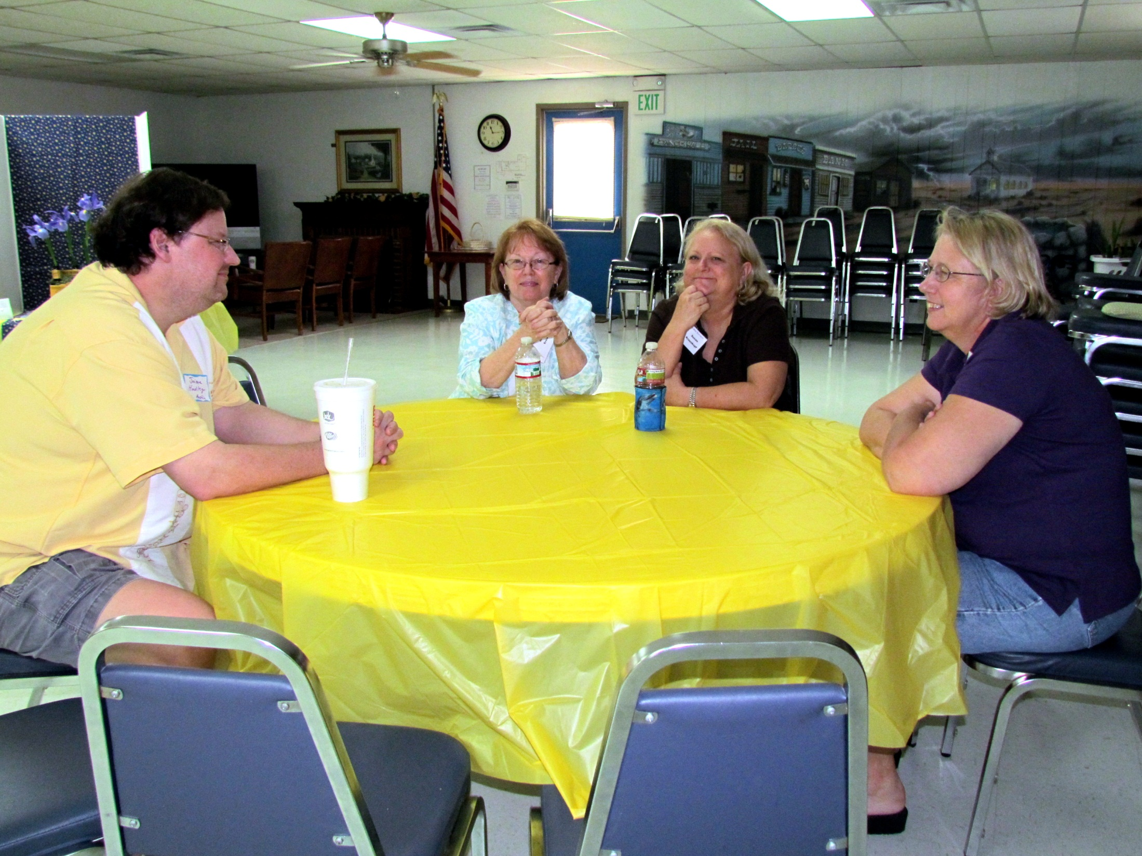
Jaime Hadley, Joan Ervin, Susan Krauskopf, and Nita Culp chat while the judging takes place.

Slide 40
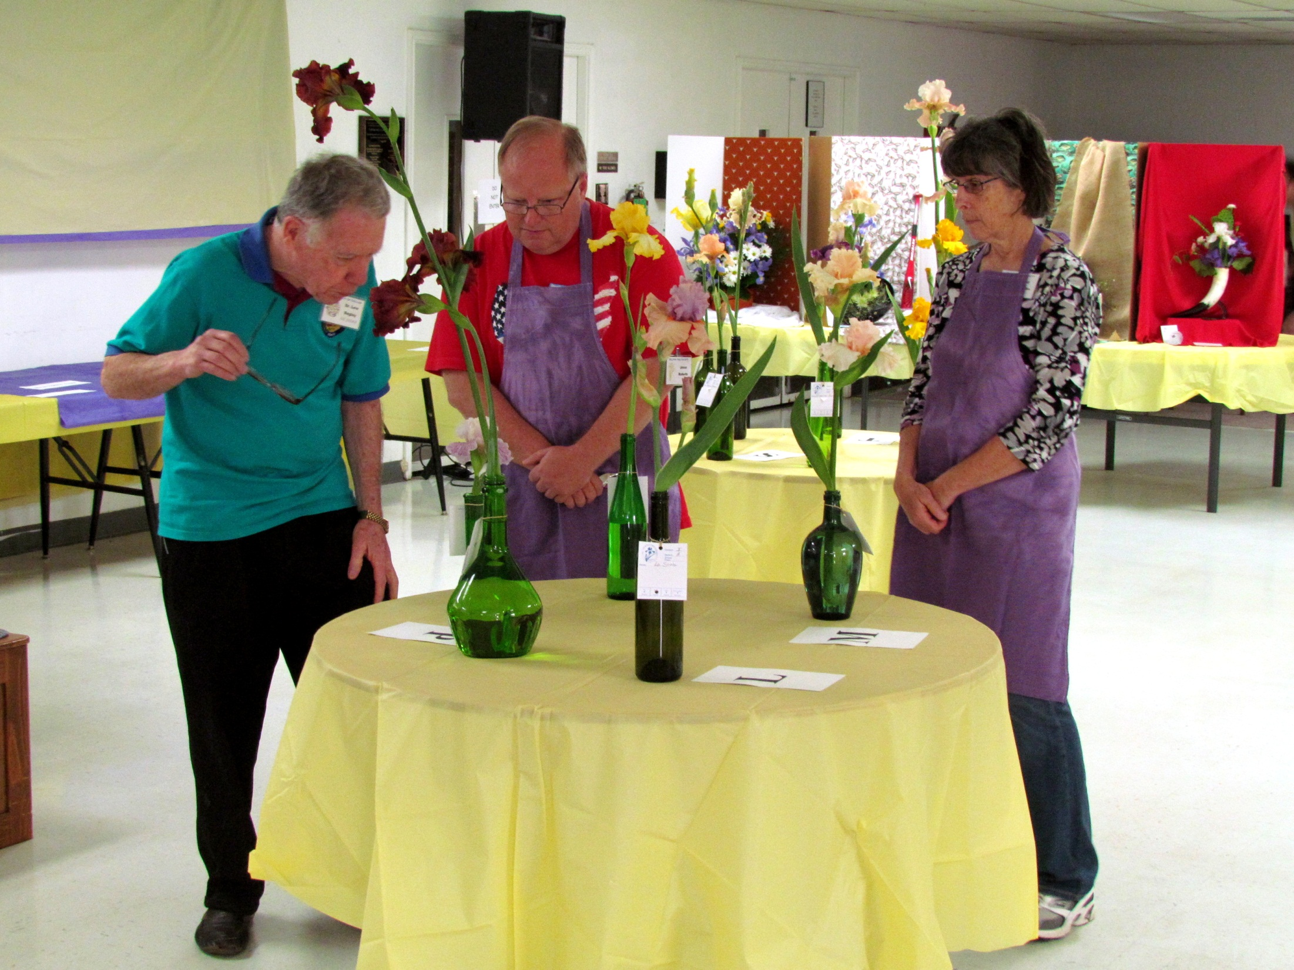
Dr. Begley closely examines an entry as clerks Jesse Roberts and Gail Jacobs look on.

Slide 41
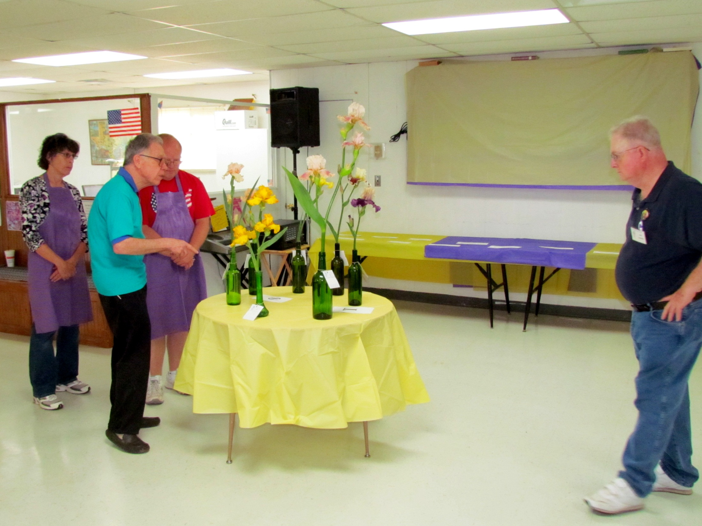

Slide 42
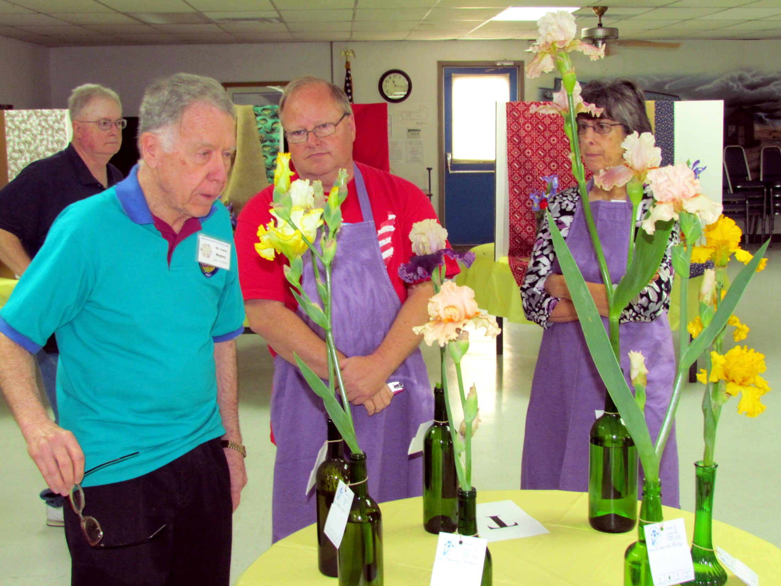

Slide 43
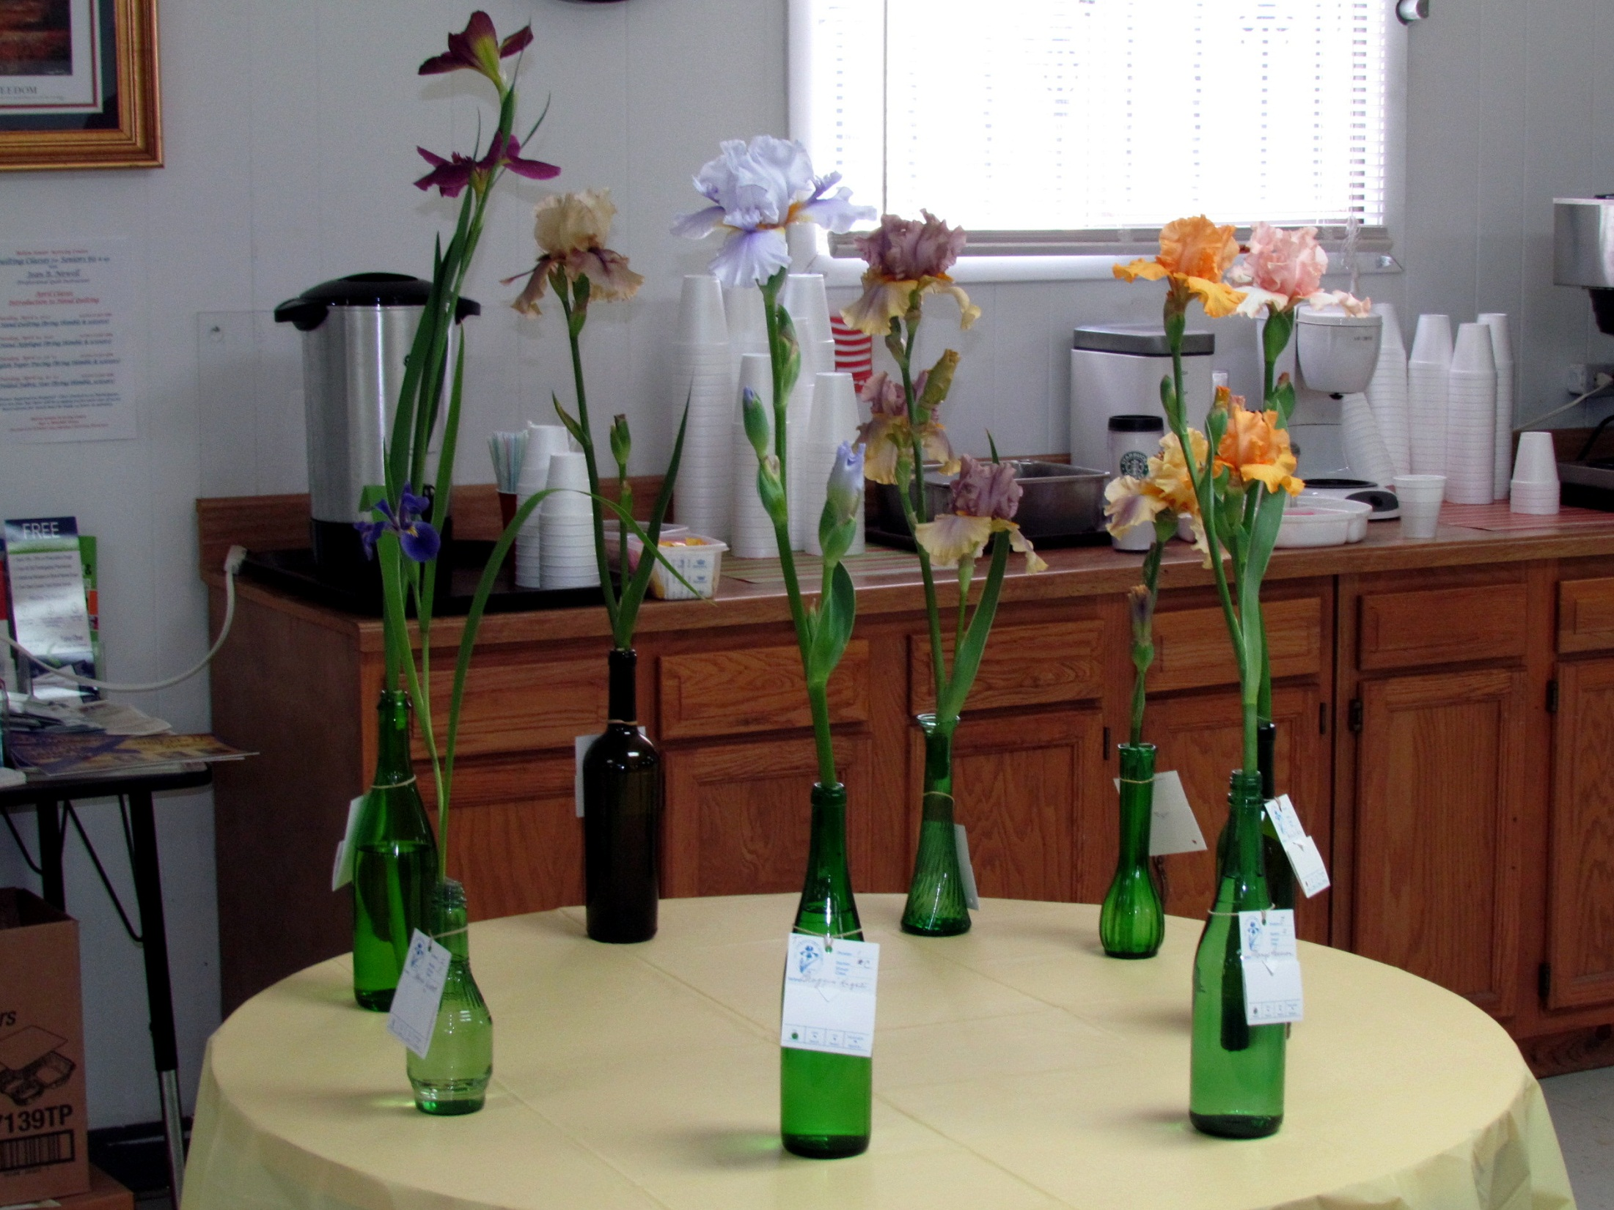
The Table of Consideration

Slide 44
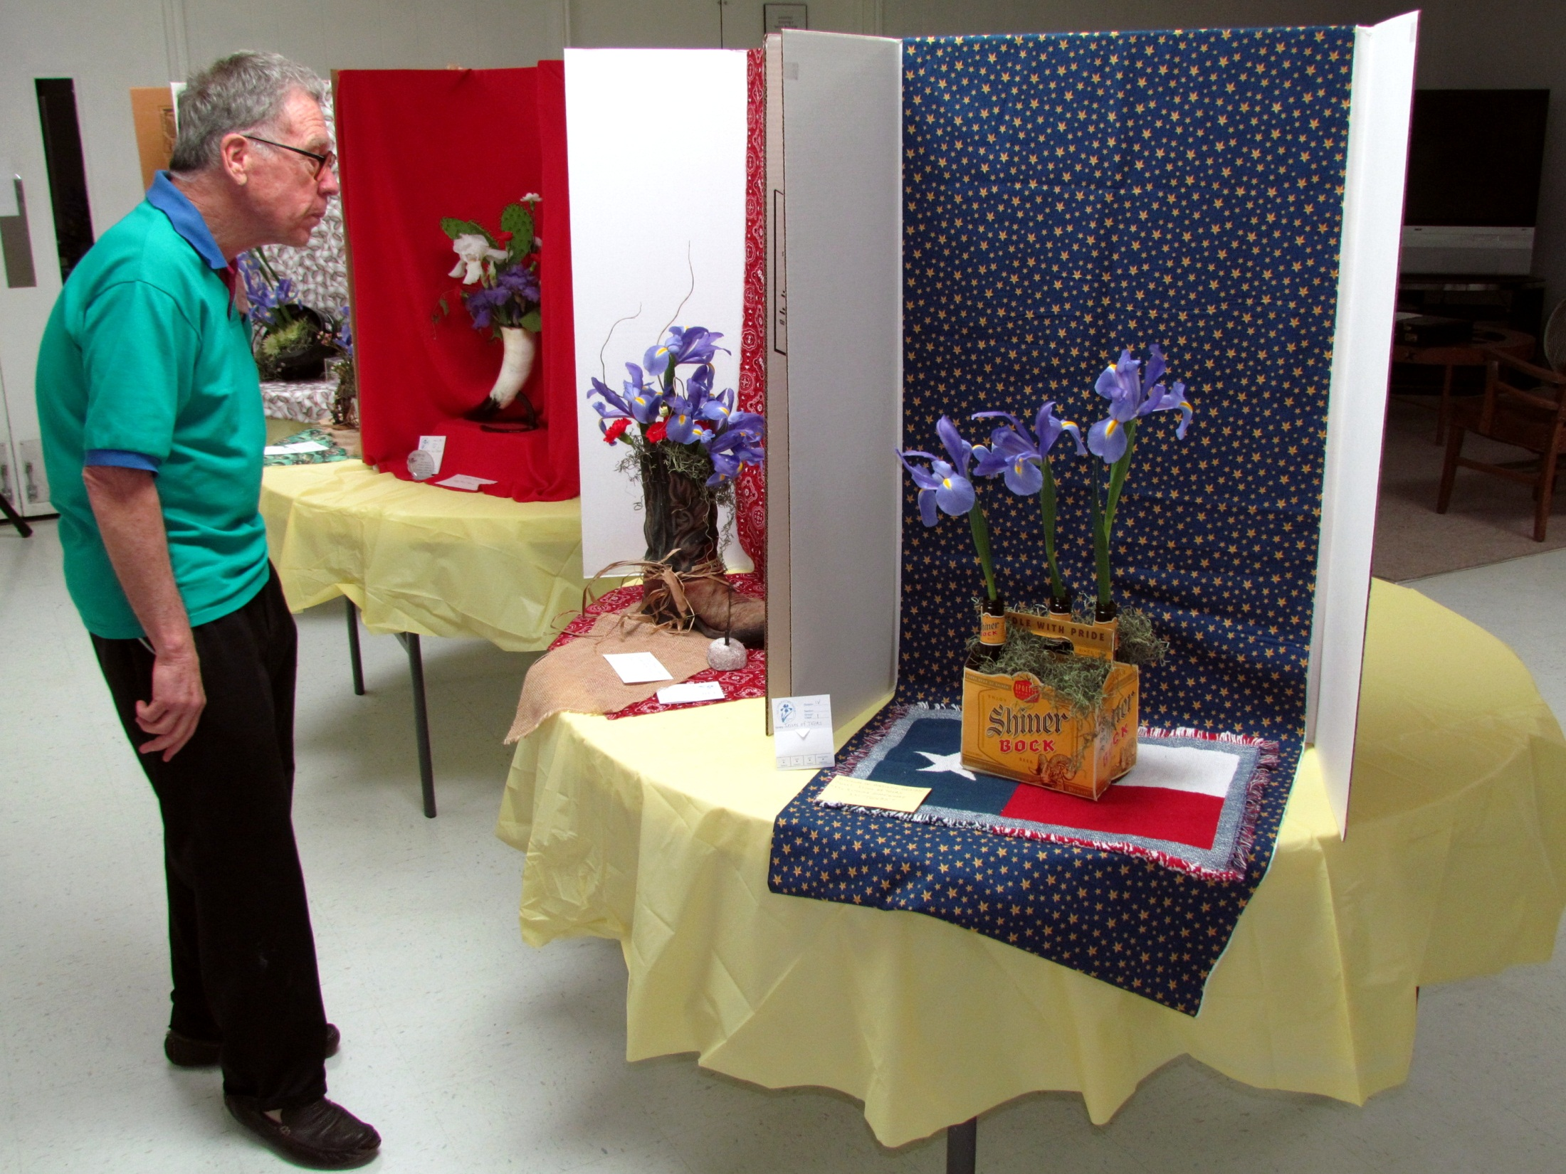
Dr. Begley studies one of the Artistic Designs.

Slide 45
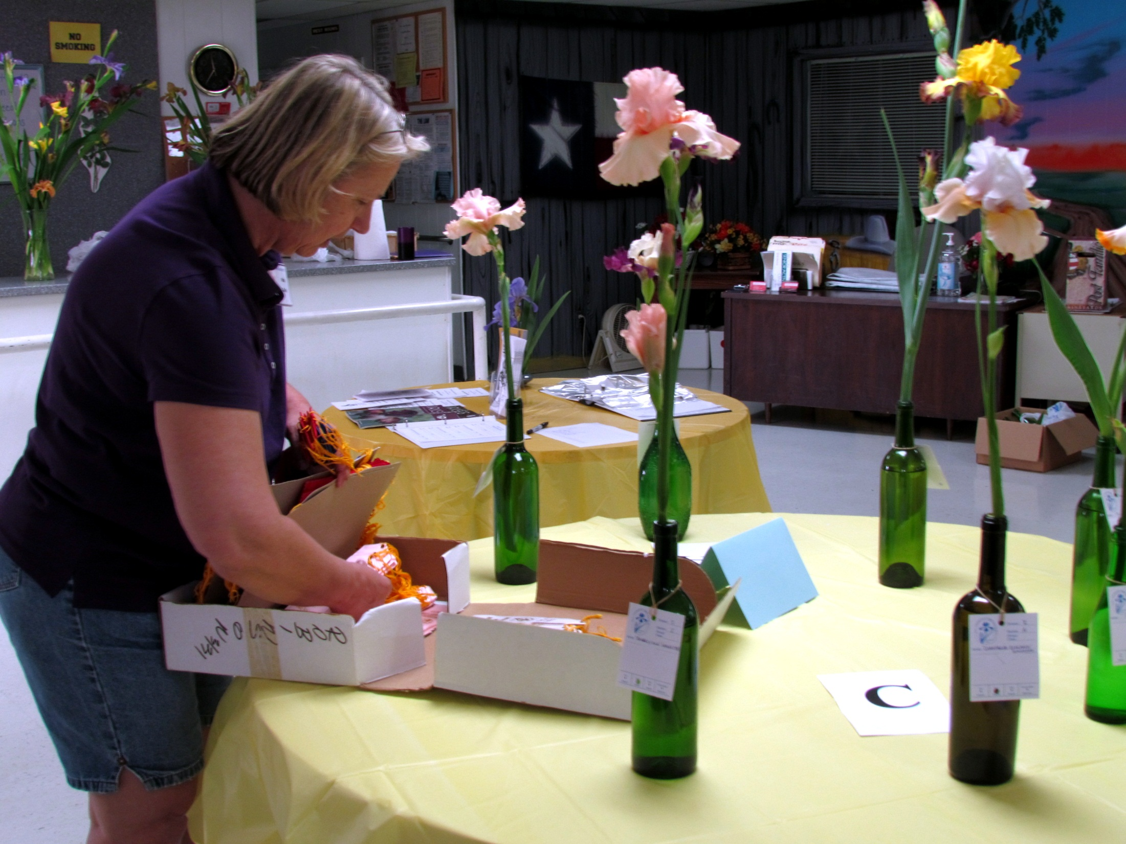
Nita Culp prepares to set out the ribbons.

Slide 46
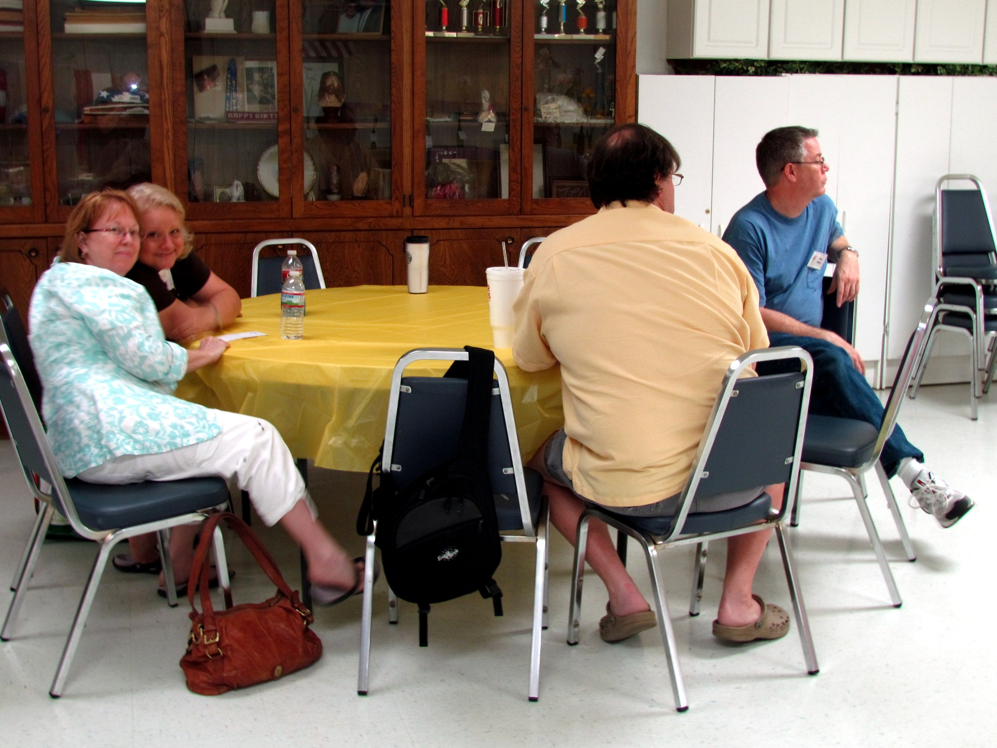

Slide 47
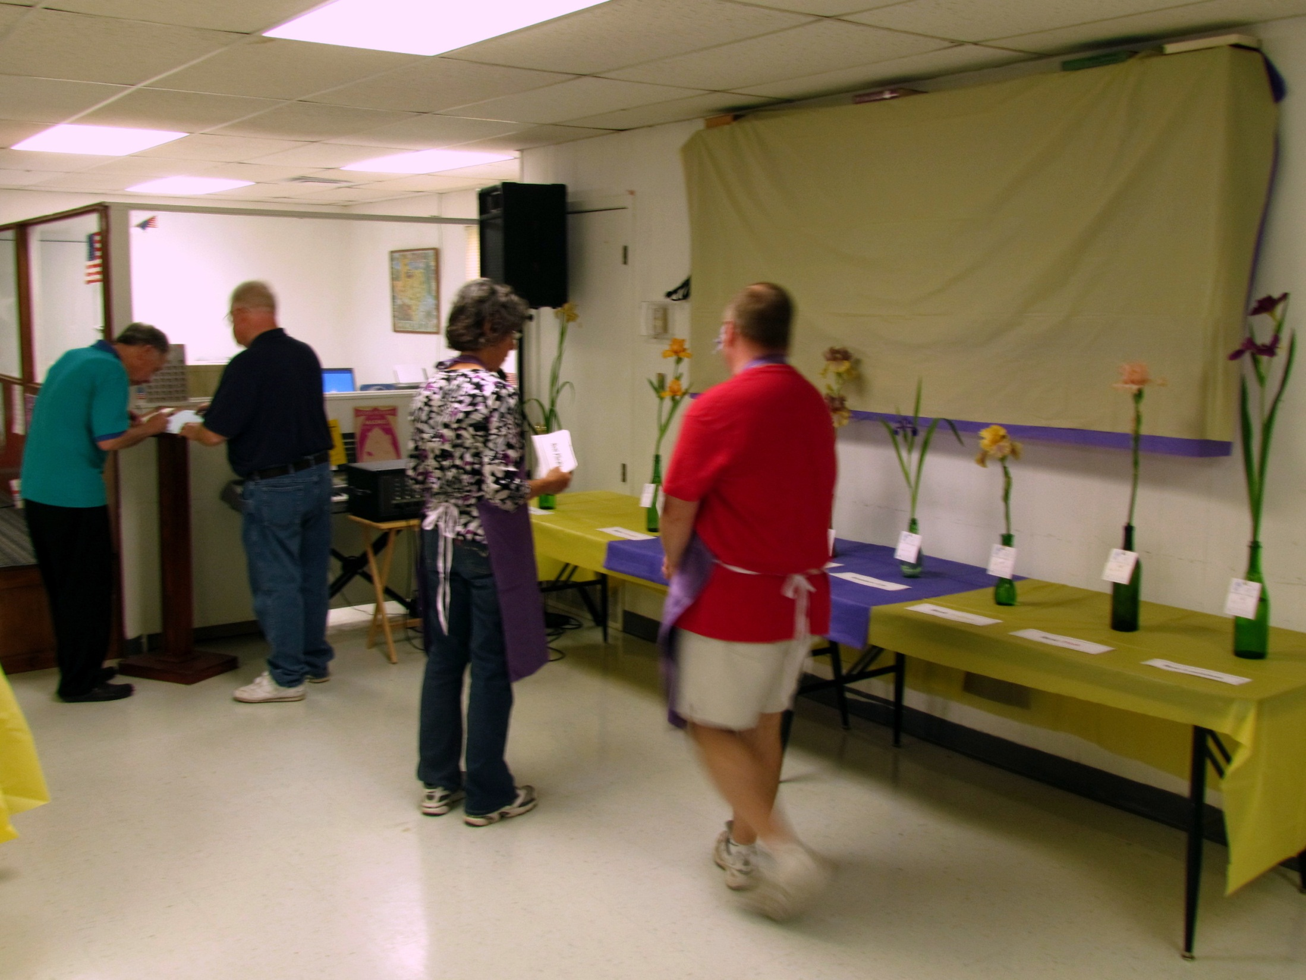

Slide 48
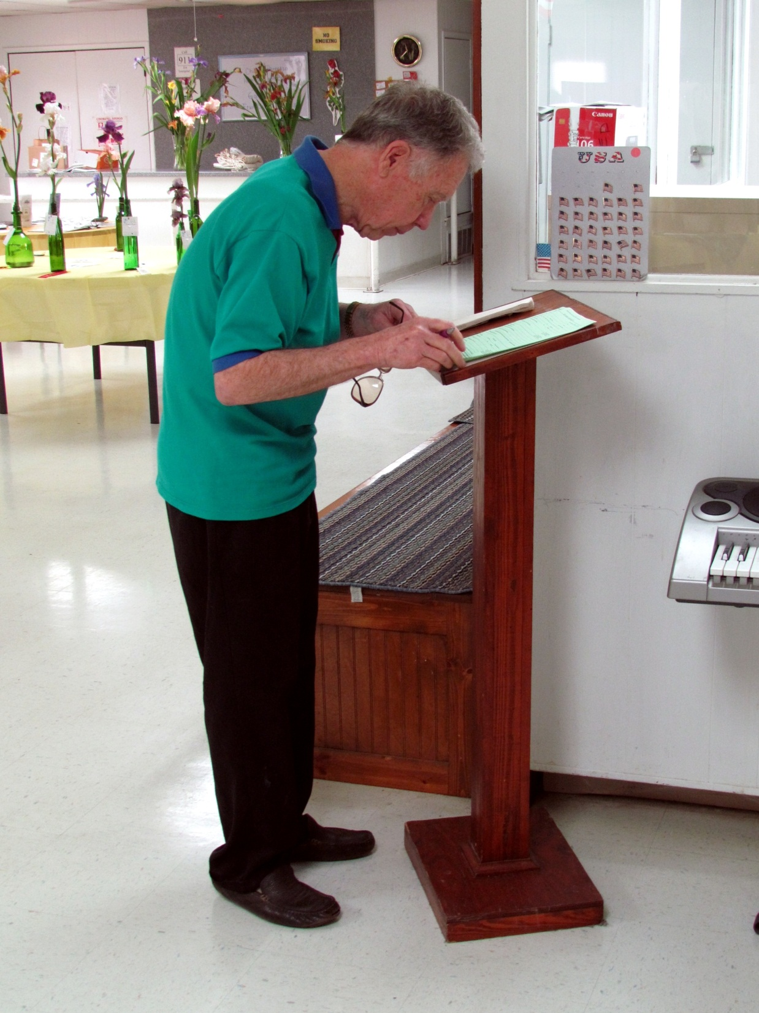
Dr. Begley prepares to sign the Show Report.

Slide 49
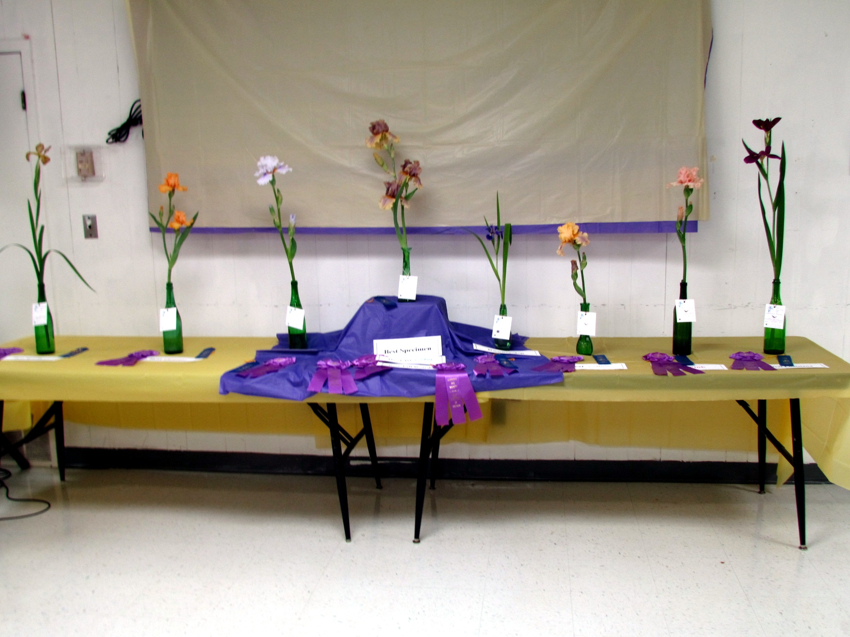
The Head Table

Slide 50
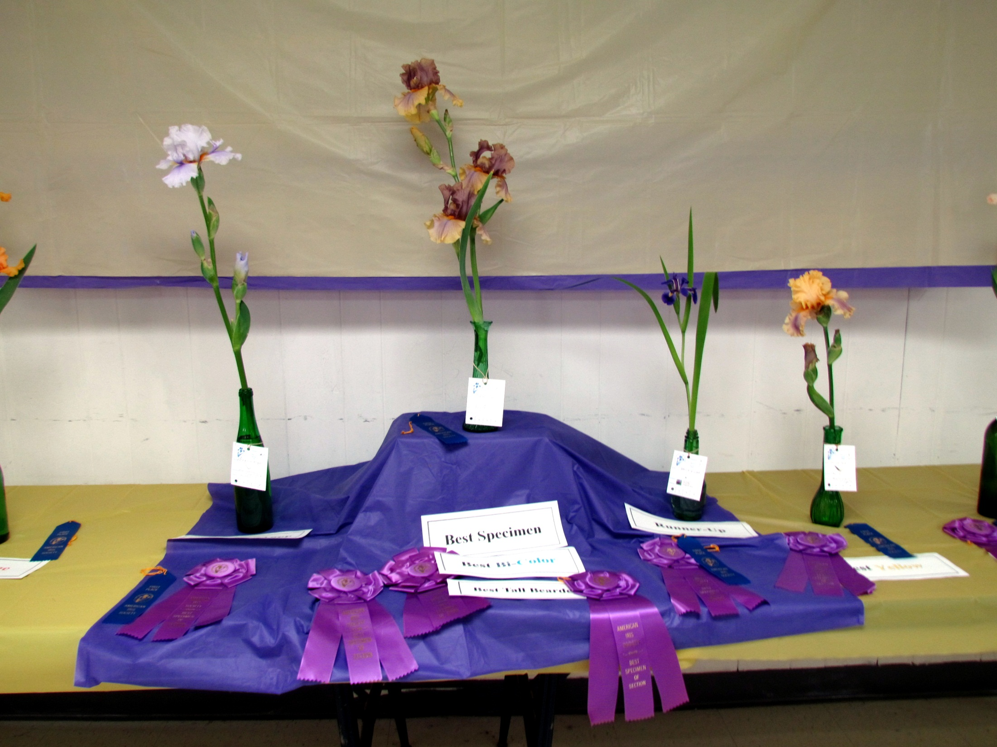

Slide 51
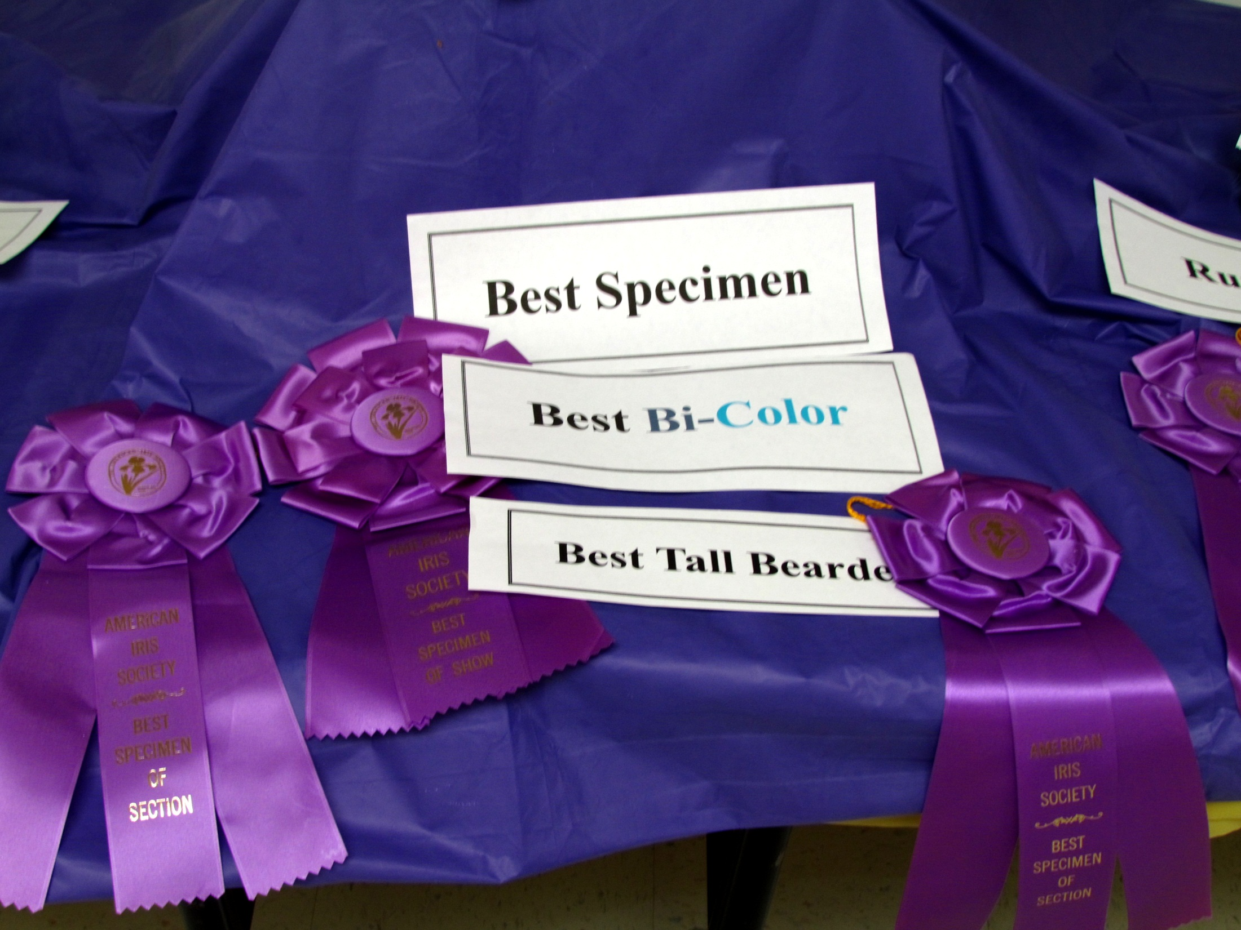

Slide 52
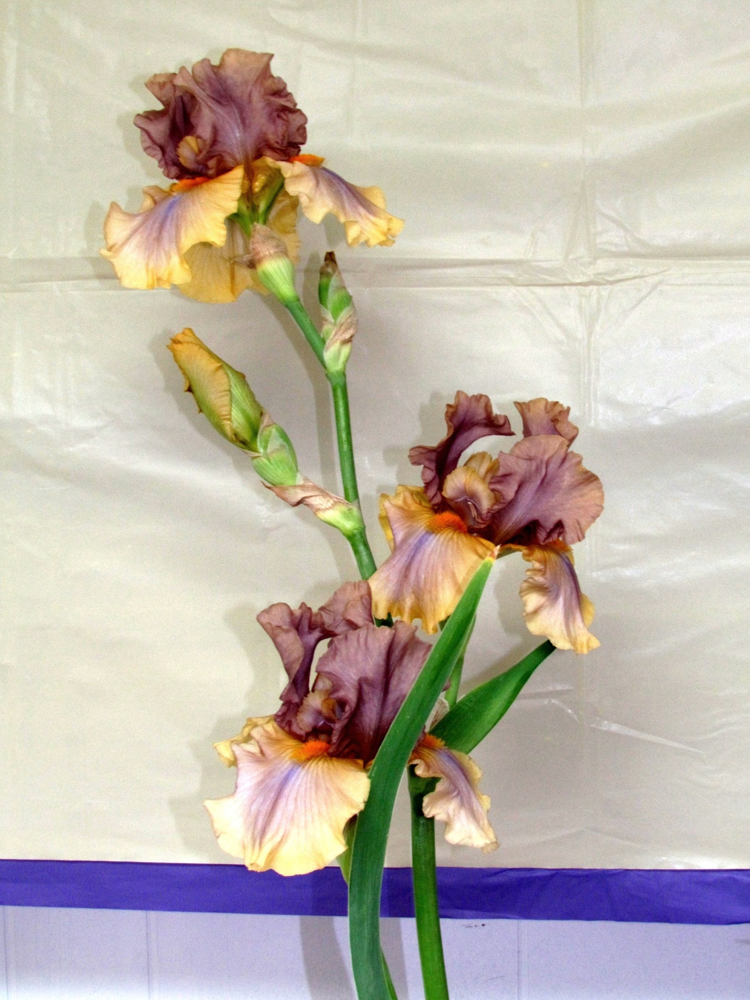
Best Specimen, Best Bi-Color, Best Tall Bearded -- 'Baditude' - Don and Pat Freeman

Slide 53

Runner-Up -- 'Wood Violet', Louisiana -- Jim Landers

Slide 54

Best Spuria -- 'Empathy '-- Don and Pat Freeman

Slide 55

Best Orange -- 'Mango Passion' -- Don and Pat Freeman

Slide 56

Best Space Age Iris -- 'Braggin' Rights' [misidentified; actually 'Ice for Brice‘] -- Don and Pat Freeman

Slide 57

Best Yellow -- 'Chinook Arch' -- Joan Ervin

Slide 58

Best Pink -- 'Bachelor Party -- Gary Whitis

Slide 59

Best Louisiana -- 'Vermilion Treasure' -- Don and Pat Freeman

Slide 60

Jaime Hadley and 'Tomcat'

Slide 61

'Wonders Never Cease' -- Jim Landers

Slide 62

'Reckless in Denim' -- Susan Krauskopf

Slide 63

'Magical' -- Jesse Roberts

Slide 64

'And Kyler Too' -- Jesse Roberts

Slide 65

'And Kyler Too'

Slide 66

'Marie Caillet' -- Jesse Roberts

Slide 67

'Marie Caillet'

Slide 68

Don Freeman watches as Jim Landers attempts to adjust the standards on 'Bayou Tiger.'

Slide 69

'Thornbird' -- Jaime Hadley

Slide 70

Gary Whitis and 'Power Point'

Slide 71

'Power Point'

Slide 72

'Golly Gee Whiz' -- Gary Whitis

Slide 73

'Fiery Temper' -- Dolores Avram

Slide 74

Dr. Begley, Don and Pat Freeman are ready for lunch.

Slide 75

Barbecue lunch from Clem Mikeska's

Slide 76


Slide 77


Slide 78

Best Artistic Design: 'Irises and Sports' -- Karen Woods

Slide 79

'Irises and Sports' - Susan Krauskopf

Slide 80

'Irises and Sports' – Joan Ervin

Slide 81

'Irises of Texas' - Longhorn theme -- Winnie Culp

Slide 82

'Irises of Texas' - Old Boot on the Texas Prairie - Joan Ervin

Slide 83

'Irises of Texas' - It's 5 o'clock Somewhere in Texas -- Susan Krauskopf

Slide 84

Karen Woods and her 'Irises and Sports'

Slide 85

Susan Krauskopf and her 'Irises and Sports'

Slide 86

Joan Ervin and her 'Irises and Sports'

Slide 87

Joan Ervin and her "Irises of Texas' without the background

Slide 88

Susan Krauskopf and her 'Irises of Texas'

Slide 89


Slide 90

'Jungle Shadows', historic BB 1959 - Dolores Avram

Slide 91

'Jungle Shadows', historic BB 1959 - Dolores Avram

Slide 92

'Sun Blaze' -- Don and Pat Freeman

Slide 93


Slide 94

Jim Landers comments on grooming to eager Belton IS members.

Slide 95


Slide 96


Slide 97

The Show is almost over.

Slide 98

Karen Woods disassembles her prize-winning design.

Slide 99
Program created by
Ken Fuchs
May 2012

